Slide 1
Click here to add text
Prof. Dr. Serdar Tekgül
Chairman Examination Committee

Slide 2
Committee Members
 | Last name | First name
1 | Tekgül | Serdar
2 | Bogaert | Guy
3 | Domínguez Escrig | José
4 | Figueiredo (Expert) | Arnaldo
7 | Baumanis | Edgars
8 | Chkhotua | Archil
9 | Correia de Almeida Pinto | Rui
11 | Henningsohn | Lars
12 | Kouriefs | Chrysanthos
13 | Marszalek | Martin
14 | Mattocks | Stephen
15 | Müller | Stig
16 | Özgök | Yaşar
17 | Rauchenwald (Expert) | Michael
18 | Scholtz | Bianca
19 | Skrzypczyk | Michał
20 | Steffens | Joachim
21 | Tomašković | Igor
22 | van Moorselaar | Jeroen
Full members: 22
Associate members: 62
U N I O N E U R O P É E N N E D E S M É D E C I N S S P É C I A L I S T E S ( U . E . M . S . )

Slide 3
1 | Al Jaafari | Feras | United Kingdom
2 | Alnajjar | Hussain M | United Kingdom
3 | Anastasiadis | Anastasios | Greece
4 | Antunes-Lopes | Tiago | Portugal
5 | Aragón Chamizo | Juan | Spain
6 | Aziz | Atiqullah | Germany
7 | Ballestero Diego | Roberto | Spain
8 | Bañuelos Marco | Beatriz | Germany
9 | Belej | Kamil | Czech Rep
10 | Branchereau | Julien | France
11 | Bube | Sarah | Denmark
12 | Busuttil | Gerald | Malta
13 | Cakir | Omer Onur | Turkey
14 | Campos-Juanatey | Felix | Spain
15 | Carballo Quintá | Manuel | Spain
16 | Castiglione | Fabio | United Kingdom
17 | Cocci | Andrea | Italy
18 | Czech | Anna | Poland
19 | D'Andrea | David | Italy
20 | De Naeyer | Gert | Belgium
21 | Dellis | Athanasios | Greece
22 | Diogo Gameiro | Catarina | Portugal
23 | Doornweerd | Benjamin | The Netherlands
24 | El-Husseiny | Tamer | United Kingdom
25 | Elmussareh | Muhammad | United Kingdom
26 | Emiliani | Esteban | Spain
27 | Esperto | Francesco | Italy
28 | Fedorko | Michal | Czech Rep
29 | Ferriero | Maria Consiglia | Italy
30 | Gomez Gomez | Enrique | Spain
31 | Grivas | Nikolaos | Greece
32 | Gronostaj | Katarzyna | Poland
33 | Gul | Murat | Turkey
34 | Hanchanale | Vishwanath | United Kingdom
35 | Heck | Matthias | Germany
36 | Heidegger | Isabel | Austria
37 | Hennessey | Derek | Ireland
38 | Hernández Hernández | David | Spain
39 | Jouret | Victor-Emmanuel | Luxembourg
40 | Kallidonis | Panagiotis | Greece
41 | Karavitakis | Markos | Greece
42 | Keller | Etienne | Switzerland
43 | Kizilay | Fuat | Turkey
44 | Klatte | Tobias | United Kingdom
45 | Korotõtš | Dmitri | Estonia
46 | Mangera | Altaf | United Kingdom
47 | Mangır | Naşide | Turkey
48 | Martens | Frank | The Netherlands
49 | Mehralivand | Sherif | Germany
50 | Moreno Alarcón | Cristóbal | Spain
51 | Ogaya Pinies | Gabriel | Spain
52 | Özkan | Tayyar Alp | Turkey
53 | Pacheco-Figueiredo | Luís | Portugal
54 | Piotrowicz | Sebastian | Poland
55 | Rahnama'i | Mohammad Sajjad | The Netherlands
56 | Randazzo | Marco | Switzerland
57 | Sen | Volkan | Turkey
58 | Sener | Emre | Turkey
59 | Spinoit | Anne-Françoise | Belgium
60 | Świniarski | Piotr | Poland
61 | Van den Bergh | Roderick | The Netherlands
62 | Vila Reyes | Helena | Spain
1 | Al Jaafari | Feras | United Kingdom
2 | Alnajjar | Hussain M | United Kingdom
3 | Anastasiadis | Anastasios | Greece
4 | Antunes-Lopes | Tiago | Portugal
5 | Aragón Chamizo | Juan | Spain
6 | Aziz | Atiqullah | Germany
7 | Ballestero Diego | Roberto | Spain
8 | Bañuelos Marco | Beatriz | Germany
9 | Belej | Kamil | Czech Rep
10 | Branchereau | Julien | France
11 | Bube | Sarah | Denmark
12 | Busuttil | Gerald | Malta
13 | Cakir | Omer Onur | Turkey
14 | Campos-Juanatey | Felix | Spain
15 | Carballo Quintá | Manuel | Spain
16 | Castiglione | Fabio | United Kingdom
17 | Cocci | Andrea | Italy
18 | Czech | Anna | Poland
19 | D'Andrea | David | Italy
20 | De Naeyer | Gert | Belgium
21 | Dellis | Athanasios | Greece
22 | Diogo Gameiro | Catarina | Portugal
23 | Doornweerd | Benjamin | The Netherlands
24 | El-Husseiny | Tamer | United Kingdom
25 | Elmussareh | Muhammad | United Kingdom
26 | Emiliani | Esteban | Spain
27 | Esperto | Francesco | Italy
28 | Fedorko | Michal | Czech Rep
29 | Ferriero | Maria Consiglia | Italy
30 | Gomez Gomez | Enrique | Spain
31 | Grivas | Nikolaos | Greece
32 | Gronostaj | Katarzyna | Poland
33 | Gul | Murat | Turkey
34 | Hanchanale | Vishwanath | United Kingdom
35 | Heck | Matthias | Germany
36 | Heidegger | Isabel | Austria
37 | Hennessey | Derek | Ireland
38 | Hernández Hernández | David | Spain
39 | Jouret | Victor-Emmanuel | Luxembourg
40 | Kallidonis | Panagiotis | Greece
41 | Karavitakis | Markos | Greece
42 | Keller | Etienne | Switzerland
43 | Kizilay | Fuat | Turkey
44 | Klatte | Tobias | United Kingdom
45 | Korotõtš | Dmitri | Estonia
46 | Mangera | Altaf | United Kingdom
47 | Mangır | Naşide | Turkey
48 | Martens | Frank | The Netherlands
49 | Mehralivand | Sherif | Germany
50 | Moreno Alarcón | Cristóbal | Spain
51 | Ogaya Pinies | Gabriel | Spain
52 | Özkan | Tayyar Alp | Turkey
53 | Pacheco-Figueiredo | Luís | Portugal
54 | Piotrowicz | Sebastian | Poland
55 | Rahnama'i | Mohammad Sajjad | The Netherlands
56 | Randazzo | Marco | Switzerland
57 | Sen | Volkan | Turkey
58 | Sener | Emre | Turkey
59 | Spinoit | Anne-Françoise | Belgium
60 | Świniarski | Piotr | Poland
61 | Van den Bergh | Roderick | The Netherlands
62 | Vila Reyes | Helena | Spain

Slide 4
Associate members
24 from 2020 38 from 2021
Great contribution !! ☺
More than 700 mcq’s
Nearly 40 cases for oral exam

Slide 5
EXAMINATION COMMITTEE
85 members:
22 delegates
62 Associate Members
Associate Members are young FEBUs
Associate Members write content which is reviewed/edited by the committee
Special contributors are to be part of exam committee

Slide 6
DEVELOPMENTS
Recruiting younger work force
Developing an efficient and objective exams that is ready for the next generation. / continuous process
Substantial changes on the oral exam after Online exam in 2021.
Revisiting our structure and mode of operation for the written exam and ISA. Upgrading our technical infrastructure.
Liaising with international societies to use our exams- International Certification / Interest from Middle East and India

Slide 7
IN-SERVICE ASSESSMENT
100 single correct answer MCQ on the entire range of urological topics
Not a necessarily preparation exam; an interim assessment during training which helps
Candidate to compare and learn
Programme Director to monitor progress
Available for 5 days (Monday to Friday)
Since 2021 offered as a Learning Tool
Candidate is given access to the MCQs with detailed validation comments for educational purposes

Slide 8
IN-SERVICE ASSESSMENT. 2023
In-Service Assessment 2023 | Candidates
Austria | 37
Belgium | 33
Croatia | 3
Czechia | 35
Denmark | 36
Estonia | 1
France | 1
Germany | 52
Greece | 34
Italy | 16
Lithuania | 14
Malta | 4
Netherlands | 21
Norway | 21
Poland | 79
Portugal | 15
Slovenia | 2
Spain | 98
Sweden | 20
Switzerland | 81
Turkey | 32
United Kingdom | 21
Indonesia | 9
Lebanon | 35
Malysia | 44
Pakistan | 8
Singapore | 16
Thailand | 10
ROW | 11
TOTAL | 789
Scoring
Average score | 64,7
Low score | 22
High scoree | 90
Candidates | 789
Residents | 720
Urologist | 69
From EBU certified centres | 206
Scoring
Average score | 64,7
Low score | 22
High scoree | 90
Candidates | 789
Residents | 720
Urologist | 69
From EBU certified centres | 206

Slide 9
WRITTEN EXAM
100 single correct answer MCQ on the entire range of urological topics
English, German, Hungarian, Polish & Turkish
Organised with Pearson VUE, either taken
At a secured test centre
Online
Only who scores above the passing score will be able to take the oral exam

Slide 10
506

Slide 11
FEBU Written Exam 2022 | Delivery | Candidates | Pass | Fail | %
Europe | Test Centre + OnVUE | 303 | 266 | 37 | 87,8
Austria | Test Centre | 34 | 29 | 5 | 85,3
Egypt | Test Centre + OnVUE | 24 | 12 | 12 | 50,0
Hungary | Test Centre | 13 | 12 | 1 | 92,3
Poland | Paper exam | 63 | 51 | 12 | 81,0
Switzerland | Test Centre | 37 | 36 | 1 | 97,3
Turkey | Test Centre + OnVUE | 32 | 31 | 1 | 96,9
TOTAL |  | 506 | 406 | 68
Scoring
AVG score | 68,23
Standard Deviation | 8,79
Passmark | 61
Pearson VUE delivery mode | 451
Test Centres | 298
OnVUE | 153

Slide 12
Chair: Tekgul.
Oral TF Tekgul / Doornweerd; De Naeyer
WE TF Muller / Hennessey, Diogo
ISA TF Tomaskovic/ Hennessey, Diogo

Slide 13
Strategic planning
Increasing efficiency
Higher in quality in content and procedures
Structure
Technical upgrade
Scientific update

Slide 14
MCQ writing
EC members
Initial screening
WE/ISA chairs/
Evaluation of the content / approval
EC task forces
Associates
EBU office
Strict criteria will be followed
Adherence to MCQ w. guidelines
Validation comment
Reference standards
Online instructions
Online
Meeting
Selection
Chairs
translation
Polish / Austrian /Swiss Hungarian/Turkish delegates

Slide 15
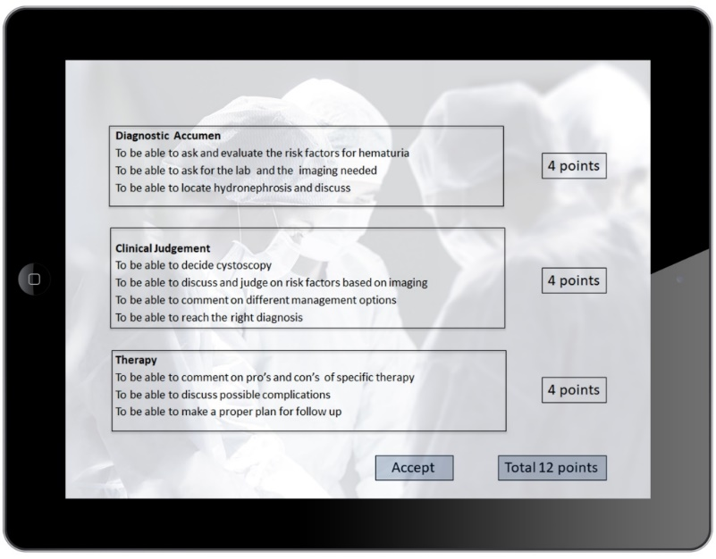
FEBU ORAL EXAM
Offering a standardized exam enhances the reliability and objectivity
Each candidate scored by 2 reviewers independently
Candidate with a marginal score is subjected to a third review

Slide 17
FO-22 | 333 | Pass rate
WARSAW (main) | 216 | 88.5%
HUNGARY | 10 | 100 %
POLAND | 59 | 98%
TURKEY | 48 | 88%

Slide 18
FO 23
Date: Saturday 3 June 2023
Venues: - European exam: Leuven
- Hungarian exam: Budapest
- Turkish exam: Istanbul
Polish exam: Warsaw
Format: Taken onsite via the internet
One examiner ( more active)

Slide 19
Format
Cases are presented and questions are asked by the computer .. prerecorded
4 long cases ( 15 min ea) ..
Answers are recorded by the system for a 2nd or 3rd review !
One examiner conducting the whole exam

Slide 20
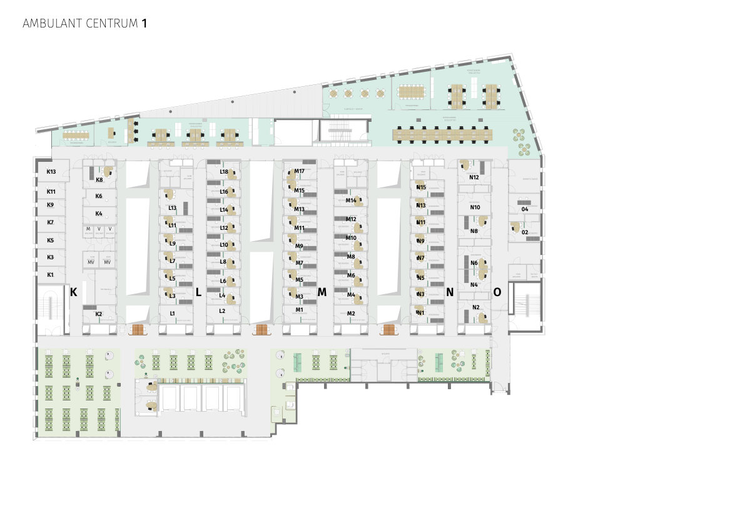
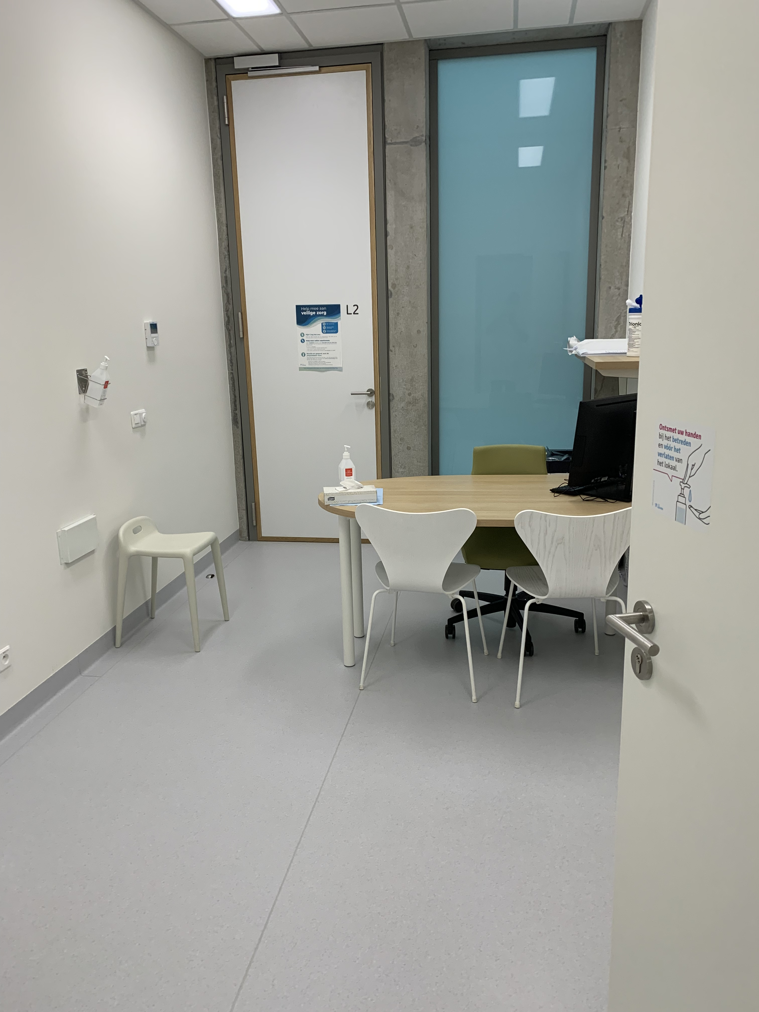
42 - 45
14
14
14
Every exam room = IN + OUT door

Slide 21
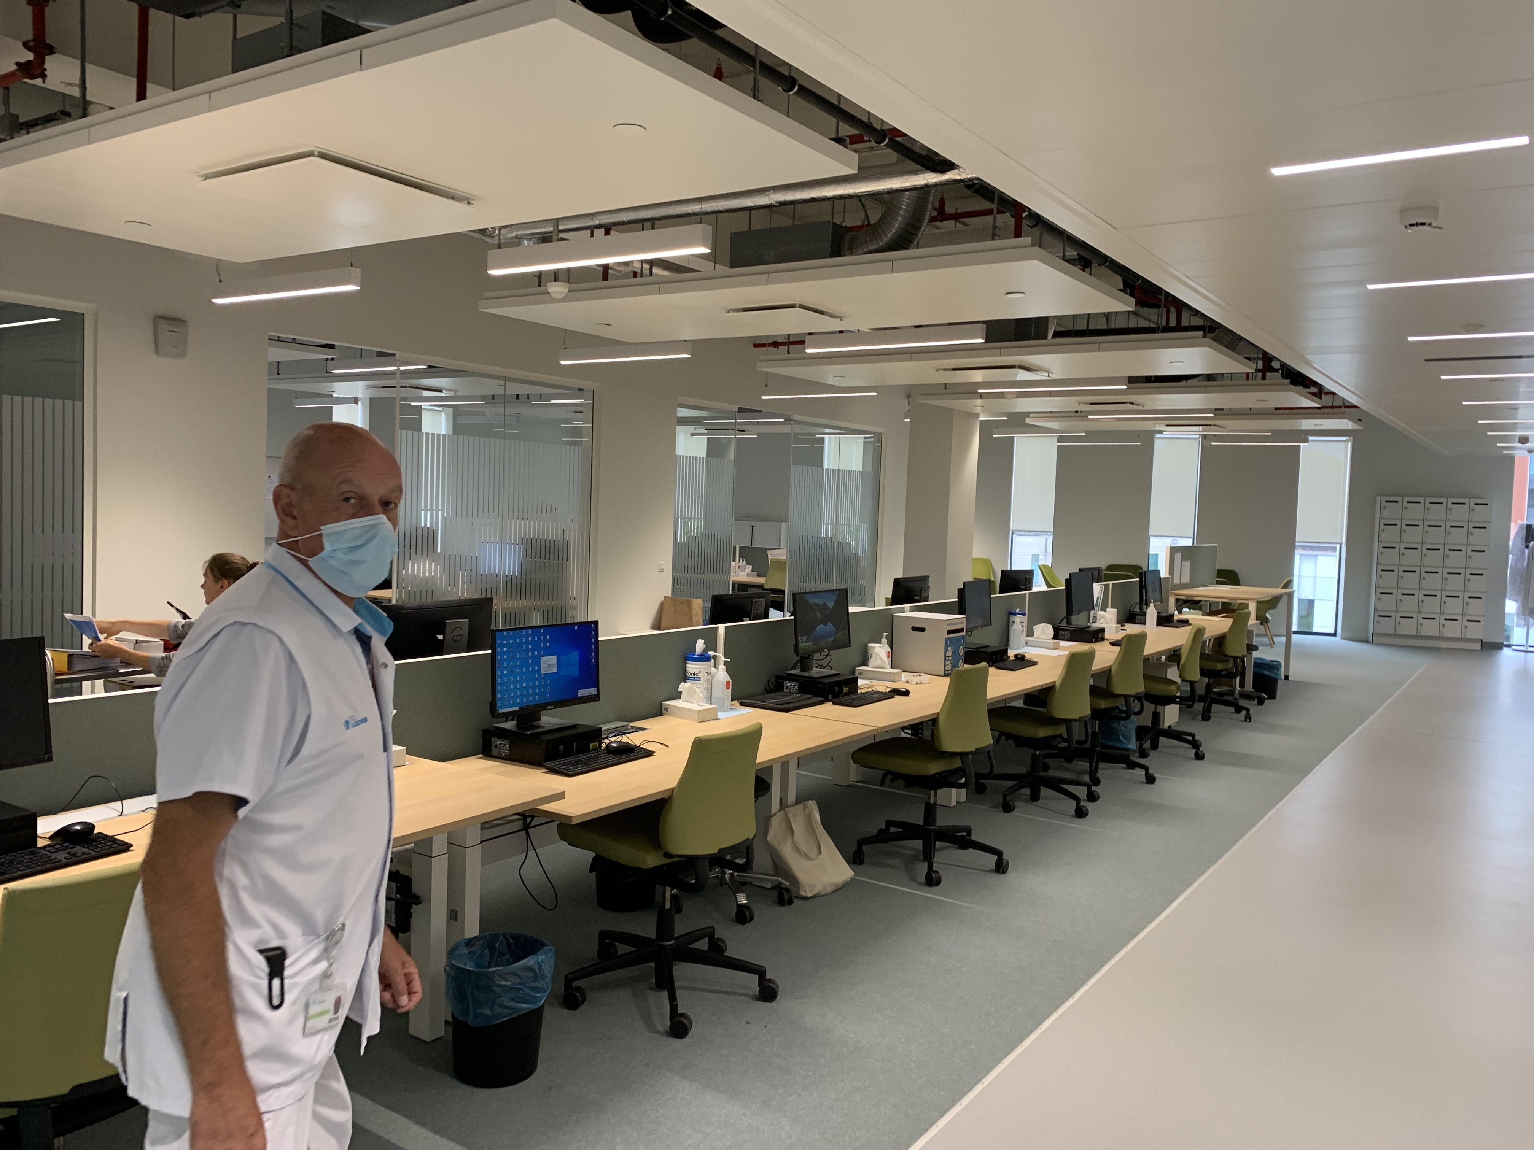
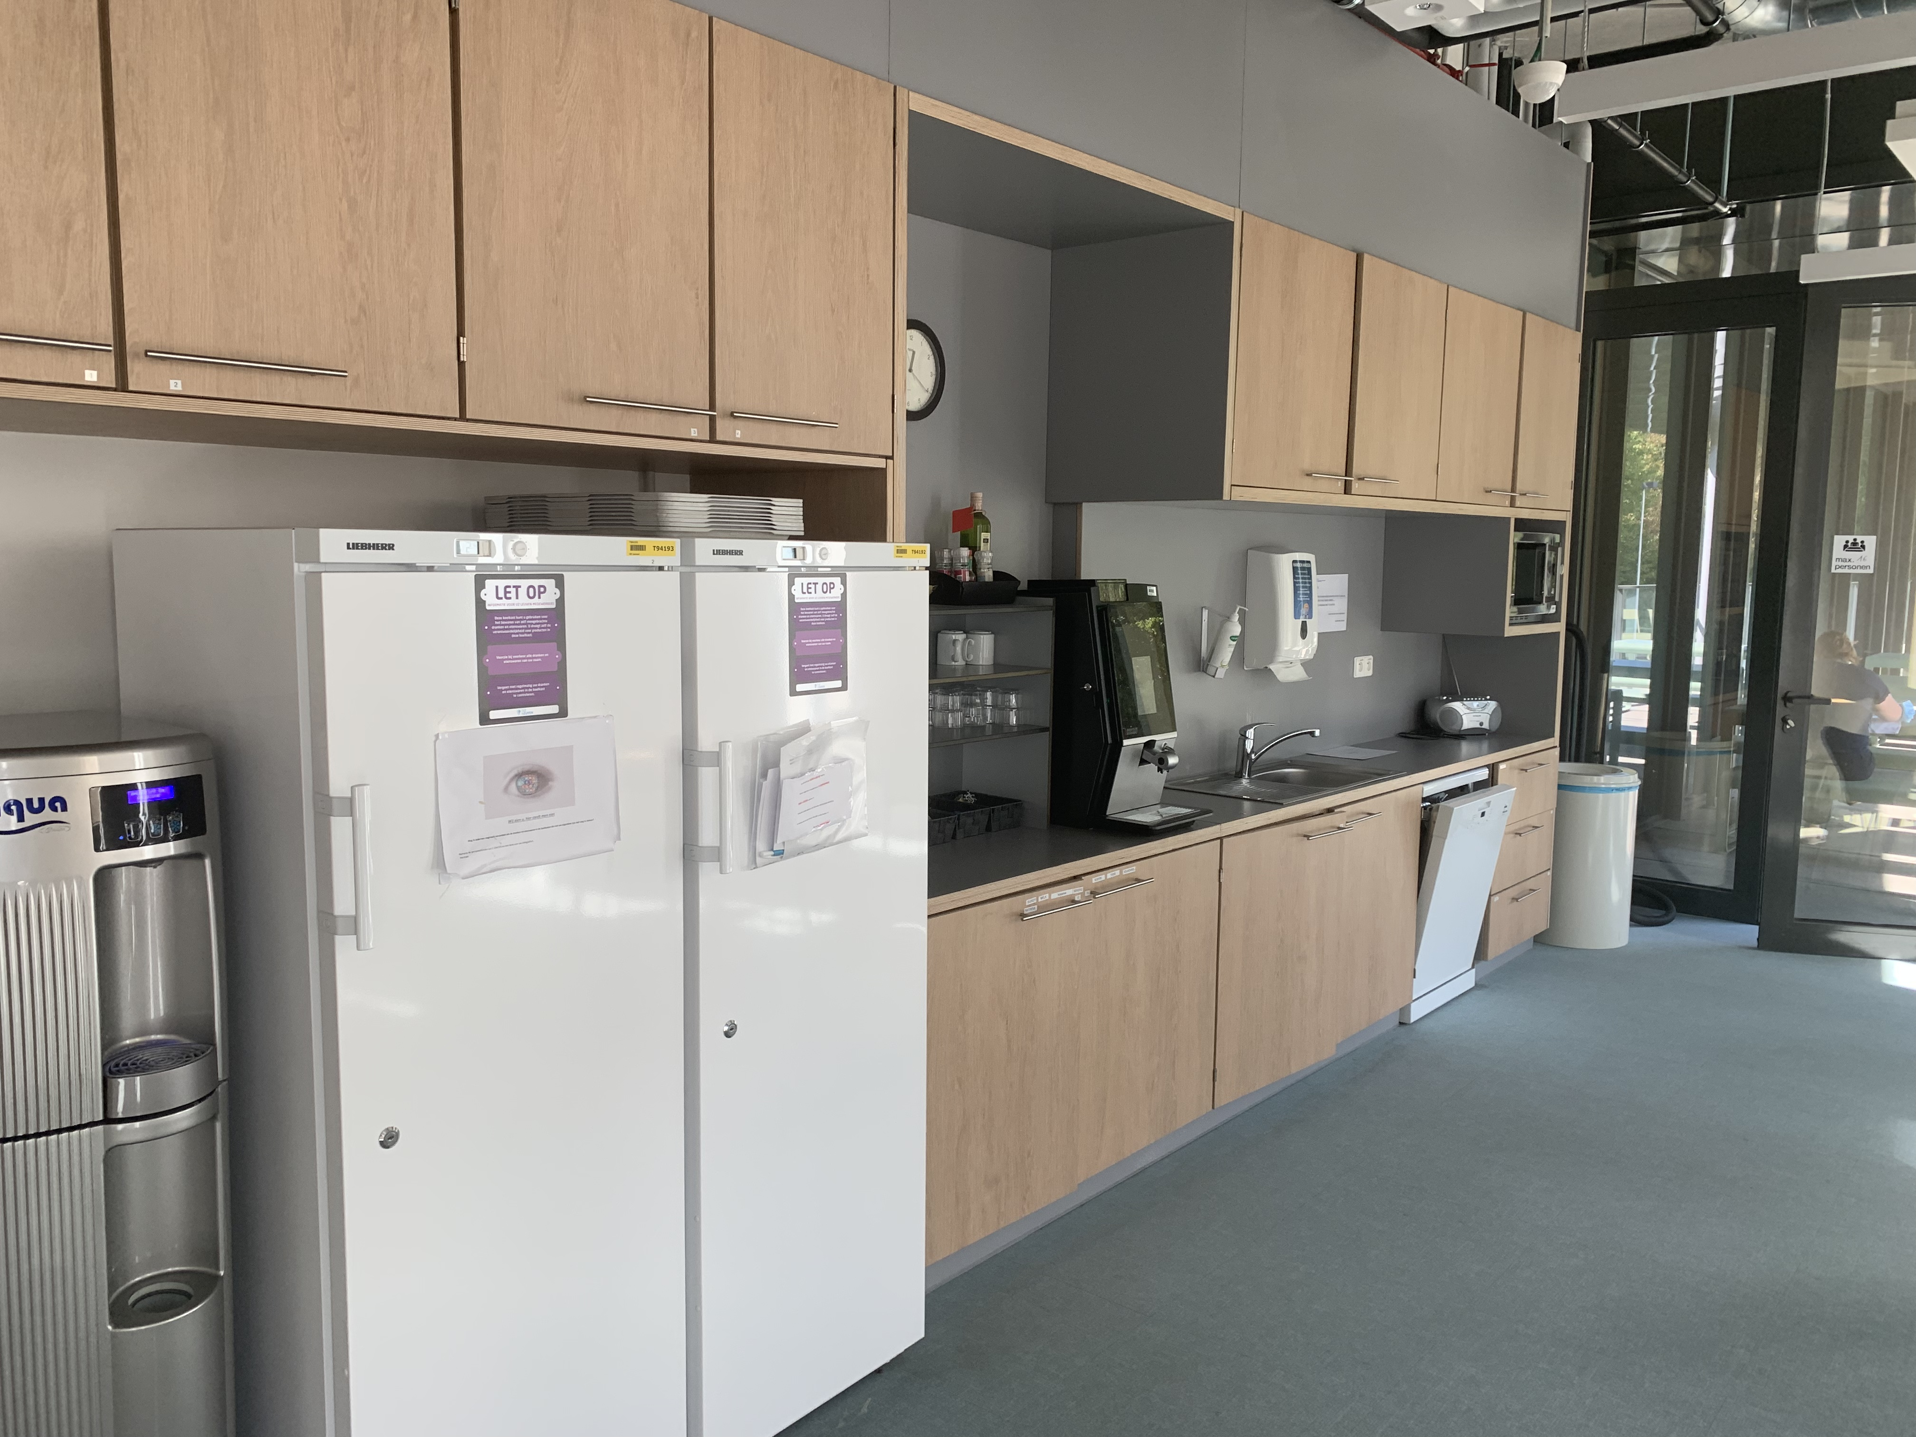
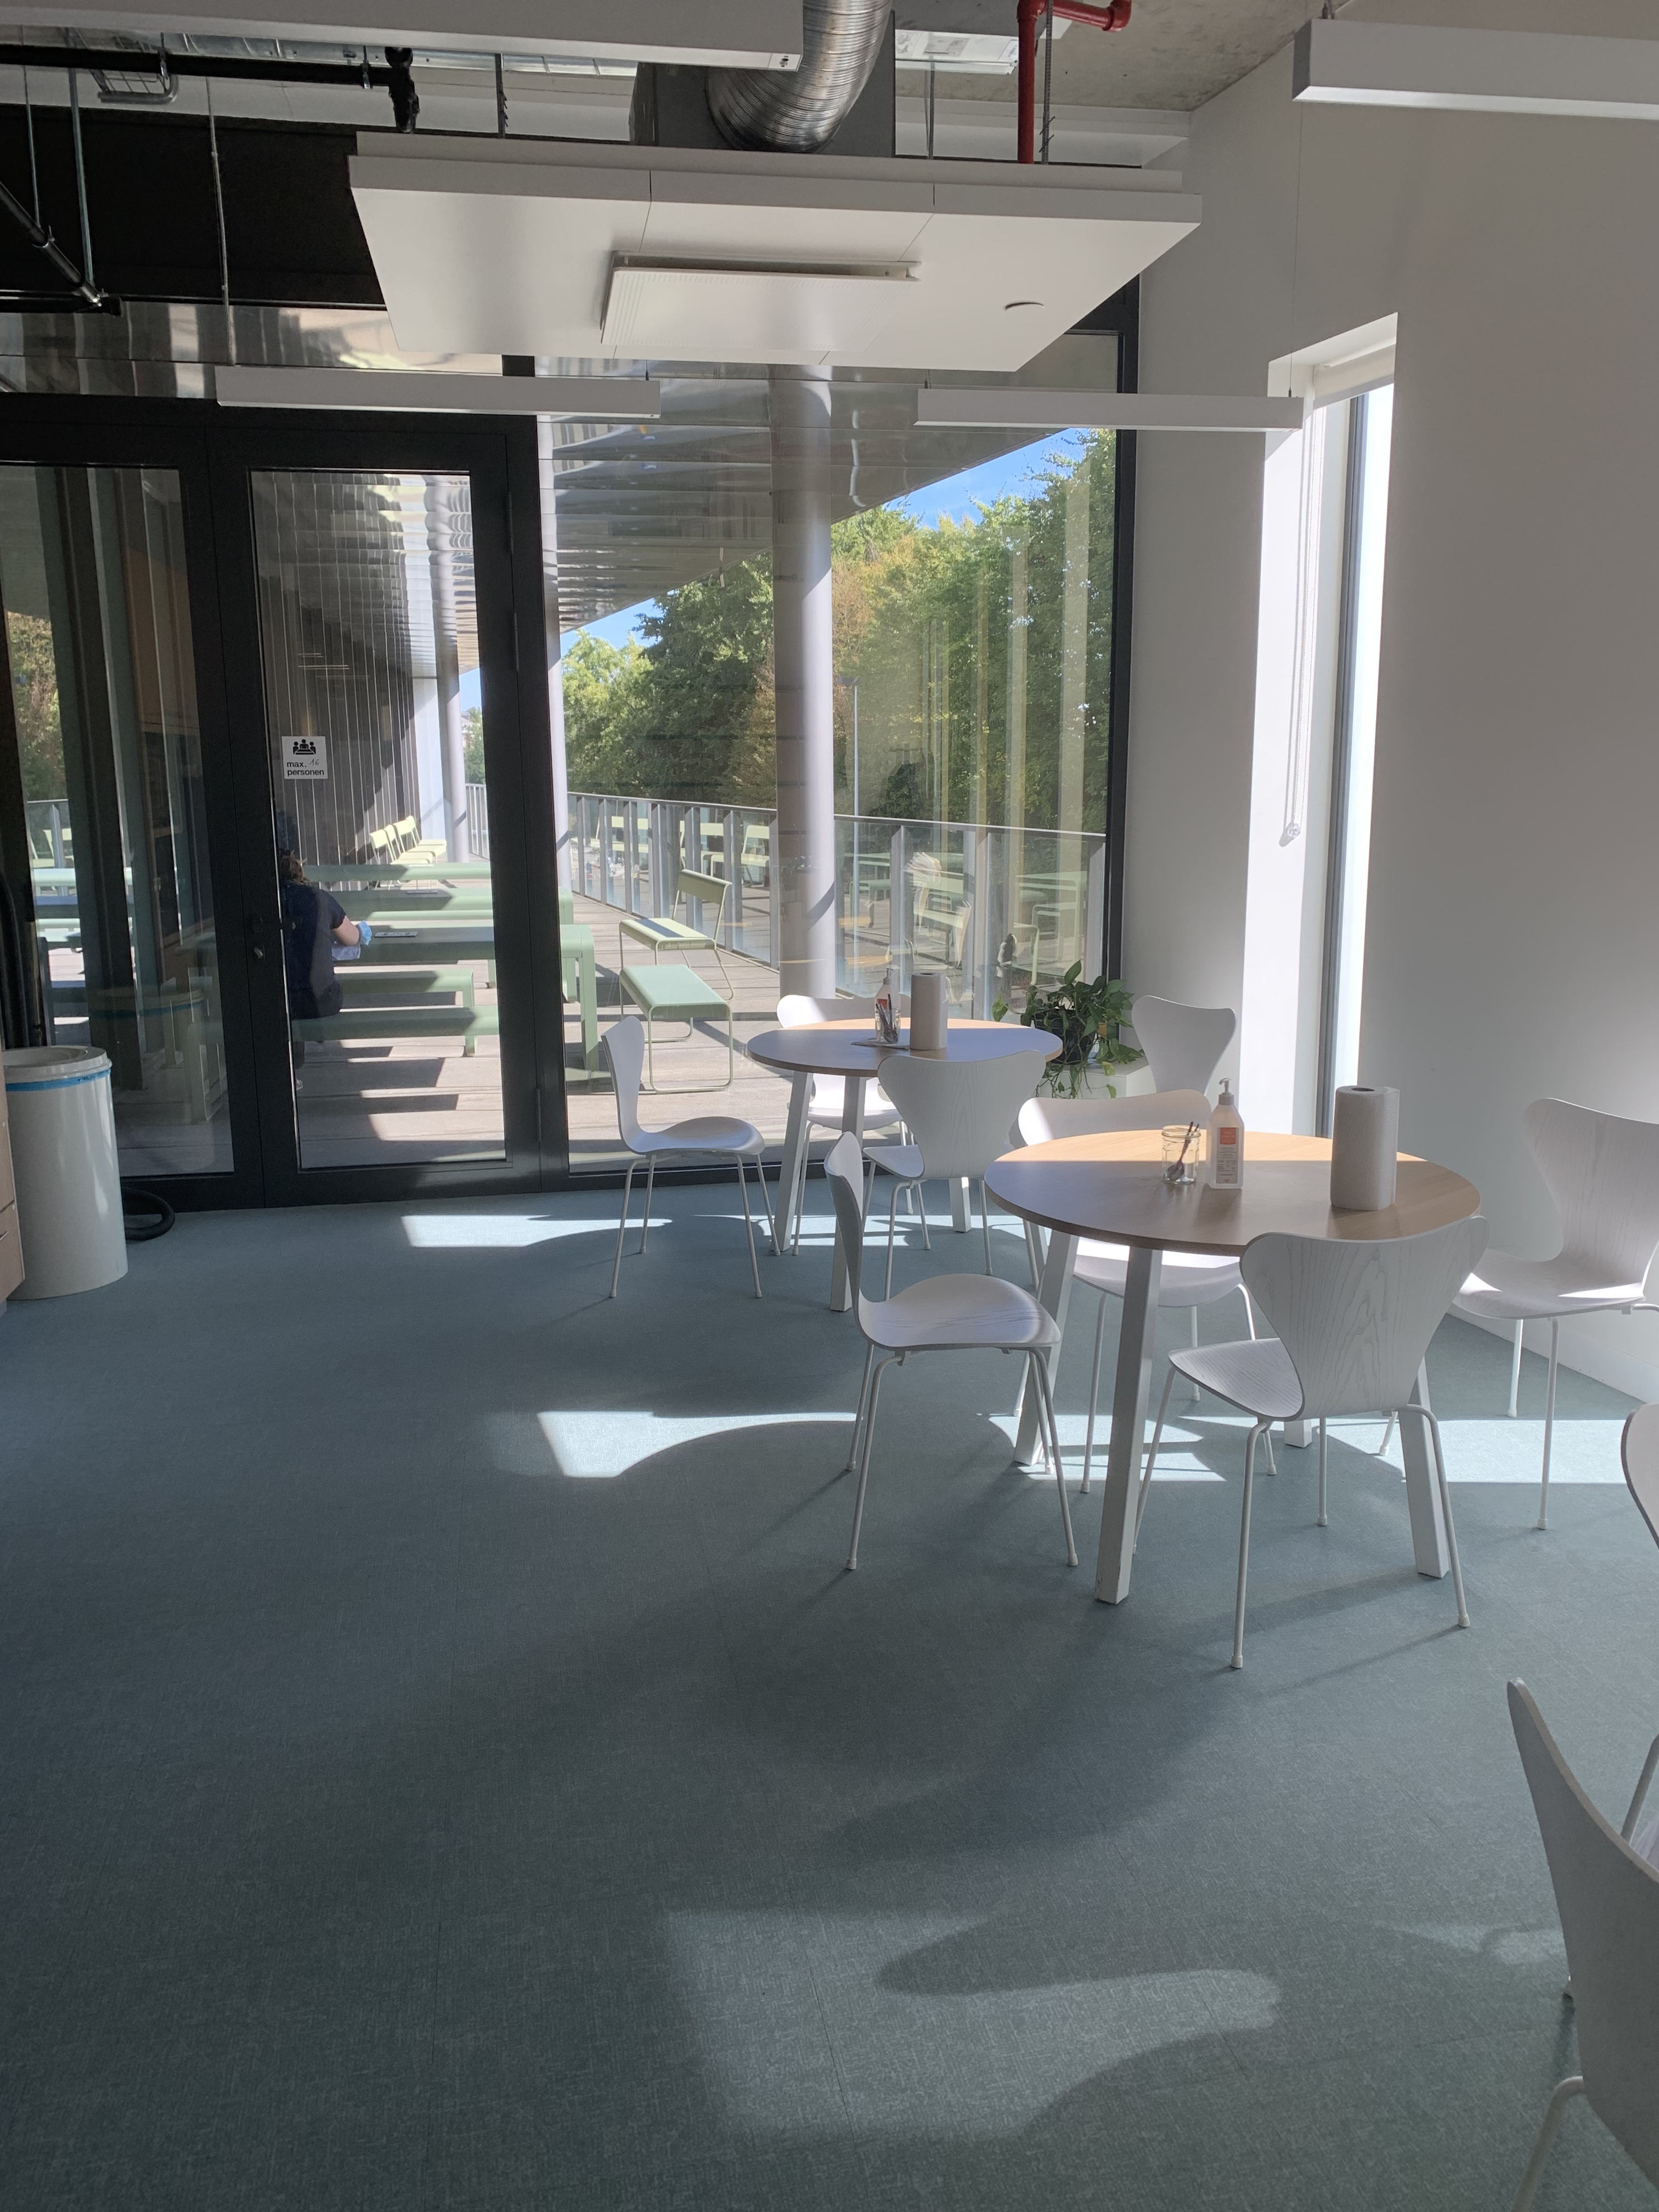
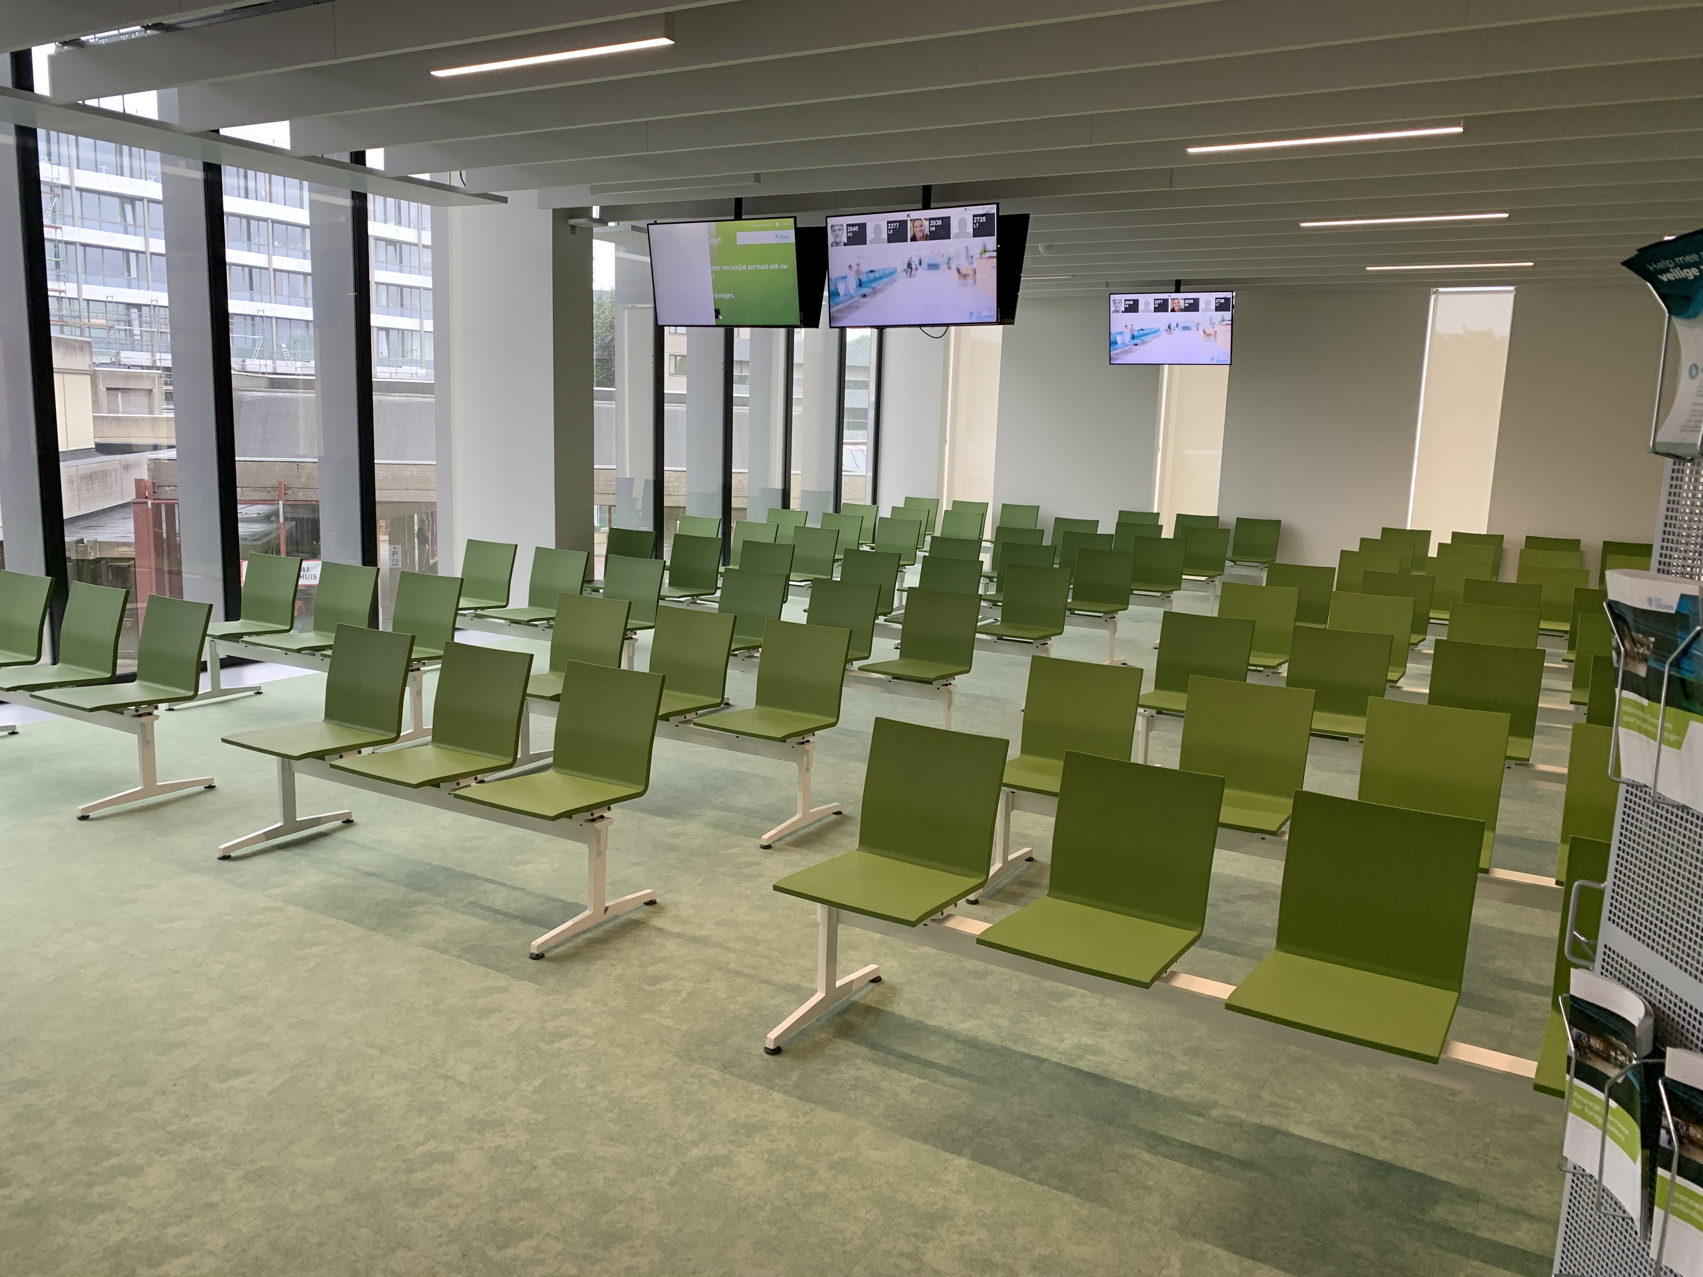
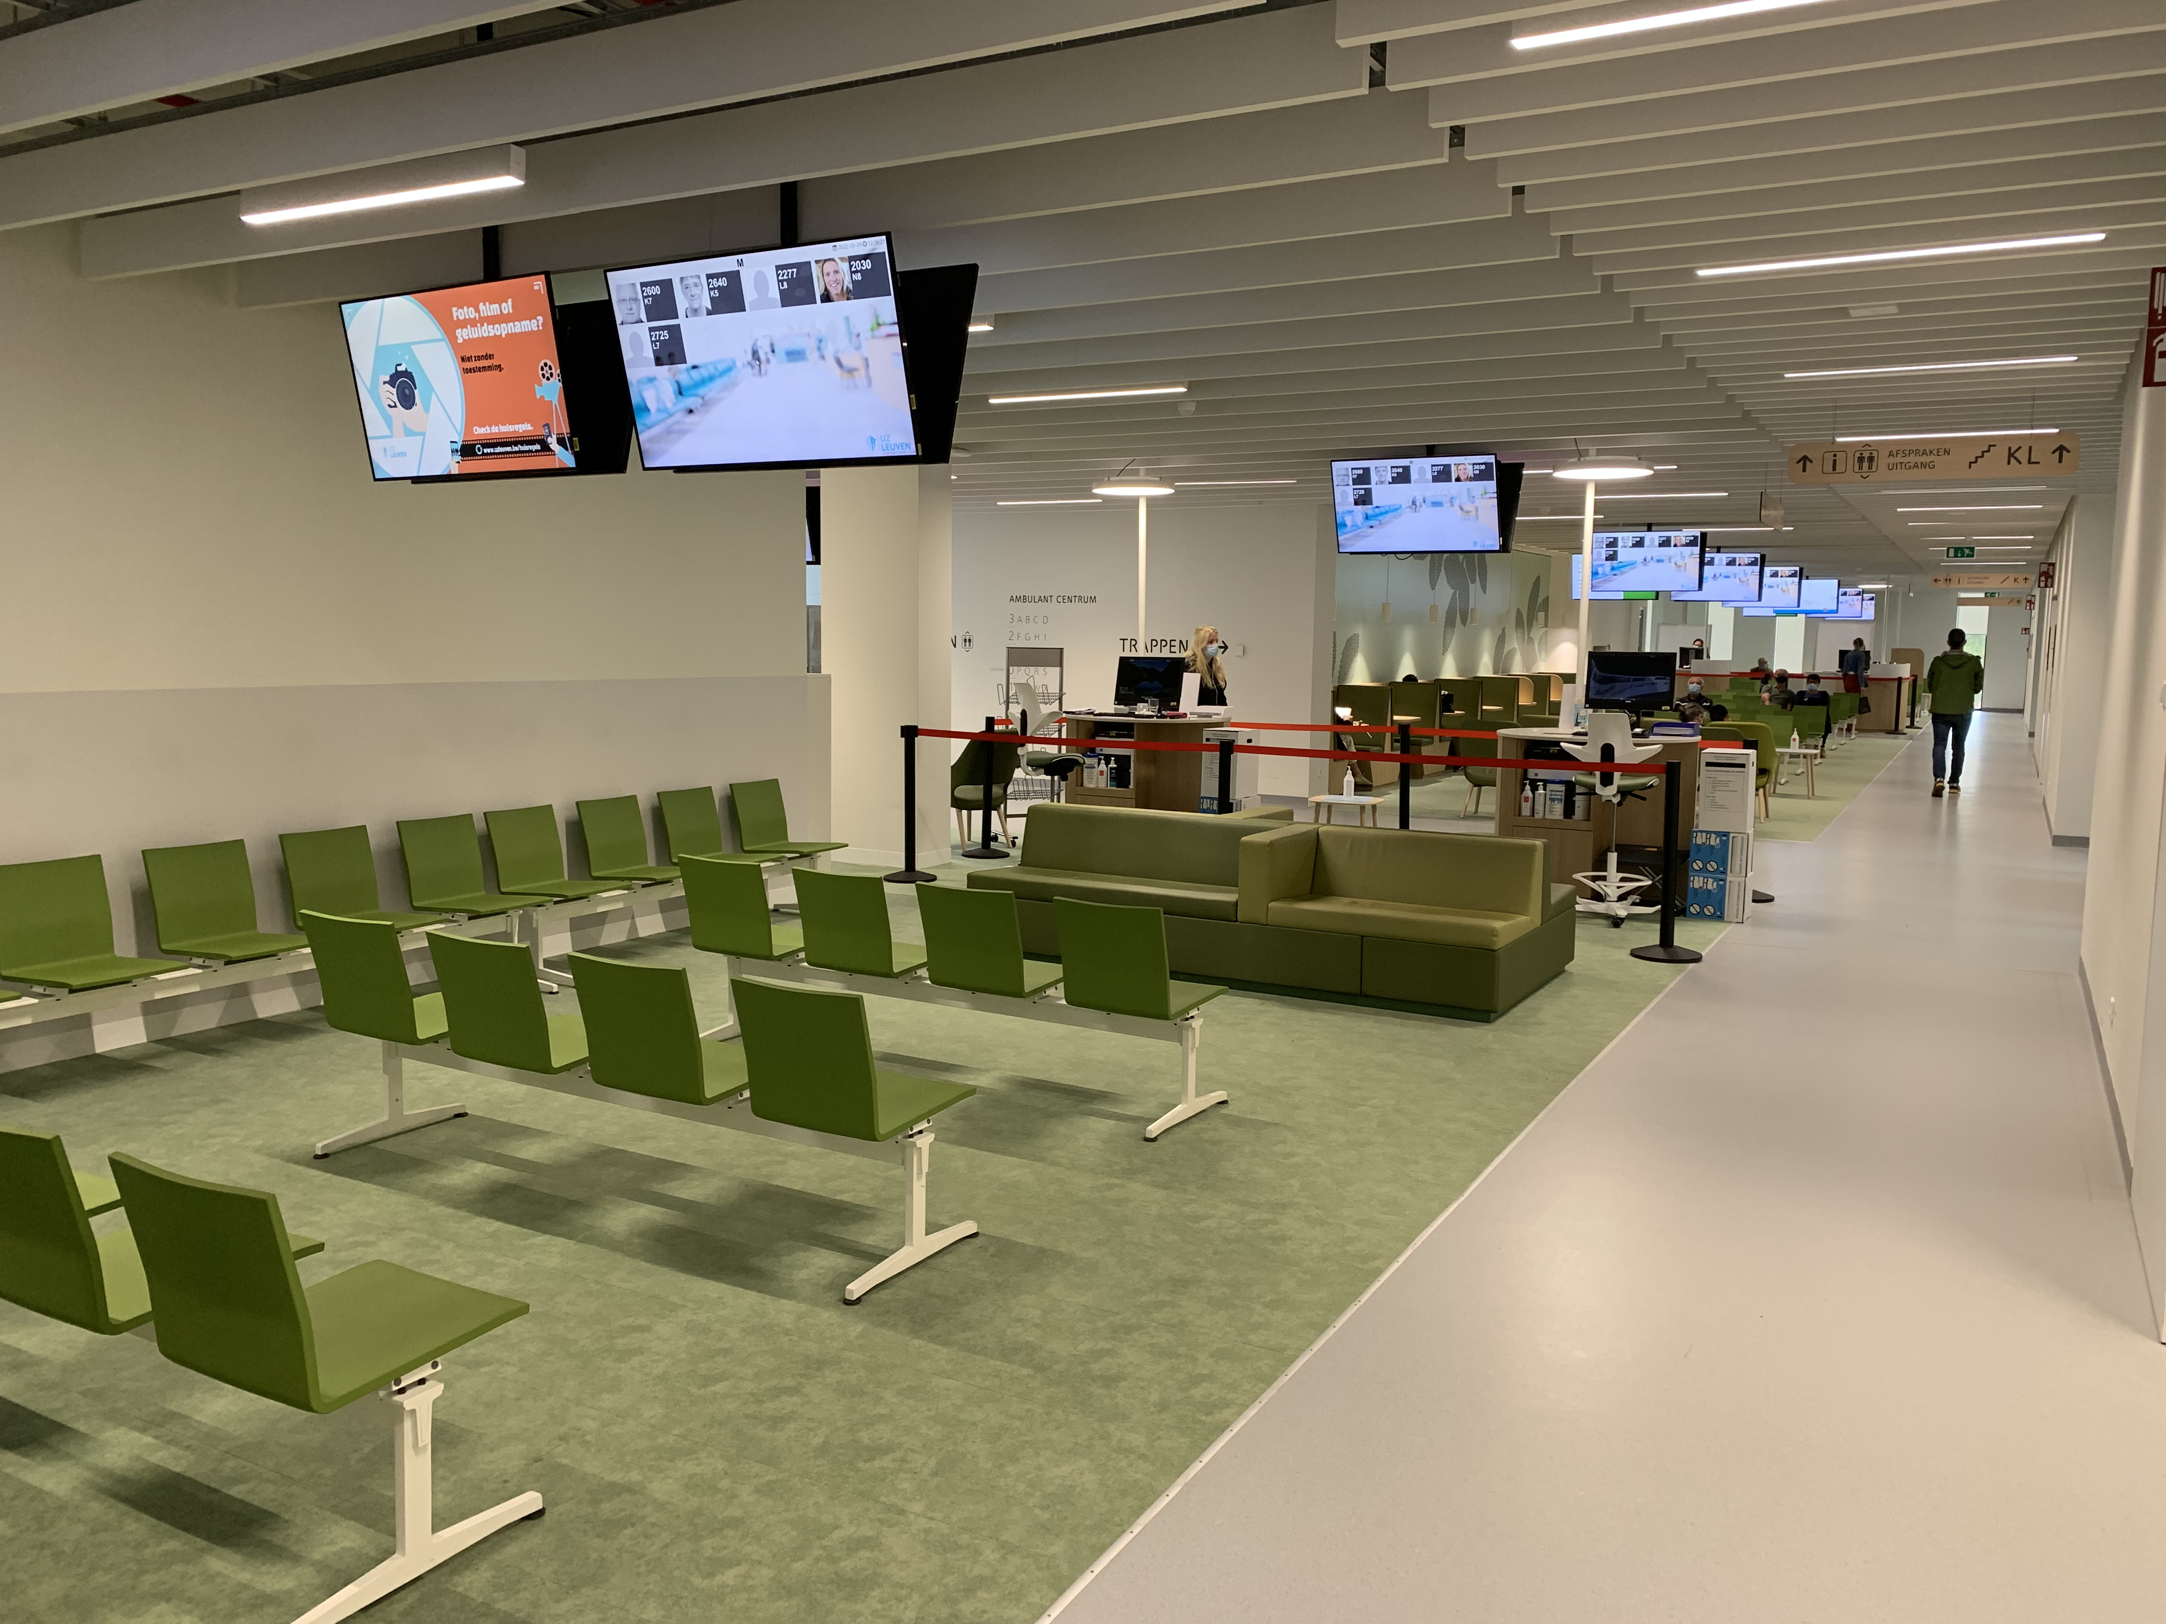
Back office examinors area
Office
Printers
Kitchen
Coffee
Water
Terrace
Candidates area
Spacious
Day light
Water fountains
Administrative support amongst
Screens with information

Slide 22
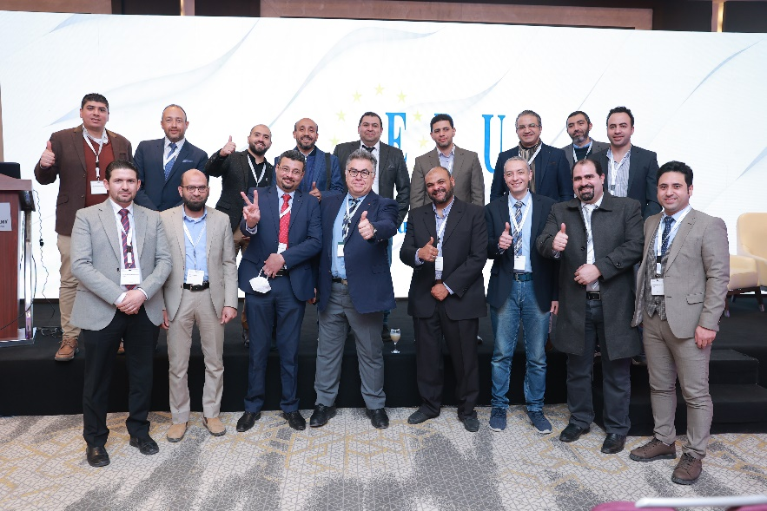
INT CERTIFICATION ORAL EXAM
Open to urologists certified outside Europe
2021 exam had 56 candidates registered by the Egyptian Urological Association
Due to technical issues majority did not pass
Re-exam held in Cairo on 12 March 22

Slide 23
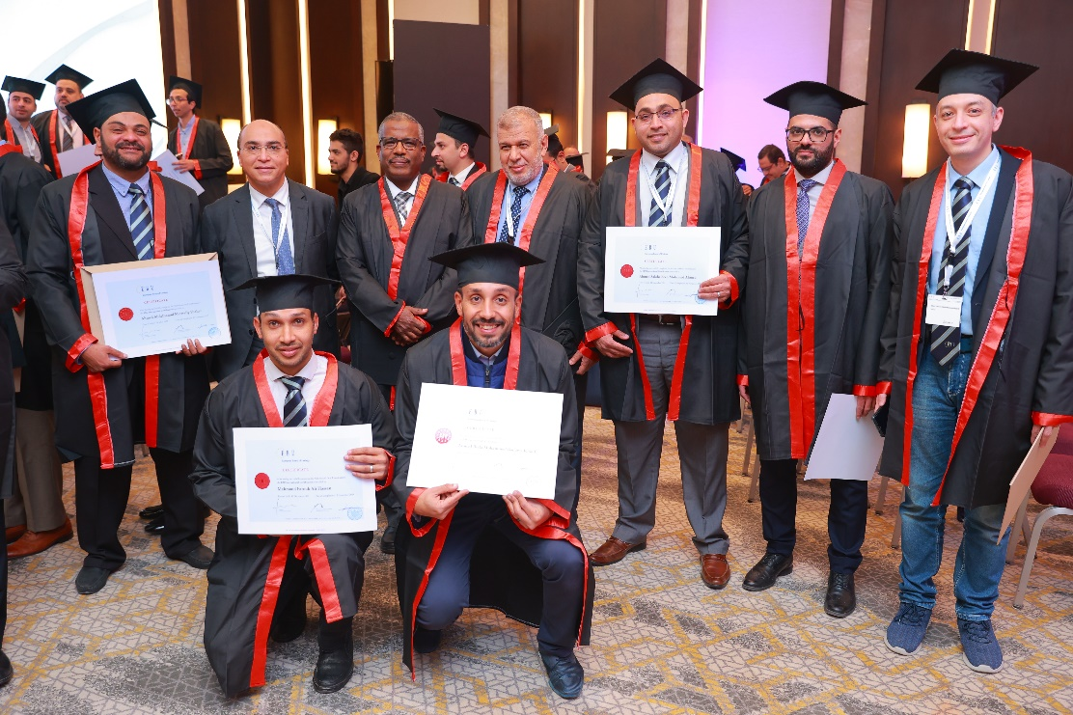
INT CERTIFICATION ORAL EXAM
Out of 56 candidates 48 passed (86%)
Successful candidates receive the EBU International
Certification
Upcoming exam in Cairo.
13 May 2023.
25 participants

