Slide 1
Board Meeting May 6th, 2023
Prof. dr. Jeroen van Moorselaar
President
U N I O N E U R O P É E N N E D E S M É D E C I N S S P É C I A L I S T E S ( U . E . M . S . )

Slide 2


Slide 3
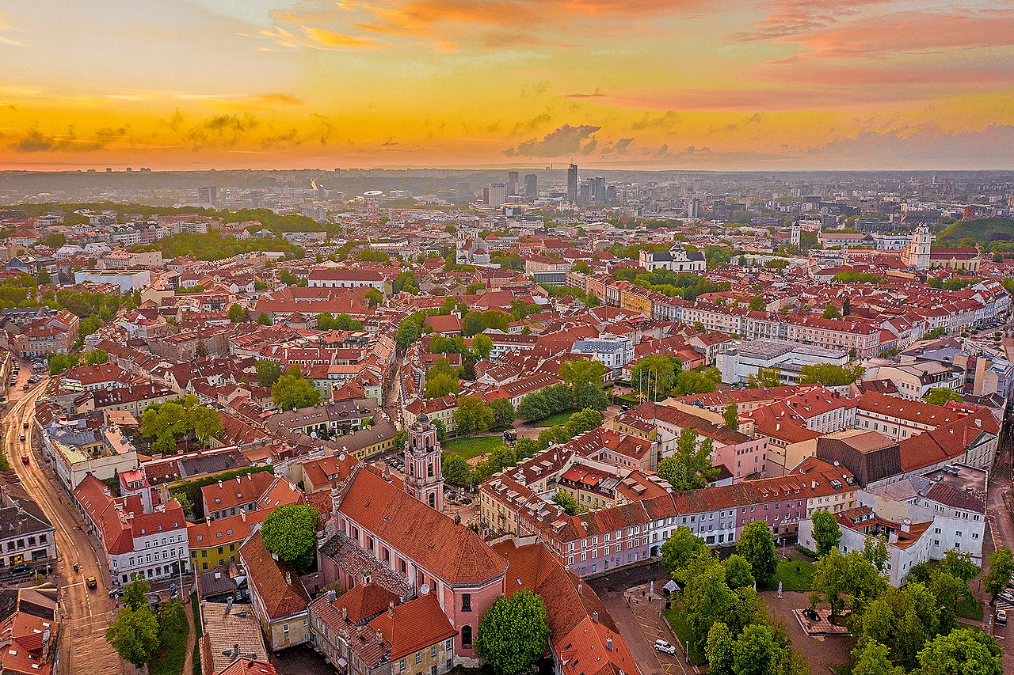



Slide 4
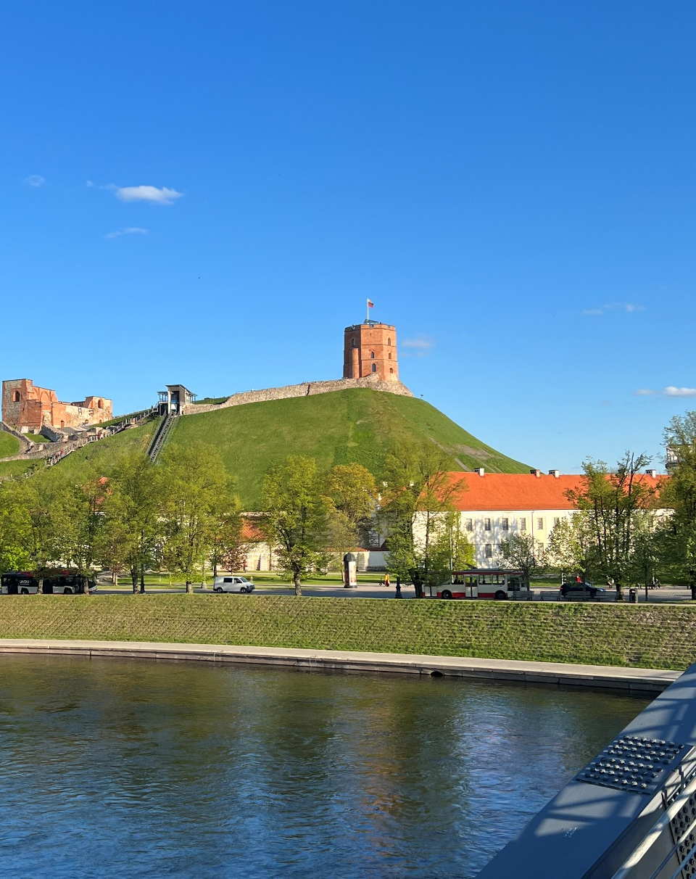
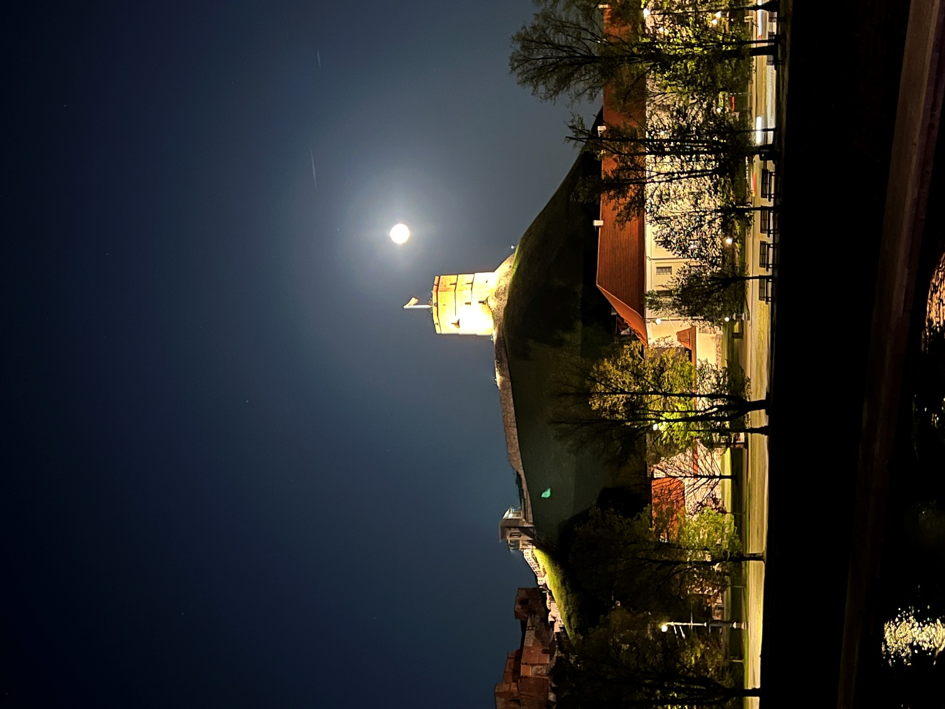

Slide 5
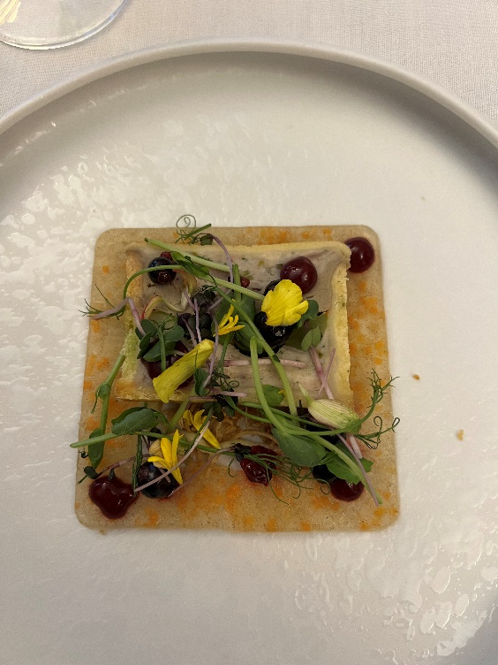
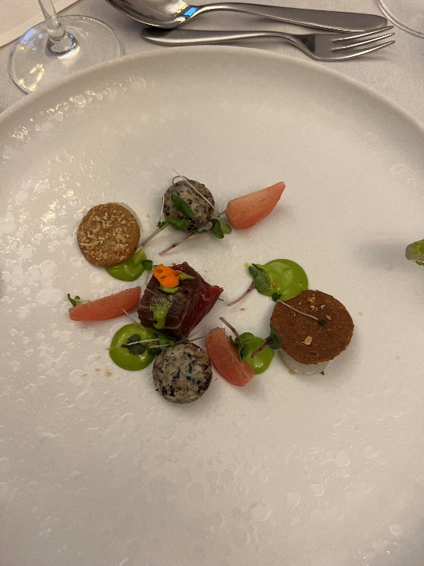
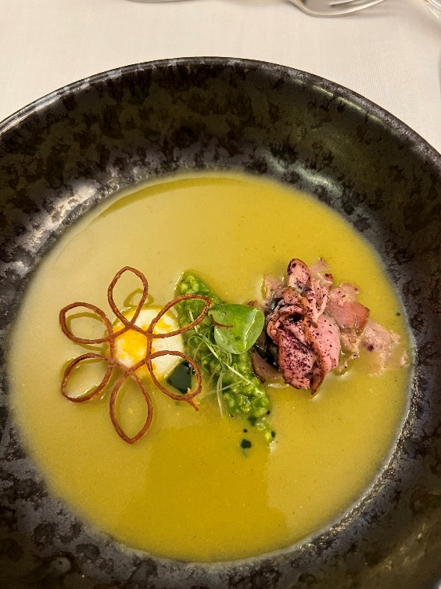
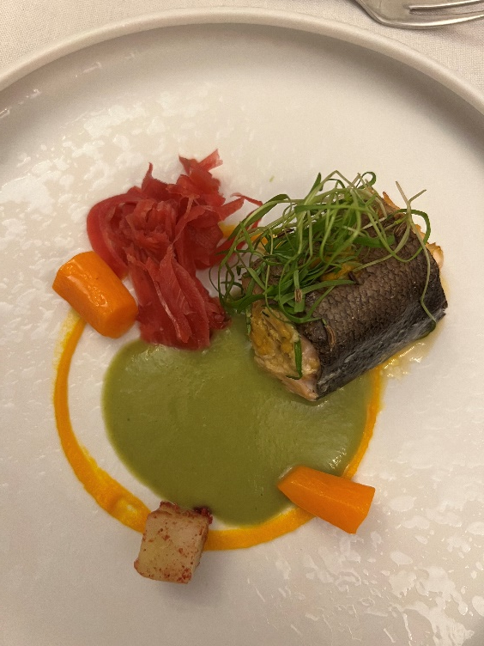
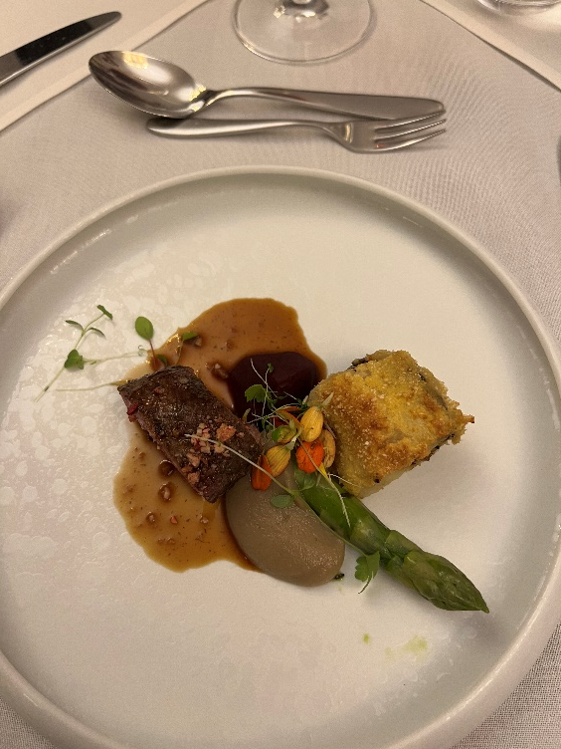
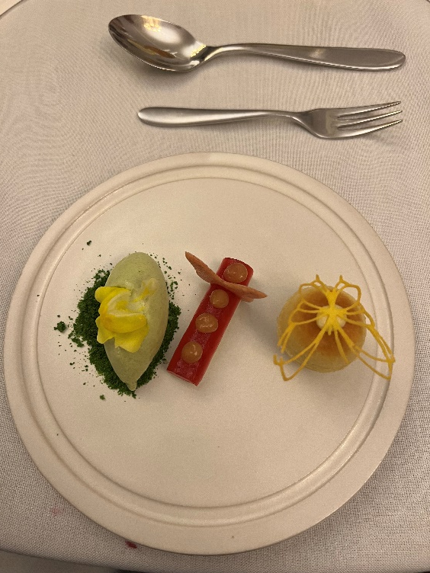

Slide 7
Statutes EBU April 12th, 2002

Slide 8

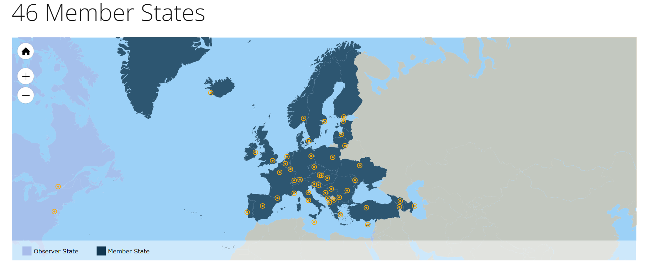
The Council of Europe is the continent's leading human rights organisation. It includes 46 member states, 27 of which are members of the European Union.
www.coe.int

Slide 9
EBU composition
All countries of the Council of Europe
1-2 board members per country (100 urologists)
Membership fee
We keep contact through a biannual newsletter

Slide 10
FEBU
FEBU is a mark of quality, we should keep the quality!
Revalidation of new FEBU every 5 year
At least 40 CME points per year
We can use EU-ACME registration

Slide 12
EBU executive board
Current President elect: Michael Rauchenwald 2024 president
Next President elect: Serdar Tekgul, 2025
Current Secretary elect: Jose Dominguez Escrig 2024 secretary
Next Secretary elect: Magne Dimmen, 2025

