Slide 1
Board Meeting 6 May 2023
Prof. Archil Chkhotua
Secretary
U N I O N E U R O P É E N N E D E S M É D E C I N S S P É C I A L I S T E S ( U . E . M . S . )

Slide 2
New Board Members
Philipp Baumeister, Switzerland, CERT
Michal Fedorko, Czechia, EXAM
Manuela Petra Hiess, Austria, EXAM
Thomas Quack, Germany, ACC
Aleksander Khelaia, Georgia, ACC
U N I O N E U R O P É E N N E D E S M É D E C I N S S P É C I A L I S T E S ( U . E . M . S . )

Slide 3
EBU representative European Board of Paediatric Urology
Nomination: Yazan F. Rawashdeh as Expert Member (not an EBU board member)
Nomination: Manuela Petra Hiess
U N I O N E U R O P É E N N E D E S M É D E C I N S S P É C I A L I S T E S ( U . E . M . S . )

Slide 4
Calendar 2024
In-Service Assessment: March 11-15, 2024
Board Meeting Spring 2024: May 10, Online (?) TBC
Board Meeting Autumn 2024: October 11-12(?) TBC
FEBU Oral Exam: June 8, 2024, Leuven, Warsaw, Budapest, Ankara
FEBU Written Exam: November 14, 2024, Online exam
International Certification Oral Exam: April, Cairo, Egypt

Slide 5
Jan Nawrocki
Appointed by the British Association of Urologcial Surgeons in 2010
Member Executive Board May 2014-2021
President May 2016-2018
Served on the Examination, Certification and Accreditation Committees
Examiner FEBU Oral Exam
U N I O N E U R O P É E N N E D E S M É D E C I N S S P É C I A L I S T E S ( U . E . M . S . )

Slide 6
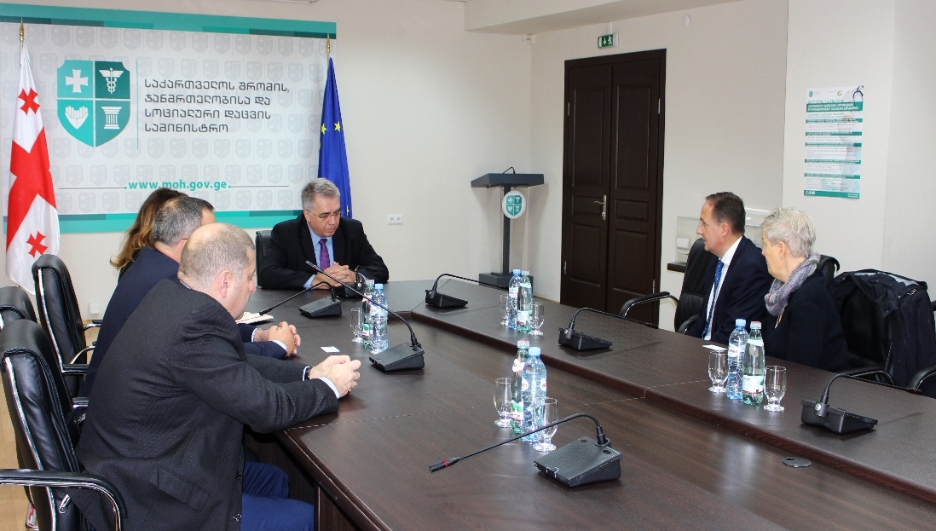
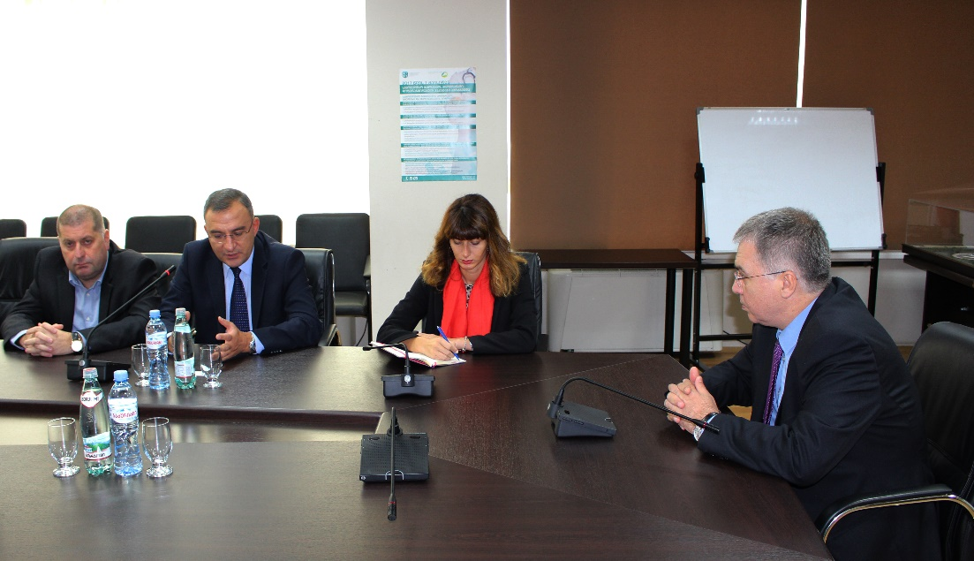
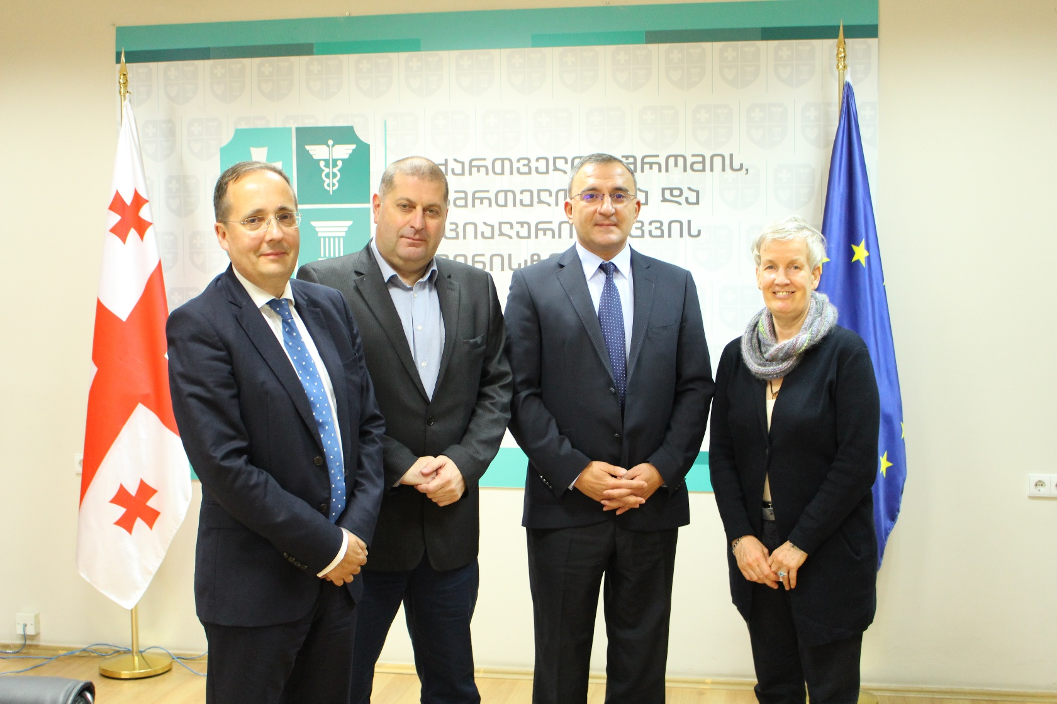
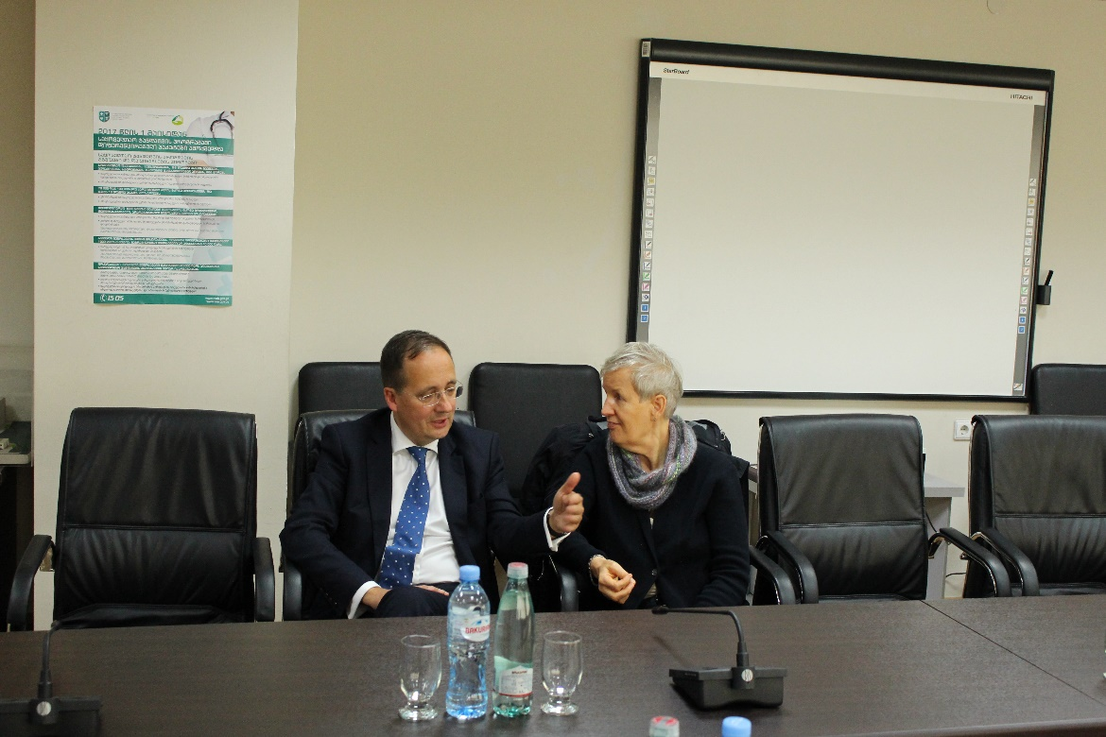
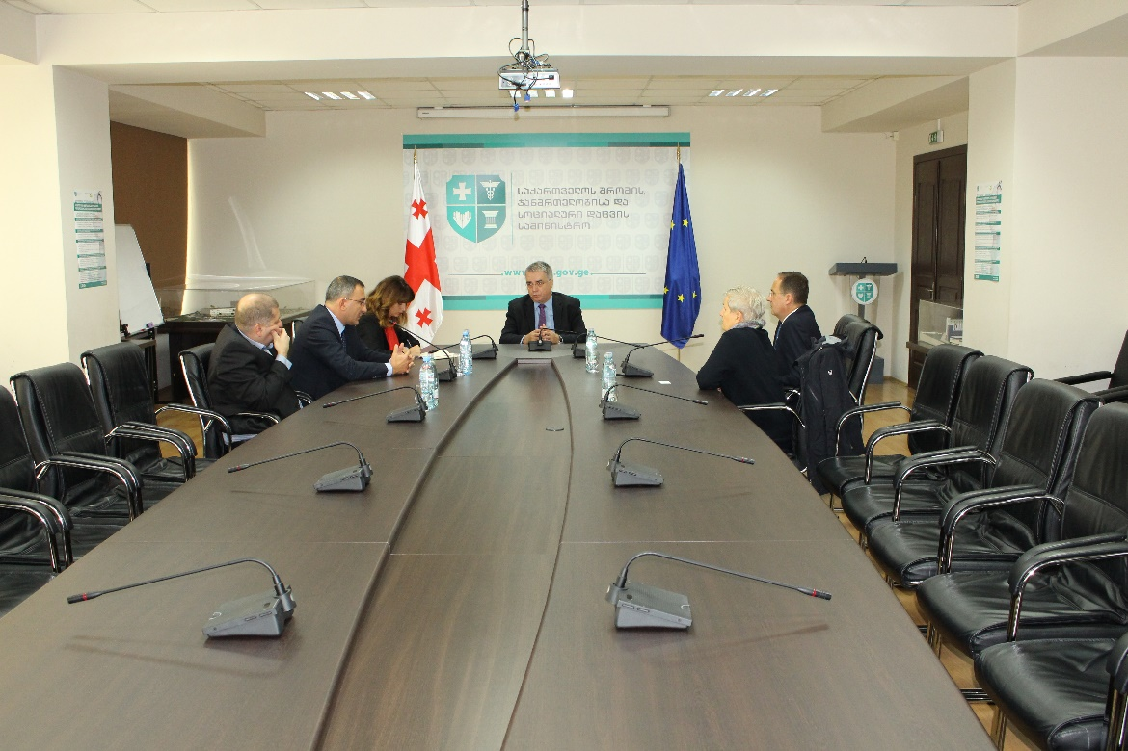
EBU Meeting Tbilisi, 2017

Slide 7
Arnaldo Figueiredo
Appointed by the Portuguese Association of Urology in 2005
Member Executive Committee May 2012-2023
President May 2018-2021
Member Examination Committee and Examiner FEBU Oral Exam
U N I O N E U R O P É E N N E D E S M É D E C I N S S P É C I A L I S T E S ( U . E . M . S . )

Slide 8
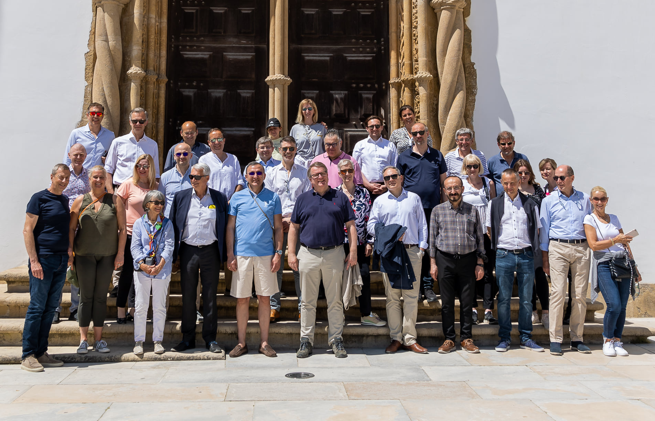
EBU Meeting Coimbra 2022

Slide 9
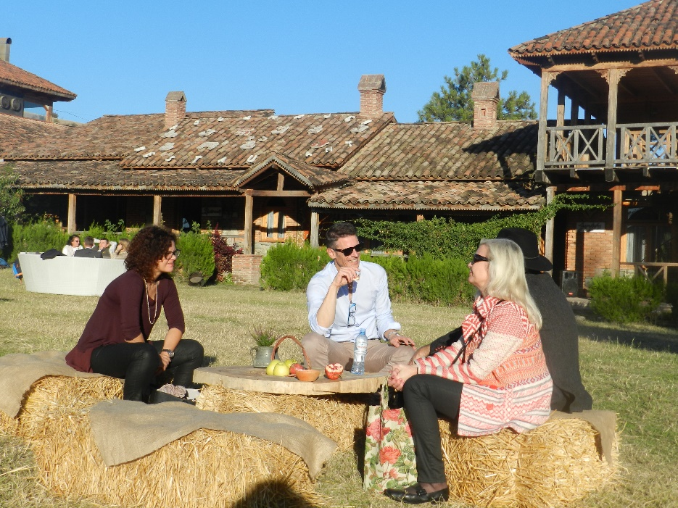
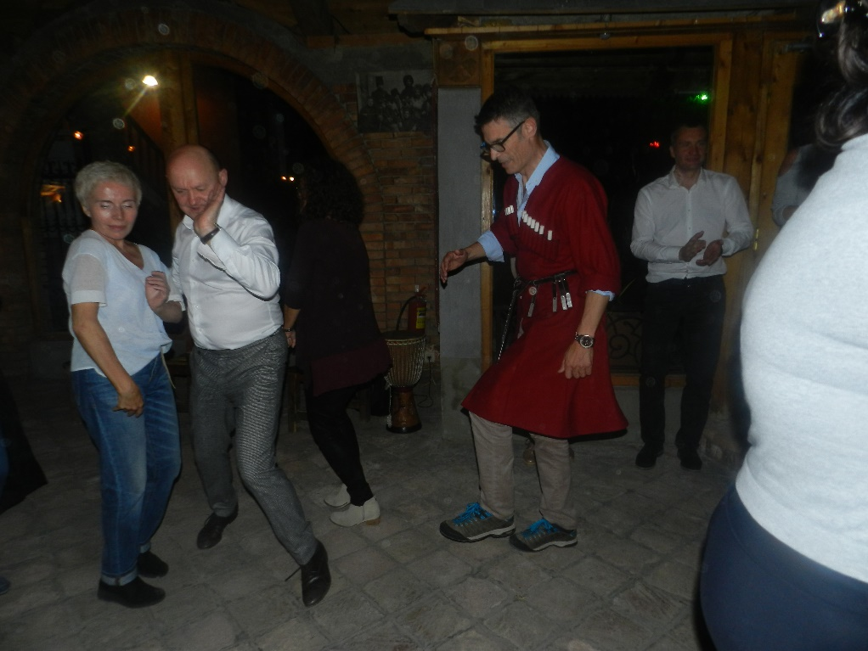
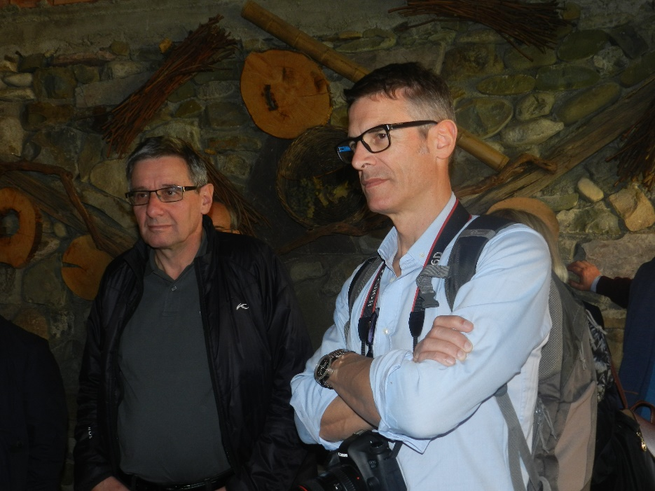
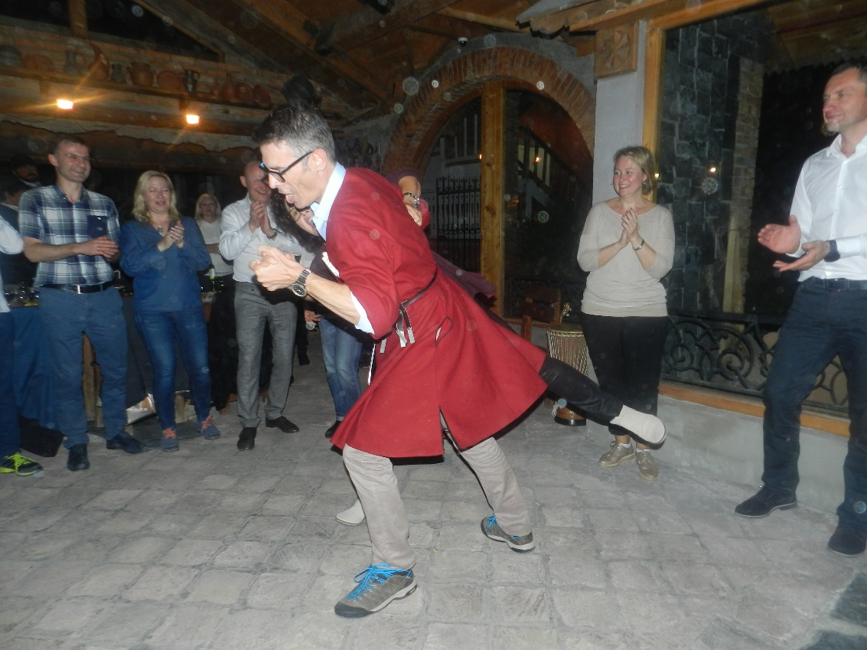
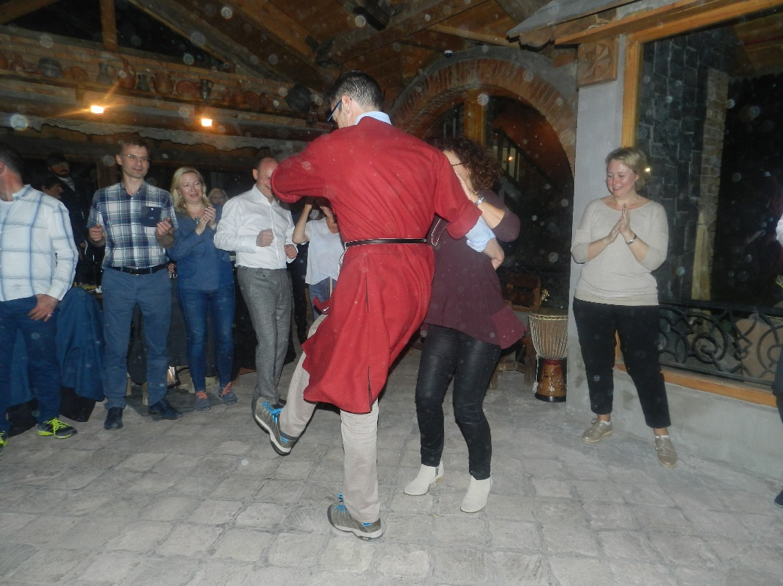

Slide 10
Edgars Baumanis
Appointed by the Latvian Urological Association in 2011
Member Examination Committee
U N I O N E U R O P É E N N E D E S M É D E C I N S S P É C I A L I S T E S ( U . E . M . S . )

Slide 11
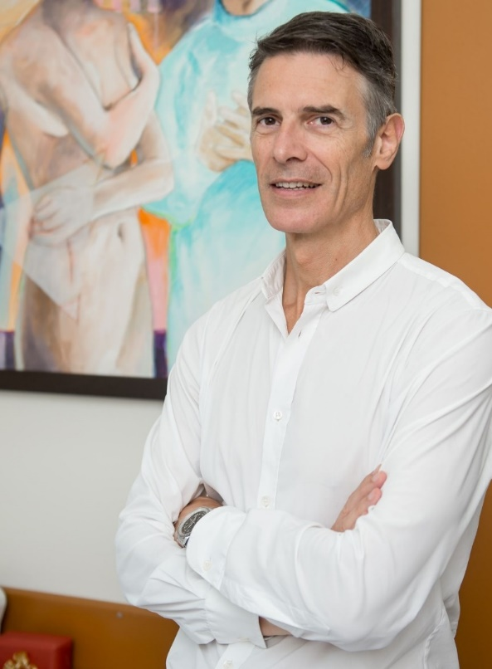
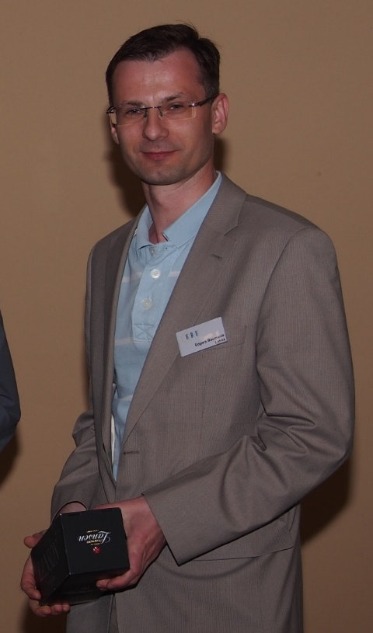
THANK YOU!

