Slide 1
Board Meeting 7 Oct 2023
Certification Committee
Magne Dimmen
Chairman
U N I O N E U R O P É E N N E D E S M É D E C I N S S P É C I A L I S T E S ( U . E . M . S . )

Slide 2
Certification committee
Milan Hora Czech Republik
Mia Madsen Denmark
Ioannis Varkaris Greece
Péter Riesz Hungary
Francesco Esperto Italy
Arunas Zelvys Lithuania
Pedro Coelho Nunes Portugal
Sebastian Voinea Romania
Frederico Gonçalves Slovakia
Simon Hawlina Slovenia
Marius Rebek Slovenia
Philipp Baumeister Switzerland
Han van der Zee Netherlands
Magne Dimmen Norway
Expert members:
Radu Constantinu, Romiana
Olivier Haillot, France
Hans Peter Schmid, Switzerland
Egils Vjaters, Latvia
U N I O N E U R O P É E N N E D E S M É D E C I N S S P É C I A L I S T E S ( U . E . M . S . )

Slide 3
RTPU certifications
3 site visits performed
2 first certifications
1 recertification (2nd term)
No online evaluations (virtual site visit)
U N I O N E U R O P É E N N E D E S M É D E C I N S S P É C I A L I S T E S ( U . E . M . S . )

Slide 4
RTPU certifications
Oct 2023: 7 new applications
All for recertification
All site visits will be done on-site by two members of the committee
No new certifications due to delayed transfer to new EAU database
U N I O N E U R O P É E N N E D E S M É D E C I N S S P É C I A L I S T E S ( U . E . M . S . )

Slide 5
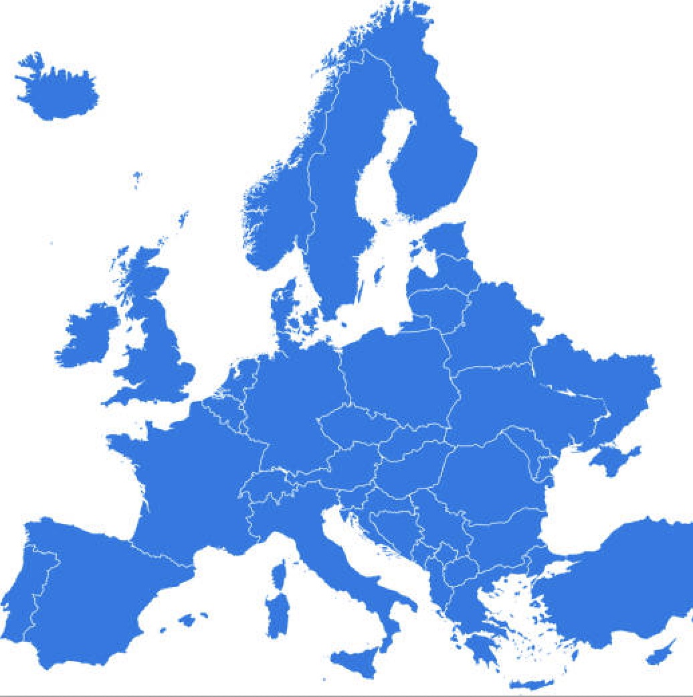
65 RTPU centers 19 countries
2
2
1
0
1
2
7
4
13
1
3
7
1
1
1
1
1
7
9
1
U N I O N E U R O P É E N N E D E S M É D E C I N S S P É C I A L I S T E S ( U . E . M . S . )
0

Slide 6
RTPU recertification
From 75 to 65 certified centres
One year ago 85 centres were certified.
Delays related to change of database system

Slide 7
How to promote RTPU certification
Catch up on pending recertifications
Simplify the application form?
Presentations at national meetings
Encourage national delegates to EBU to promote certificaton

Slide 8
EUSP Host centre
No applications evaluated since the last meeting.
All applications evaluated by one representative from EAU (Marko Babjuk)
and EBU (M. Dimmen)
U N I O N E U R O P É E N N E D E S M É D E C I N S S P É C I A L I S T E S ( U . E . M . S . )

Slide 9
EUSP Host centre 52 programmes 27 centres 12 countries
1
3
2
4
3
0
1
1
https://certifications.ebu.com/certified-host-centres
3
0
5
2
1
1
U N I O N E U R O P É E N N E D E S M É D E C I N S S P É C I A L I S T E S ( U . E . M . S . )

Slide 10
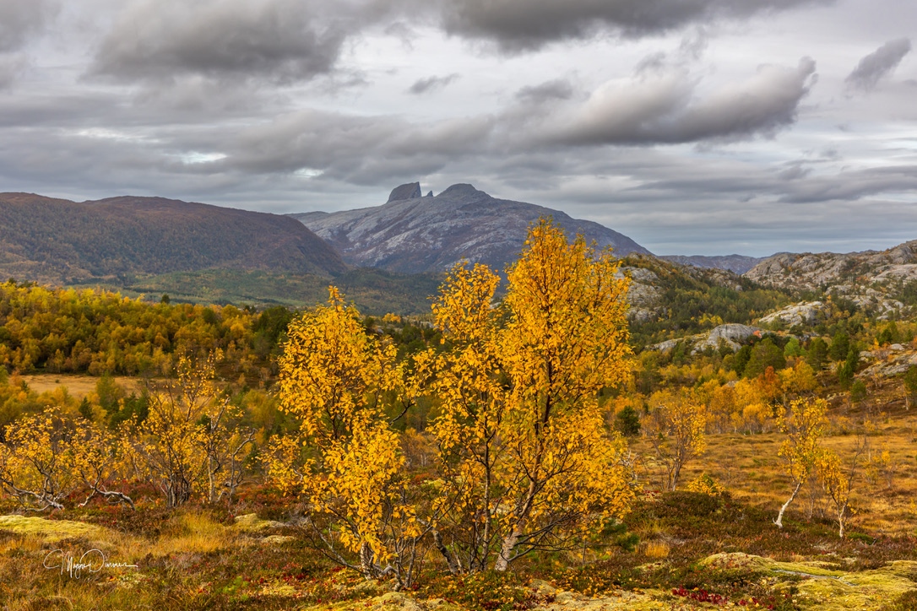
U N I O N E U R O P É E N N E D E S M É D E C I N S S P É C I A L I S T E S ( U . E . M . S . )
Notes:
Aalst is listed on the EUSP web-site, but not the EBU web-site.

