Slide 1

The European Board of Urology meets the
European Society of Residents in Urology
Luca Afferi, M.D., on behalf of ESRU
Chairman elect, European Society of Residents in Urology
- No disclosures -
@ESRUurology
@Luca_Afferi
Notes:
Main reason for me to step into this field is that I want to try to improve the conditions of the residents across Europe, give them a voice.
If there will be an improvement, it will probably take place in years, so it will affect future generations, that means that indirectly it will involve us as well.
One of the reasons why I think it is important to enter such bodies is that, if we believe in residency as such, we need to make it better.
We should always remember ourselves, that what we have today is the efforts of those who came before us.
The decision or the initiatives we take today will inevitably have an impact on us or next residents.

Slide 2




Luca Afferi, M.D.
Loic Baekelandt, M.D.
Urology Resident,
Luzerner Kantonsspital (CH)
MPH student, Harvard
School of Public Health
Chairman Elect,
ESRU
Associate, YAU,
Urothelial Cancer
Urology Resident,
UZ Leuven
PhD student,
UZ Leuven
Webmaster,
ESRU
Associate, YAU,
Urotechnology group
@Luca_Afferi
@LoicBaekelandt

Slide 3
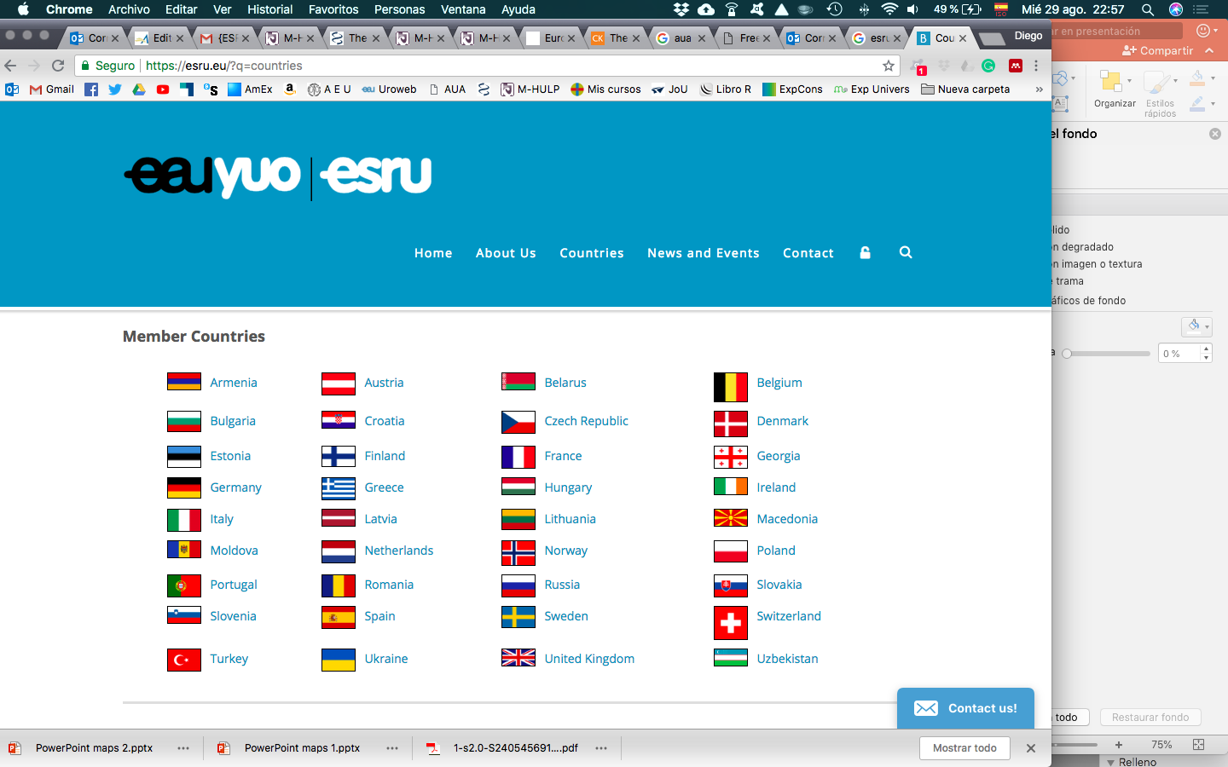
What is ESRU
ESRU = European Society
of Residents in Urology
Founded in 1991
ESRU represents Urology
residents training in
Europe
@ESRUurology
Notes:
Around 3500 urology residents in Europe

Slide 4

ESRU’s structure
Executive committee
(Ex-Comm)
National Communication Officers
(NCO)
@ESRUurology
Notes:
We have 2 representatives from each European state who come to our meetings

Slide 5

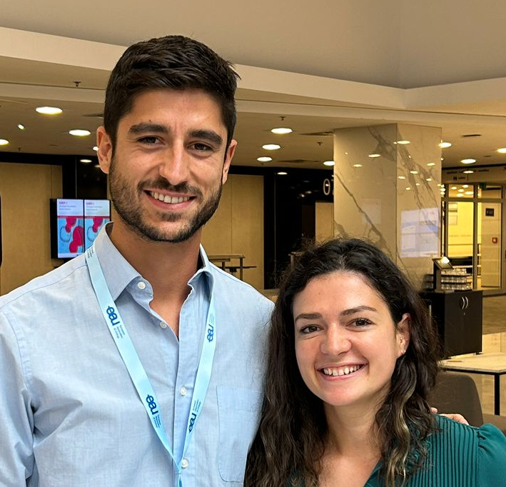
ESRU executive committee
Luca Aferi (CH)
Chairman-elect
Diego Carrion M (ES)
Past-Chairman
Adrian Khelif (BE)
Secretaty
Enrico Checcucci (IT)
Chairman
Anna Goujon (FR)
Internal coordinator
Loic Baekelandt (BE)
Webmaster
Cristina Bujoreanu (RO)
European Urology Today editor
Carlos Toribio (ES) and Gaelle Margue (FR)
Project managers
@ESRUurology
Notes:
In our last meeting we had representatives from 27 countries, now this number increased to 31.

Slide 6
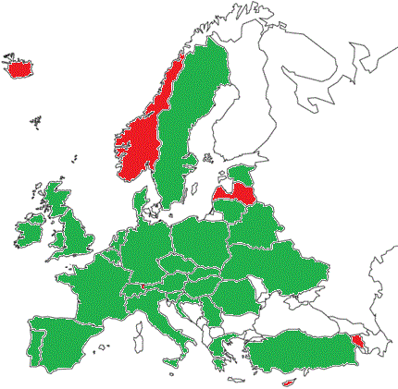
National communication officers (NCO)
Currently 52 NCO from 29 countries.
10 UEMS Countries not represented: (Armenia; Cyprus; Iceland; Iraq; Israel; Latvia; Luxembourg; Morocco; Norway; Tunisia)
@ESRUurology
Notes:
In our last meeting we had representatives from 27 countries, now this number increased to 31.

Slide 7
@ESRUurology

Slide 8
The goals of ESRU
To represent European residents in urology at the international level
To support training in urology in Europe
To closely collaborate with other EAU offices, the European Board of Urology (EBU)
and other recognized organizations
To organize educational activities for European urology residents
To maintain a representation in the EBU and in organizations involved in
urological training in Europe
To support the creation of national associations for urologists in training in Europe
To gather information about residents’ need and address educational and training
gaps
@ESRUurology

Slide 9
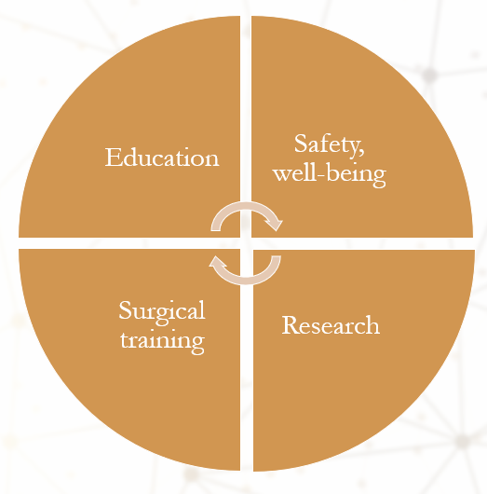
Residents’ needs, training gaps
Past ESRU surveys | Prague Meeting, 2023
Notes:
Main topics of interest when it comes to residency are the following ones:
XX

Slide 10


EBU/ESRU - Residency Training in Urology Across Europe
Background: Training in urology varies considerably among European countries. It has never been established what the similarities and differences are.
Aim: Understanding National Requirements and residents’ Rights for each UEMS member country.
Target Audience: Residents of the UEMS member countries.
  At least 3 residents for each country (member of UEMS)
    Preferably one last year resident

Slide 11
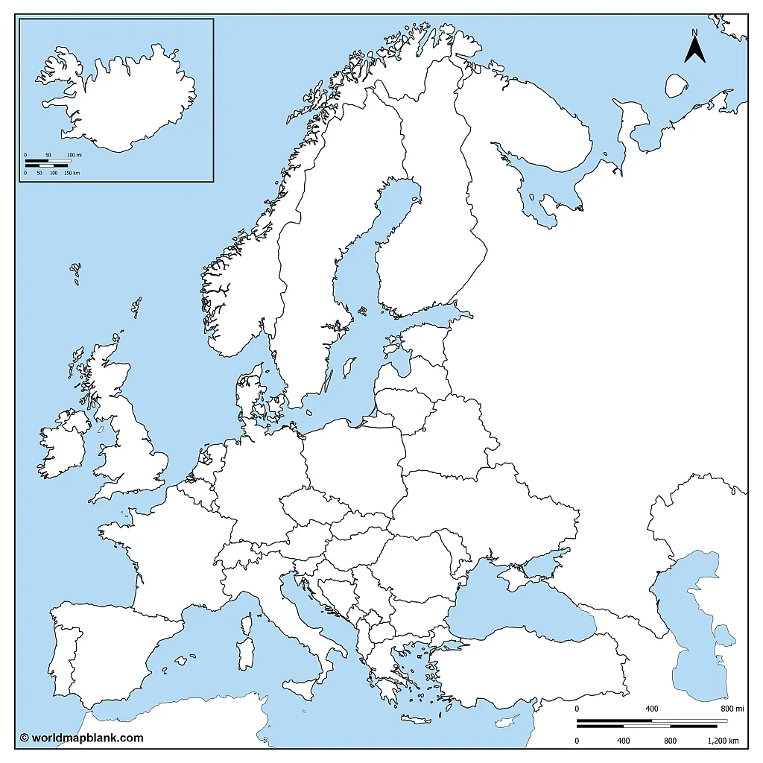

EBU/ESRU - Residency Training in Urology Across Europe
It is important to include all UEMS member countries. Some are not represented in ESRU yet!
  Armenia
  Cyprus
  Iceland
  Iraq
  Israel
  Latvia
  Luxembourg
  Morocco
  Norway
  Tunesia

Slide 12

EBU/ESRU - Residency Training in Urology Across Europe
Next steps:
  Pilot test the survey
  Finish list of responders
  Collect answers - descriptive analysis

Slide 13
ESRU views on:
In-service assessment
European Training Requirements (ETR)
14 core procedures (listed in the ETR) and their assessment
Continuing Medical Education/Lifelong Learning
@ESRUurology

Slide 14
ESRU views on:
In-service assessment
European Training Requirements (ETR)
14 core procedures (listed in the ETR) and their assessment
Continuing Medical Education/Lifelong Learning
@ESRUurology

Slide 15
In-service assessment
Summary:
100 MCQ | Urological topics (EBU) | Mo-Fr (5d) | 1x/year
Utility/Goals:
Learning tool for resident | Monitoring from Program Director
Useful? Can we do better?
@ESRUurology

Slide 16
In-service assessment: pros and cons
PROs | CONs
Students can see their progress every year | Cheating probably common – issue?
Students can see their weak points → motivation to study more those specific topics | Test questions sometimes odd
Program director could identify the gaps in theoretical training and introduce improvements
Useful to see how FEBU exam will look like
Explanation of the answers
Accessible cost
@ESRUurology
Notes:
It would be quite useful if they could provide the solutions with the explanatory text.

Slide 17
In-service assessment: our takes
It probably helps/motivate/trigger some residents
Unclear if the tests elicits reactions from program directors
@ESRUurology

Slide 18
ESRU views on:
In-service assessment
European Training Requirements (ETR)
14 core procedures (listed in the ETR) and their assessment
Continuing Medical Education/Lifelong Learning
@ESRUurology

Slide 19
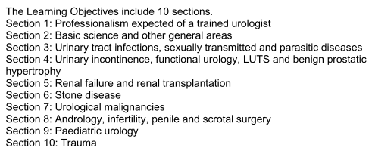
European training requirements
@ESRUurology

Slide 20
ETR: remarks
What about minimum statistical competences?
Principles of safety in the work environment (i.e. radiological exposure)?
@ESRUurology

Slide 21
ESRU views on:
In-service assessment
European Training Requirements (ETR)
14 core procedures (listed in the ETR) and their assessment
Continuing Medical Education/Lifelong Learning
@ESRUurology

Slide 22
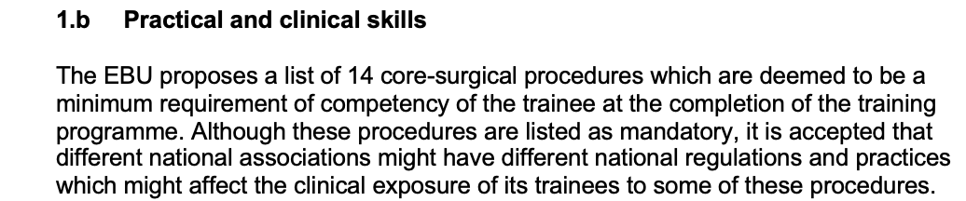
14-Core procedures = minimum req.
The EBU sets a standard for program directors
and for national associations
@ESRUurology
Notes:
Bottom line
It is an important statement to define what the EBU expects from European Urologists.

Slide 23
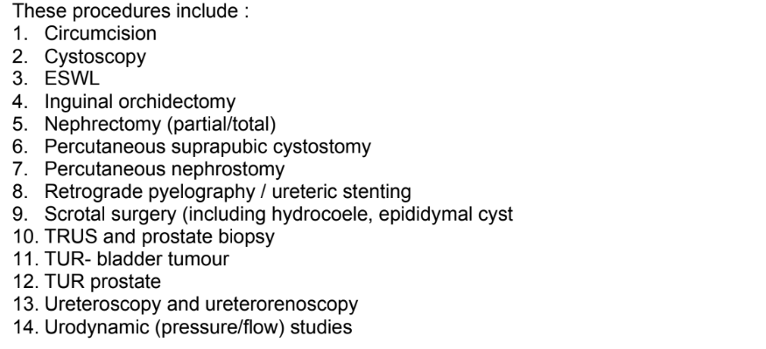

Slide 24
14-core procedures | Confidence
1. Circumcision | 88%
2. Cystoscopy | 93%
3. External Shockwave lithotripsy (ESWL) | 51%
4. Inguinal orchiectomy | 60%
5. Nephrectomy (partial/total) - Open - Minimally invasive | 13% 8%
6. Percutaneous suprapubic cystostomy | 76%
7. Percutaneous nephrostomy | 38%
8. Retrograde pyelography/stenting | 89%
9. Scrotal surgery | 76%
10. TRUS and prostate biopsy | 85%
11. TURBT | 65%
12. TURP | 47%
13. Endoscopy upper tract - Ureteroscopy - RIRS | 56% 31%
14. Urodynamic studies | 37%
14-Core procedures: issue (1)
Survey EUREP 2017
350 last year residents (46% RR)
14% adequate surg. Exposure
30% satisfied w surgical training
Main reasons for lack of training:
  ≈ 80% lack of organization from
  department / control from regulatory
  authorities
  63% attendees learning curve / lack of
  supervision
Adapted from: Carrion, WJU, 2020
Notes:
Not testing the impact

Slide 25
14-Core procedures: remarks
Skill to perform nephrectomies required from everyone?
Skill to perform percutaneous nephrostomy required from everyone?
What about assisting to minimally invasive (laparoscopic) procedures?
What about examining on some of these procedures for the EBU exam?
@ESRUurology
Notes:
Regarding point 4:
For example:
- picking 2 procedures at random (one on external genitals for example, one endourological)
- Having some examiners in the country of interest and having them going to the center and checking that the procedure is done correctly and with the resident as first surgeon
Possible consequences:
- Having more applicants as this type of exam would give more weight to the certification
Lukas steinkeller
I think this would go beyond the scope of the EBU; probably in 10-15y but at the moment the differences between countries are to huge

Slide 26
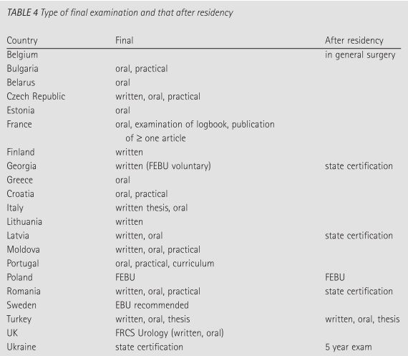
14-Core procedures: issue (1)
Parkar et al., BJUi, 2005

Slide 27
ESRU views on:
In-service assessment
European Training Requirements (ETR)
14 core procedures (listed in the ETR) and their assessment
Continuing Medical Education/Lifelong Learning
@ESRUurology

Slide 28
Continuing medical education: our take
Important to offer activities/events/worskshops that provide state of the art discussions principally on controversial topics
Online webinars useful
Issue: Some countries do not accept European credits
@ESRUurology

Slide 29
ESRU views on:
In-service assessment
European Training Requirements (ETR)
14 core procedures (listed in the ETR) and their assessment
Continuing Medical Education/Lifelong Learning
Bonus slide: The FEBU exam
@ESRUurology

Slide 30

The FEBU exam
Is it enough to motivate to do the FEBU exam?
What is the use of it besides CV/portfolio?
Why not giving more benefits?
@ESRUurology

Slide 31

Questions?

Slide 32
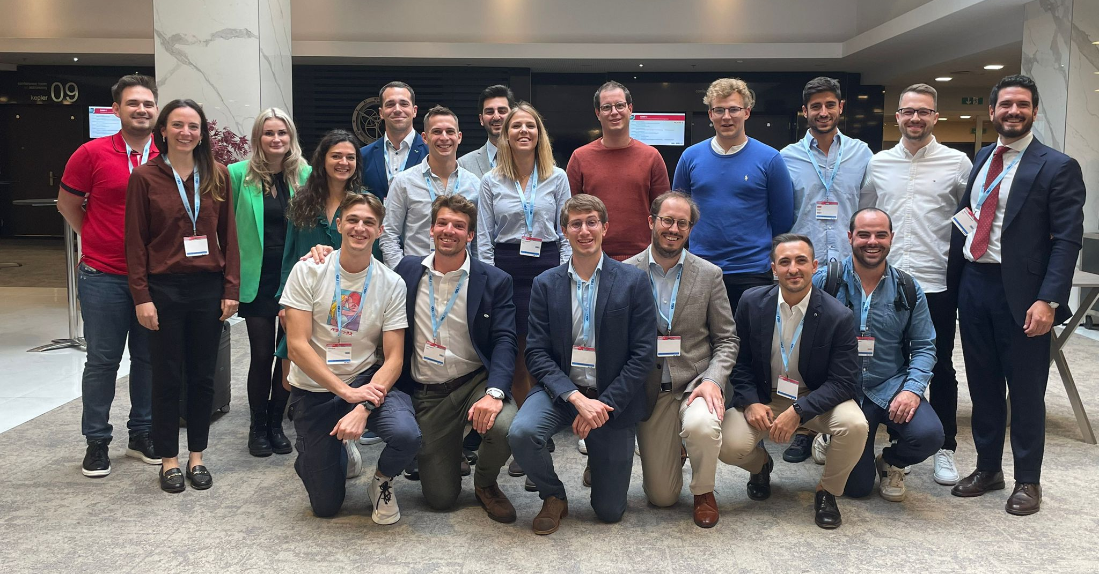
Thank you for your attention
Luca Afferi, M.D., on behalf of ESRU
Chairman elect, European Society of Residents in Urology
@ESRUurology
@Luca_Afferi

