Slide 1
Click here to add text
Prof. Dr. Serdar Tekgül
Prof. Dr. Guy Bogaert

Slide 2
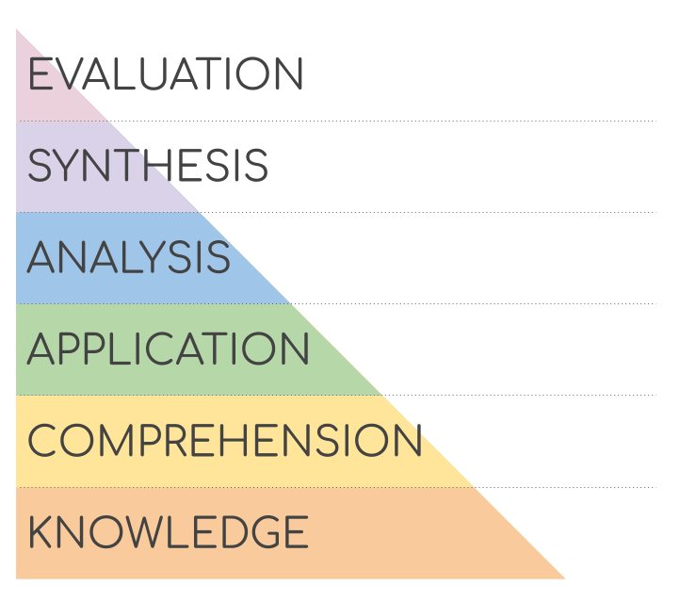
What does EBU ?
Formative exam = ISA (spring)
know the basics / essentials
Summative exam = written (fall)
know to interprete the basics / essentials
Oral exam
clinical reasoning
Certification centers / accreditation of meetings…
Bloom taxonomy of educational objectives

Slide 3
EXAMINATION COMMITTEE
85 members:
22 delegates
62 Associate Members
Associate Members are young FEBUs
Associate Members write content which is reviewed/edited by the committee
Special contributors are to be part of exam committee

Slide 4
IN-SERVICE ASSESSMENT 2023
In-Service Assessment 2023 | Candidates
Austria | 37
Belgium | 33
Croatia | 3
Czechia | 35
Denmark | 36
Estonia | 1
France | 1
Germany | 52
Greece | 34
Italy | 16
Lithuania | 14
Malta | 4
Netherlands | 21
Norway | 21
Poland | 79
Portugal | 15
Slovenia | 2
Spain | 98
Sweden | 20
Switzerland | 81
Turkey | 32
United Kingdom | 21
Indonesia | 9
Lebanon | 35
Malysia | 44
Pakistan | 8
Singapore | 16
Thailand | 10
ROW | 11
TOTAL | 789
Scoring
Average score | 64,7
Low score | 22
High scoree | 90
Candidates | 789
Residents | 720
Urologist | 69
From EBU certified centres | 206
Scoring
Average score | 64,7
Low score | 22
High score | 90
Candidates | 789
Residents | 720
Urologist | 69
From EBU certified centres | 206

Slide 5
WRITTEN EXAM
100 single correct answer MCQ on the entire range of urological topics
English, German, Hungarian, Polish & Turkish
Organised with Pearson VUE, either taken
At a secured test centre
Online
Only who scores above the passing score will be able to take the oral exam

Slide 6
FEBU Written Exam 2022 | Delivery | Candidates | Pass | Fail | %
Europe | Test Centre + OnVUE | 303 | 266 | 37 | 87,8
Austria | Test Centre | 34 | 29 | 5 | 85,3
Egypt | Test Centre + OnVUE | 24 | 12 | 12 | 50,0
Hungary | Test Centre | 13 | 12 | 1 | 92,3
Poland | Paper exam | 63 | 51 | 12 | 81,0
Switzerland | Test Centre | 37 | 36 | 1 | 97,3
Turkey | Test Centre + OnVUE | 32 | 31 | 1 | 96,9
TOTAL |  | 506 | 437 | 69
 |  |  |  |  | 86%
Scoring
AVG score | 68,23
Standard Deviation | 8,79
Passmark | 61
Pearson VUE delivery mode | 451
Test Centres | 298
OnVUE | 153

Slide 7
FEBU ORAL EXAM
Offering a standardized exam = 4 clinical cases – prerecorded = interactive = recorded = 1 score onsite + 1 score offline
enhances the reliability and objectivity
Each candidate scored by 2-3-4 reviewers independently

Slide 8
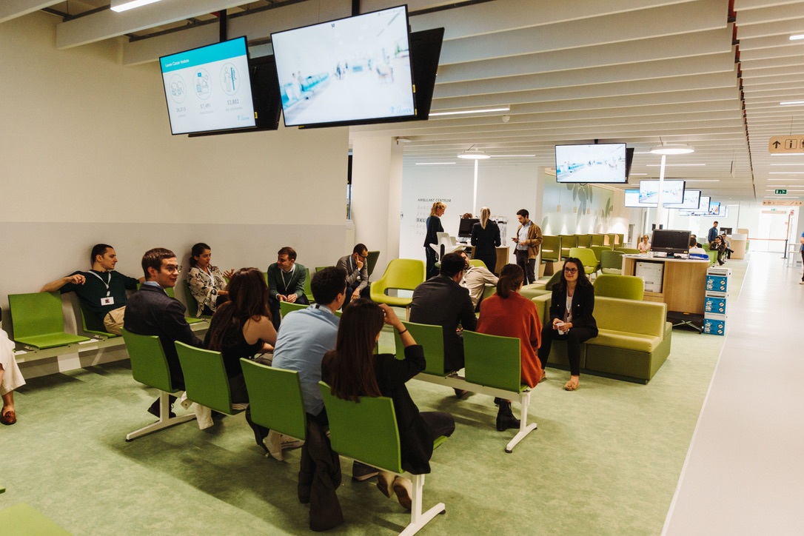
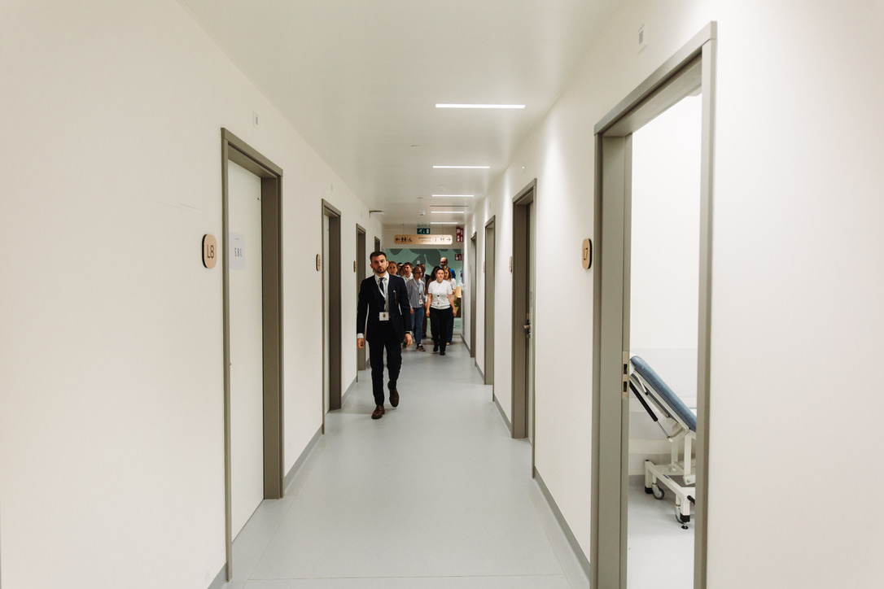
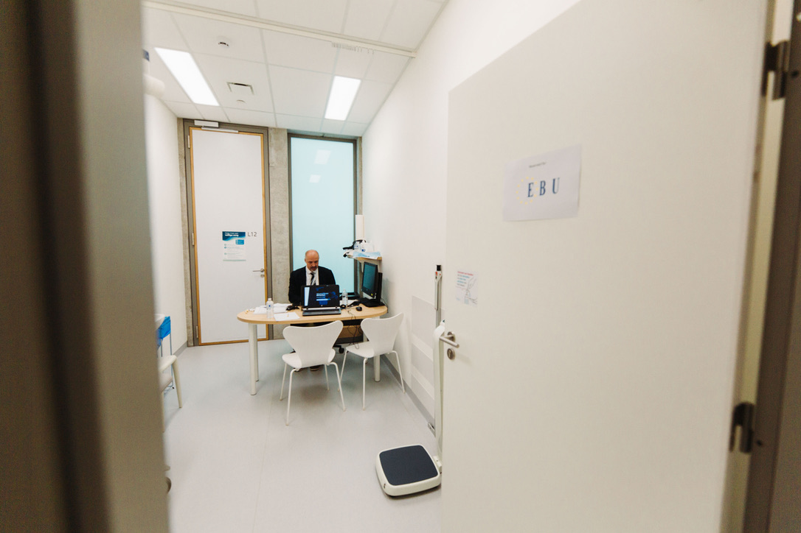
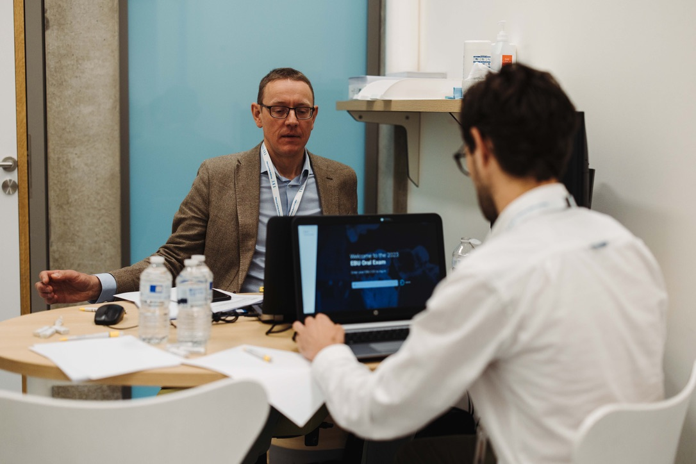

Slide 11
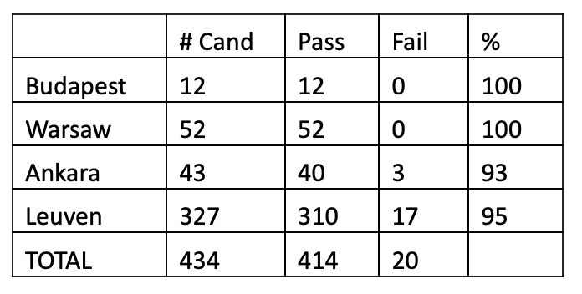
FEBU-2023 ORAL exam

Slide 12
EBU written 2023
Date : Thursday 16. November 2023 14h – 16h30
Deadline registration: 10. September 2023 (!!!!!!!!)

Slide 13
FO 24
Date: Saturday 8. June 2024
Venues: - European exam: Leuven
- Hungarian exam: Budapest
- Turkish exam: Istanbul
Polish exam: Warsaw
Format: onsite via the internet
One examiner

Slide 14
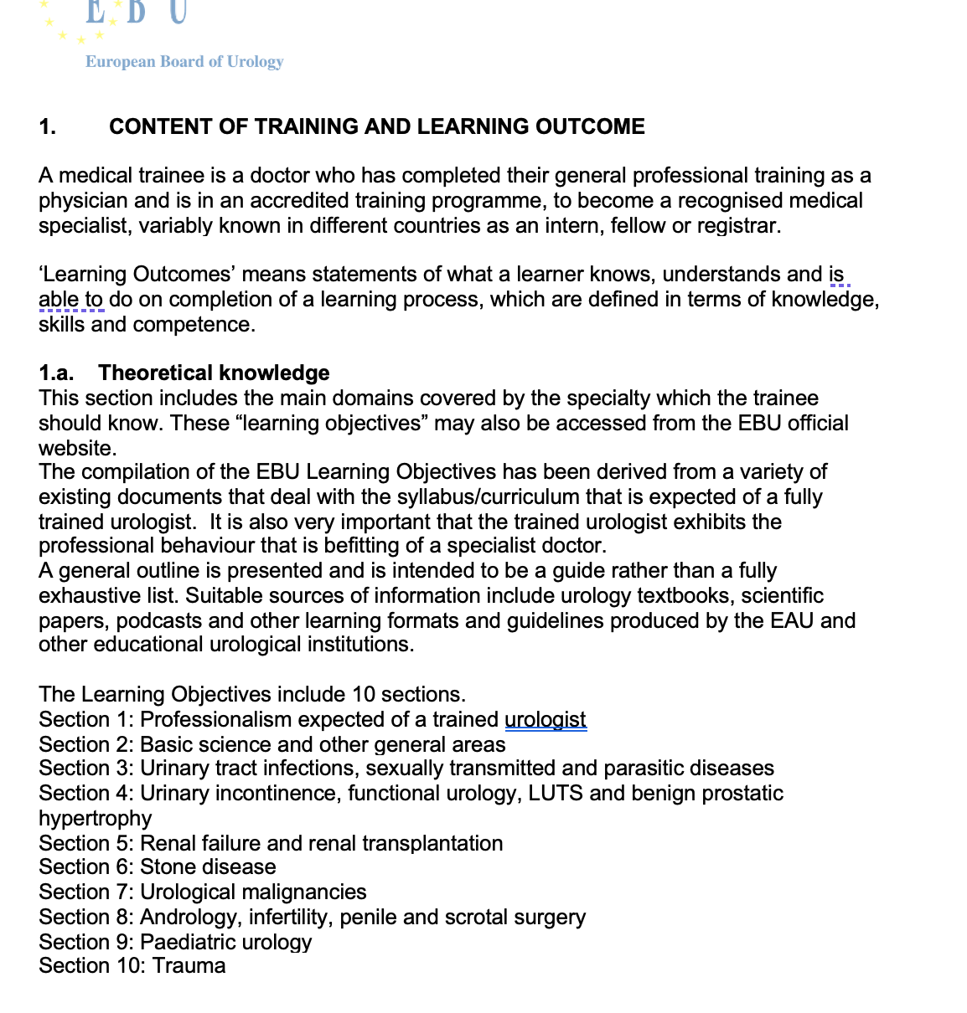
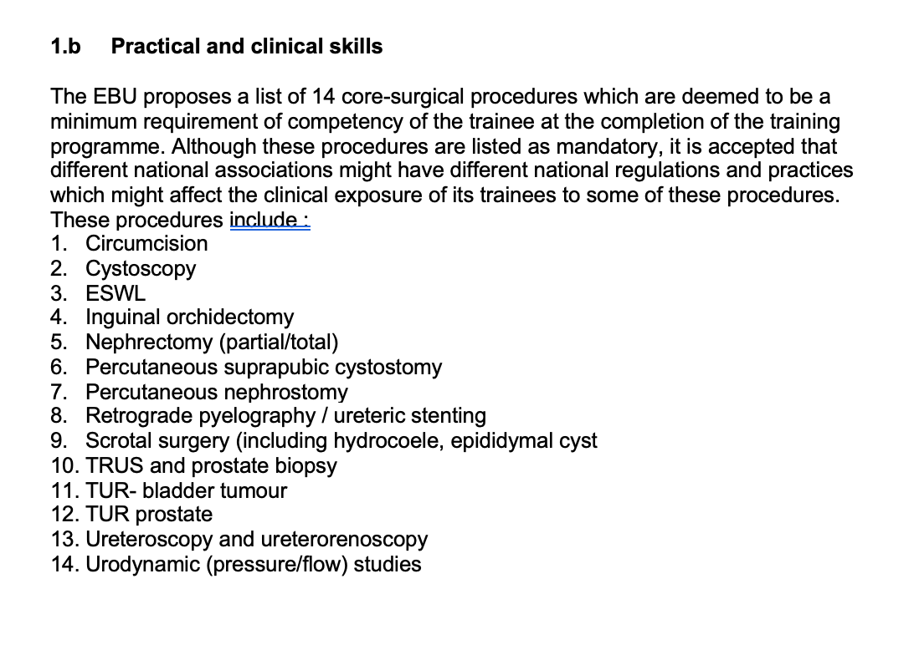
EUROPEAN TRAINING REQUIREMENTS for UROLOGY 2023
https://www.uems.eu/media-and-library/documents/adopted-documents/2026

Slide 15
2024 = big change!!!

Slide 16
EBU written exams
ISA: in-service assessment = formative exam
Written exam = summative exam
Registration: Oxgyen®
Exam delivery: Pearson VUE®
Analysis: Examfolio® + Exammanager®
Next to Oxygen® (office database) 4 different systems

Slide 17
EBU Oral Exam
Oral exam = clinical reasoning exam
Future: OSCE / …
Exam delivery & Analysis: Softwebo®
Content development time-consuming/vulnerable (confidentiality)
1st draft in Word®
2nd draft in PowerPoint®
Final version in PPT
Score sheets & Guides for reviewers
All files shared via Dropbox®
Translations
Recordings
Analysis / scoring: based on separate score sheet and guidelines for reviewers

Slide 18
assessmentQ for
EDUCATION

Slide 19
The most versatile and reliable SaaS platform
for knowledge assessments & trainings that matter.
Online practice (formative)
and
High-stakes exams (summative)

Slide 20
Preparation
Taking the test
Results/reports
Authoring
Scheduling
Login
Taking the test
Monitoring
Grading
Analysis
Reports
Certificate
Items
Assignments/ tests Media Scenarios Metadata
Scheduling
Access codes
Edumail
Offline
LMS/LTI
Login & password
Access codes
SSO with external platforms
(Secure) browser
Live monitoring
(Human) Grading
Pyschometric analysis
Reports
Certificates
Exchange scores with external platforms
E-mail certificate

Slide 21
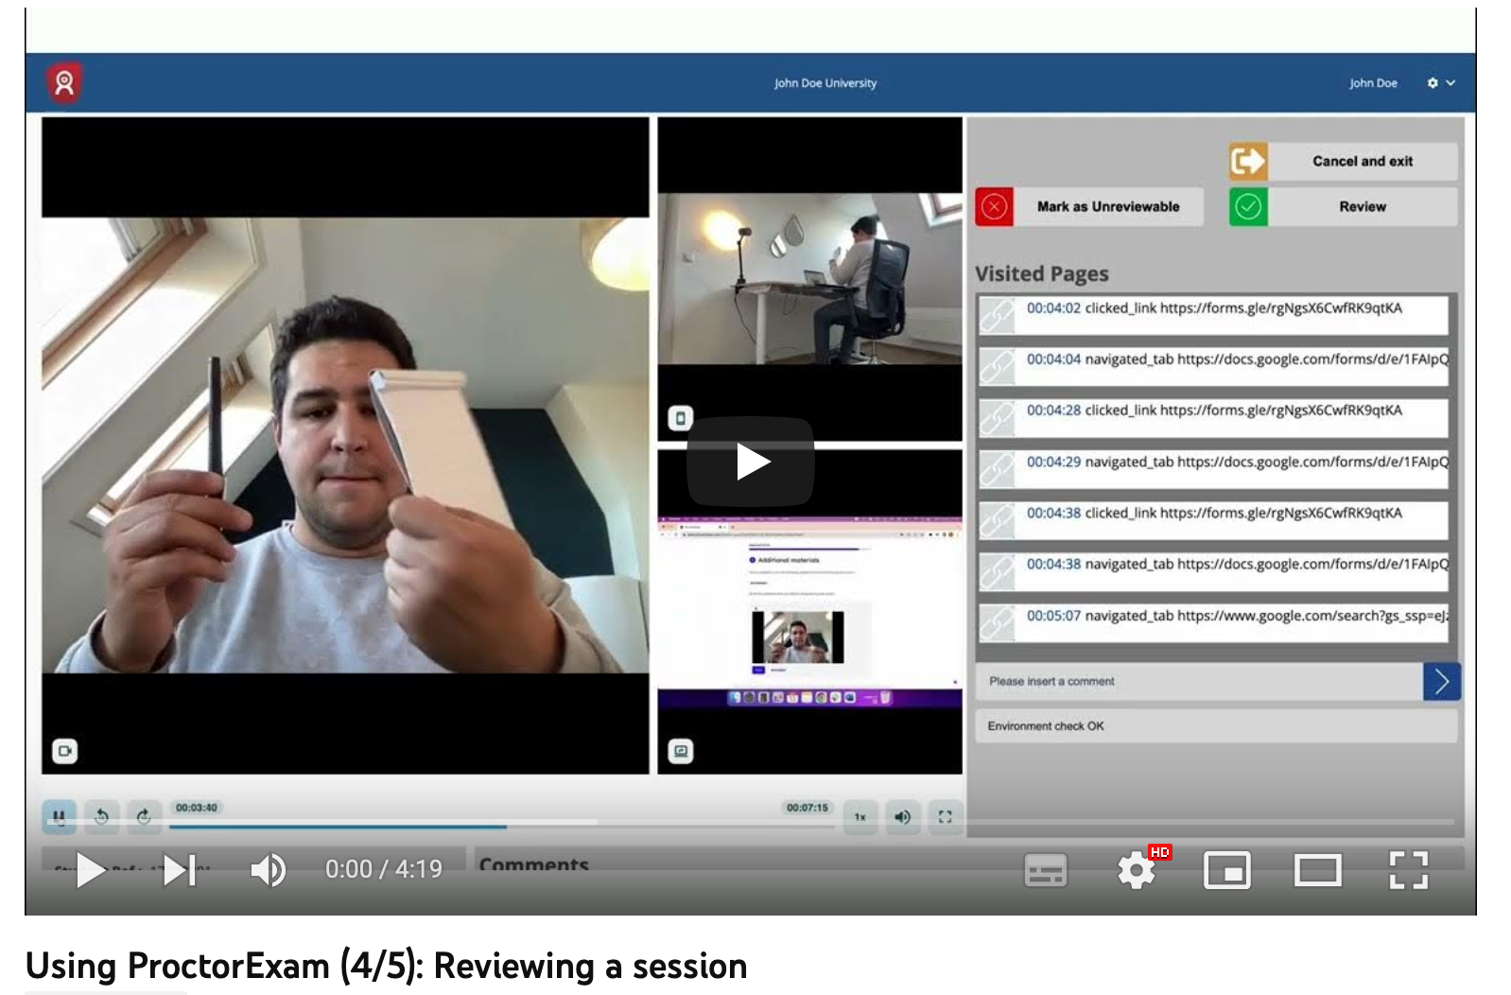
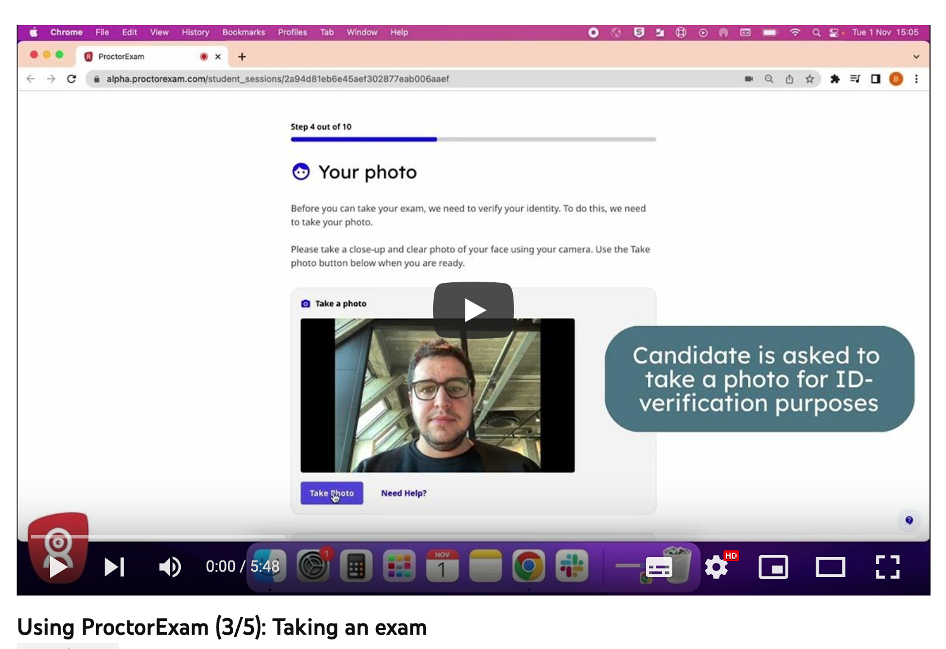
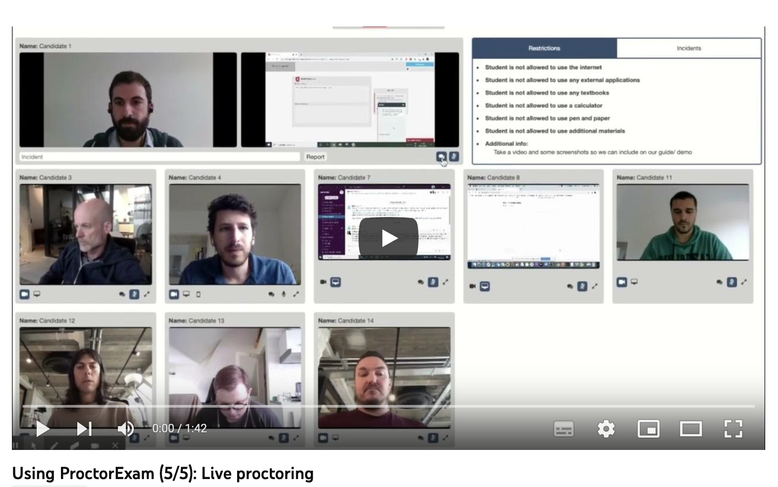
Taking an exam with ProcterExam®
https://www.youtube.com/watch?v=AP49f_qmpyA
https://youtu.be/AP49f_qmpyA

Slide 22
University location + supervision (EBU® approved) Uniformely: everybody = proctered
Warsaw
Berlin
Ankara
Amsterdam
Paris
…

Slide 23
PIOCRE® IPOCRE®
Prerecorded
Interactive
Oral
Clinical
Reasoning
Exam

Slide 24
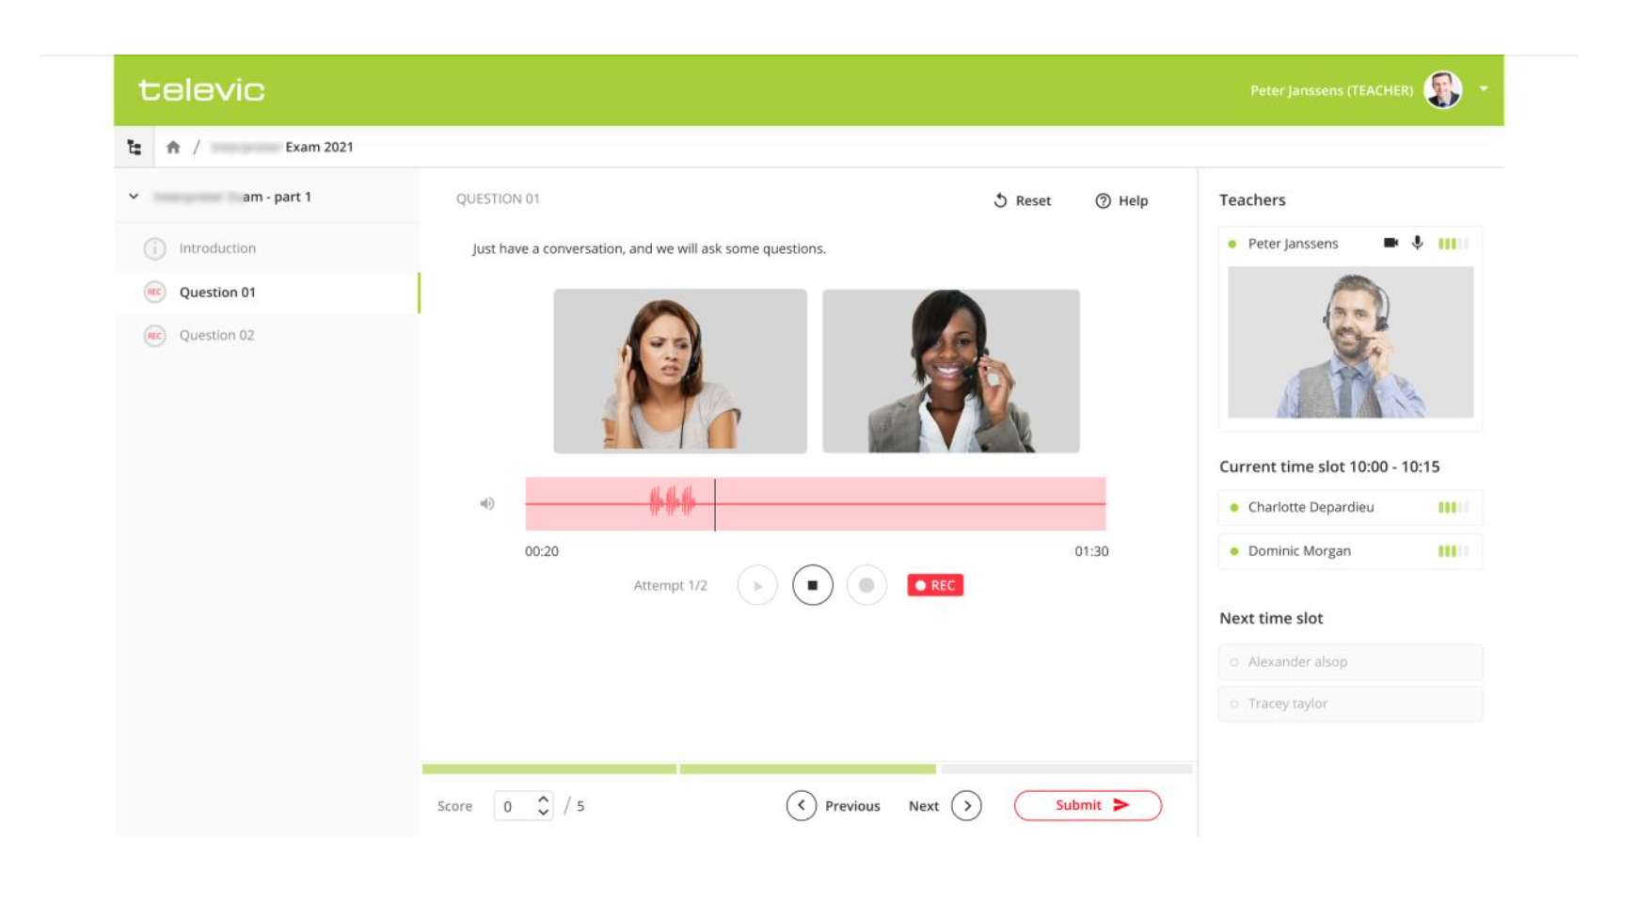
All within 1 application assessmentQ
Live interactive
Offline
EBU oral exam is not an “informal chat”

