Slide 1
Sex Med is Unique
Characteristics of Sex Med:
Bio-Psycho-Social
Holistic & Open
Multidisciplinary
Patient & Couple centered
Evidence-Based
Sex Med is not a recognized specialty
Curriculum, just approved
No defined education
No defined training program
No qualified standard for academic teachers

Slide 2
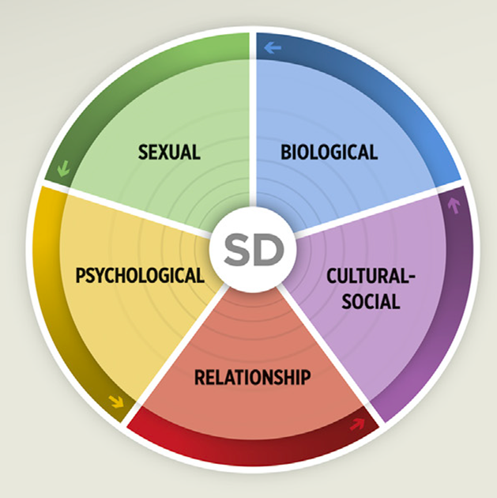
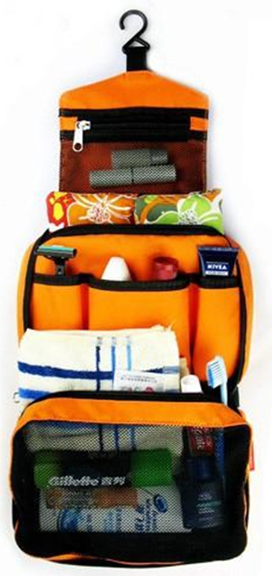
The Journey to Become a Professional in Sex Med ?
Prepare suitcase
Travel links for orientation
Travel Docs
Toiletry bag and Cloths
Devices and Charger
The approach
Patient-centered framework, Evidence-based
Bio-Psycho-Social Model
Clear CV, Diploma, specialization, training and certification
Supervision, InterVision, Multidisciplinary
Network
Hatzichristou D, Kirana PS, Banner L, et al. J Sex Med 2016;13:1166-1182

Slide 3
HOW TO PACK THINGS =
YOUR COMPETENCE
KNOWLEDGE
structured curriculum
SKILLS
structured approach
technical and non-technical skills
PROFESSIONALISM
decision making, communication and leadership
CME/CPD
assessment
KEEP THEM UPDATE
Center/supervisor with accreditation
National and European Education Providers
Training & Intervision UEMS/ESSM/EFS/ ….
Notes:
Structured curriculum including building blocks of theoretical knowledge,
Trainee can gain and demonstrate knowledge through regular formative and summative assessments.
Structured approach to become proficient. Focus on technical and
non-technical skills.
Instructions for real life training and assessment.
Simulation may provide risk-free training and objective
assessment.
Decision making, communication and leadership are core competencies for
”Specialists”.
Continuing Medical Education (CME) and Continuing Professional Development (CPD)
are generally accepted performance metrics for professionalism.
Multidisciplinary team training in realistic environment allows to train and be
assessed by colleagues. Reflection upon outcome, the trainee is likely to improve
behaviour and attitudes.

Slide 4
To Keep Bright Future for Sex Med
Bridges between generations
Collaboration with different societies, institutions and policy makers
Need for structure in:
1. education
2. certification
3. recognition and acceptation
4. formulation of health care
5. EB Sex Med

Slide 5
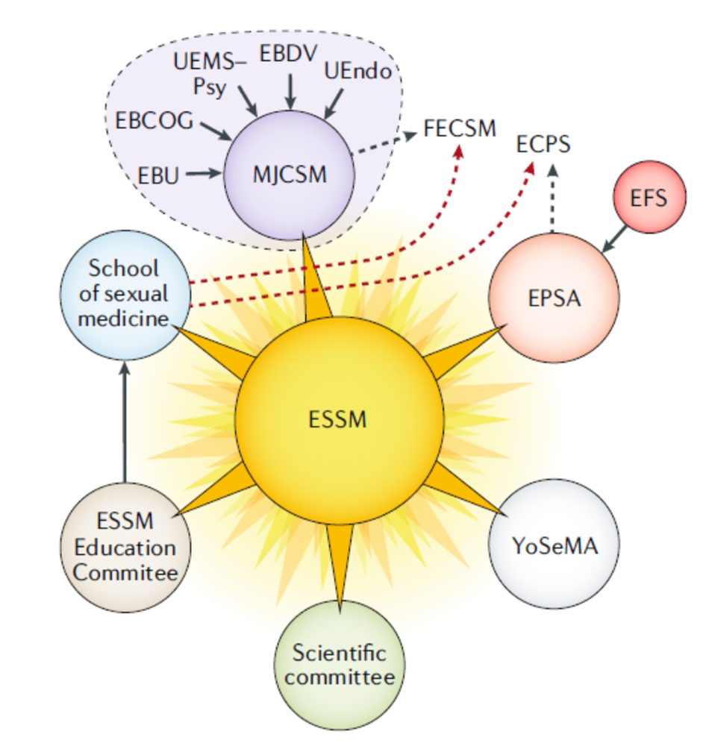
Collaboration with different societies
ISSM
SMSNA MESSM ISSWSH
EFS
WAS
EPATH
ICS
Certification
Certification
E.U.
Academy
Genital Surgery
Industry
Education & Training
Bridges between generations
recognition and acceptation
Awareness
Logos
Science & Grants
EB SexMed
Clinical Statements

Slide 6
What we have
EFS-ESSM
ESSM
MJCSM
Exam Com
Education Com
Exam Com
Curriculum
Supervision
Curriculum
Supervision
Exam
Trainers
Training Accreditation
Curriculum
Education/Training
Professional societies (Gyn, Uro, Psy, Endo)
National education
Trainers
Training Accreditation
Curriculum
Exam

Slide 7
Which Organizations are involved
European Regulation Authorities
Union Européenne des Médecins Spécialistes
MJCSM
European Scientific Societies
ESSM: a medical society; holistic, biomedical emphasis
EFS: a psychotherapists’ society; holistic, sexological emphasis
Both provide a forum for professional collaboration
Shape standards of practice
Facilitate research
Facilitate CME
National Scientific Societies
National authorities
Assessment
Education/training

Slide 8
Ege Can Serefoglu, MD, PhD
Dept. of Urology, Biruni University, Istanbul, Turkey

Slide 9
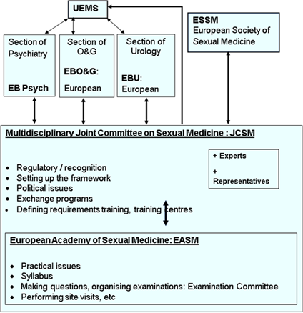
MJCSM
Overarching structure
Approval of the UEMS on 15-10-2011.
All relevant boards presented
EBU, EBPsy, EBCOG, Venereology and Endocrinology Each board 2 members.
ESSM: 5 members, one trainee
Main aim of the group is to work on the creation of a curriculum, qualification, assessment and CME

Slide 10
Progress in Europe
2010
2012
2015
UEMS Creation of a Multidisciplinary Joint Committee in Sexual Medicine (MJCSM)
Boards of Urology, O&G, Psychiatry, Endocrinology, Dermatology & ESSM
First examination in Sexual Medicine in Amsterdam
Creation of a curriculum in Sexual Medicine
Criteria for and recognition of centers of excellence in training in sexual medicine

Slide 11
MJCSM exam - FECSM
Examination in Sexual Medicine
MD with specialization or GP for 5yr practice
EU and Non-EU
CV with description of his/her educational and clinical experience in the field
All applicants should deliver authenticated proofs of their qualifications.
2 letters of recommendation
Interview of each candidate with members of the exam committee including case discussion
“Fellow of European Committee of Sexual Medicine (FECSM)”.
WWW.MJCSM.ORG

Slide 12
Examination in Sexual Medicine
The last exam was in April 2023
95 candidates from all over the world. Success percentage was 88%
Since 2023: The exam include case scenarios and taking place online (Orzone)

Slide 13
Examination in Sexual Medicine
The Council for European Specialists Medical Assessment (CESMA)
An advisory body of the UEMS created in 2007 with an aim to provide recommendation and advice on the organisation of European examinations for medical specialists at the European level.
In 2020 the MJCSM exams have been accredited by the CESMA after review of documents, website and during the exam

Slide 14
The curriculum of Sexual Medicine
The MJCSM created a curriculum based on competence levels (2015)
The curriculum has been reviewed by relevant board and approved by the UEMS on level of European Standards in Medical Training (ETR) in 2020
MJCSM curriculum is the only available and approved postgraduate curriculum in sexual medicine

Slide 15
Training Centre Accreditation
Sexual Medicine Training Center Accreditation
A Training Program in Sexual Medicine must provide a balanced education in the knowledge, skill, attitudes and behaviours required for the practice of modern Sexual Medicine
At the end of the training period and the assessment, trainees will be qualified to provide high quality care to sexual medicine patients
The training program should provide exposure to the whole breadth of sexual medicine
The minimum duration of Sexual Medicine training is 18 months

Slide 16
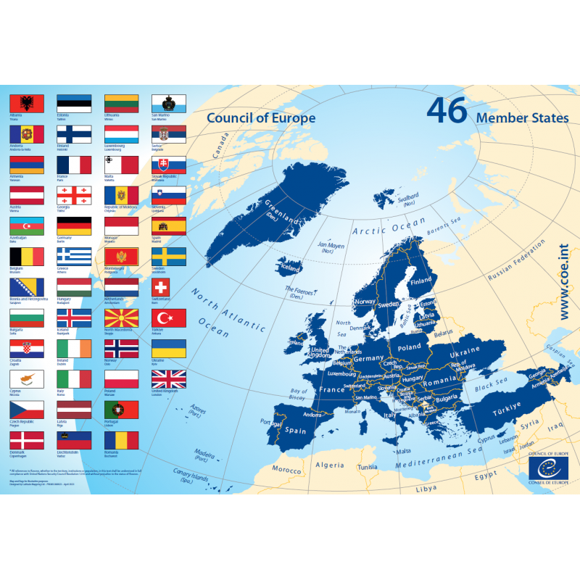
Sexual Medicine Training Center Accreditation

Slide 17
THANK YOU…

