Slide 1
Board Meeting October 7th, 2023
Prof. dr. Jeroen van Moorselaar
President
U N I O N E U R O P É E N N E D E S M É D E C I N S S P É C I A L I S T E S ( U . E . M . S . )

Slide 2
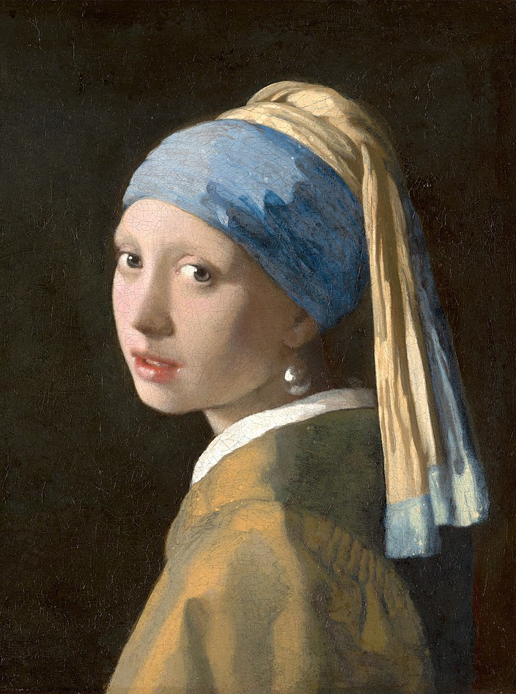
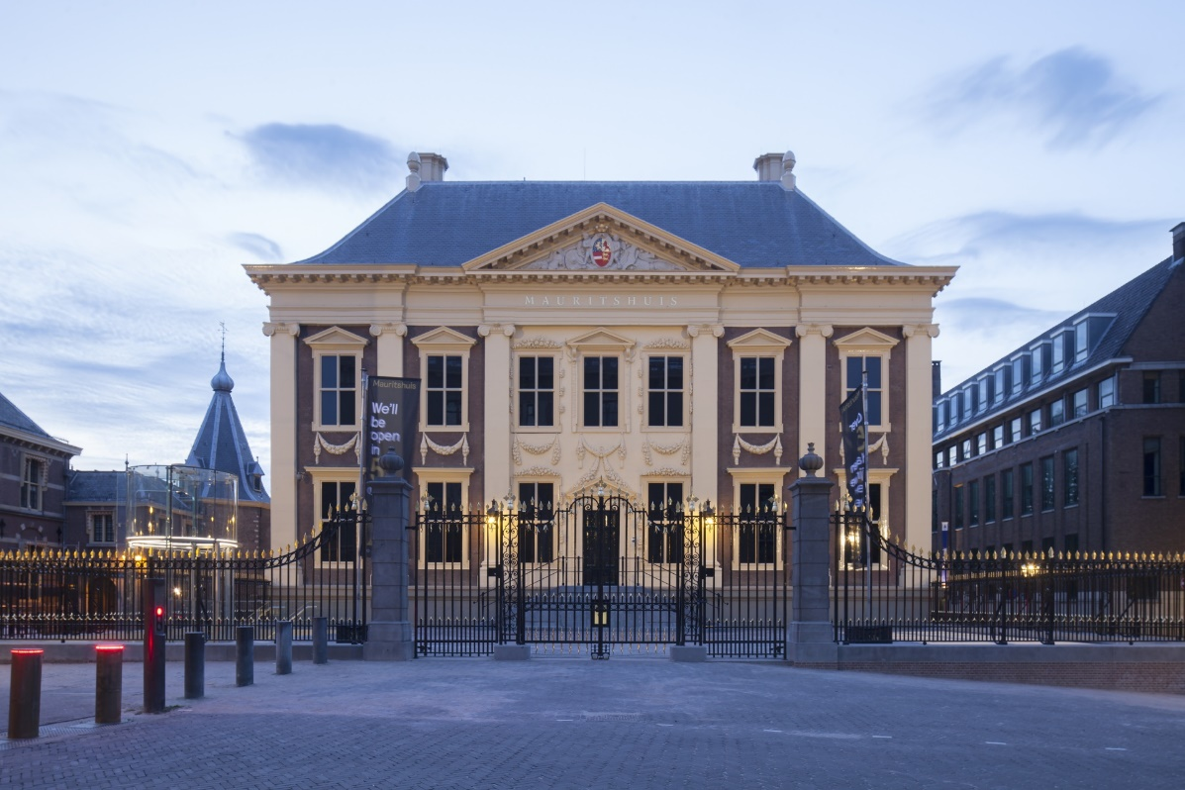

Slide 3
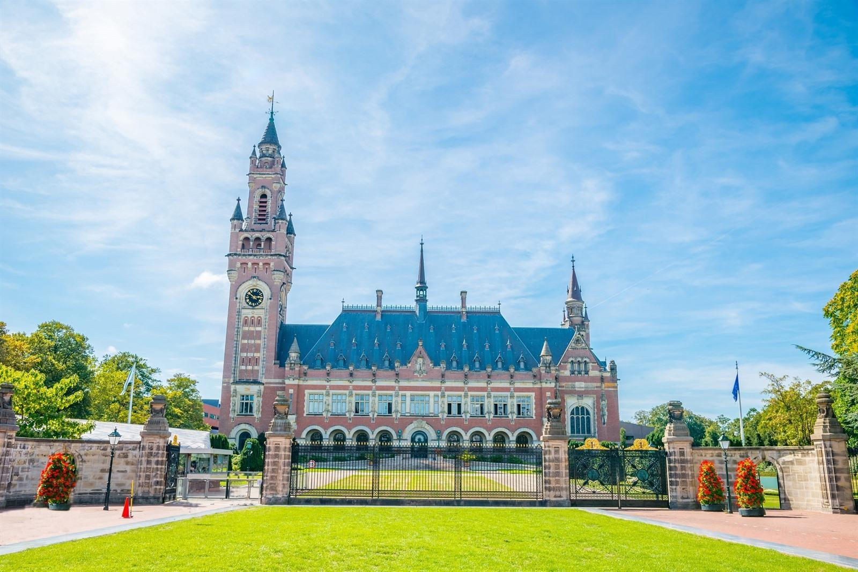

Slide 4


Slide 5
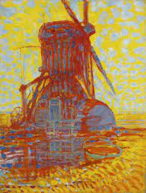
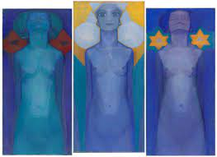
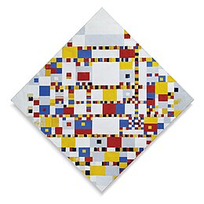
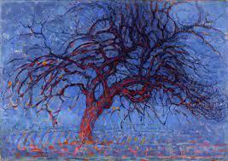
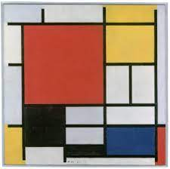

Slide 6
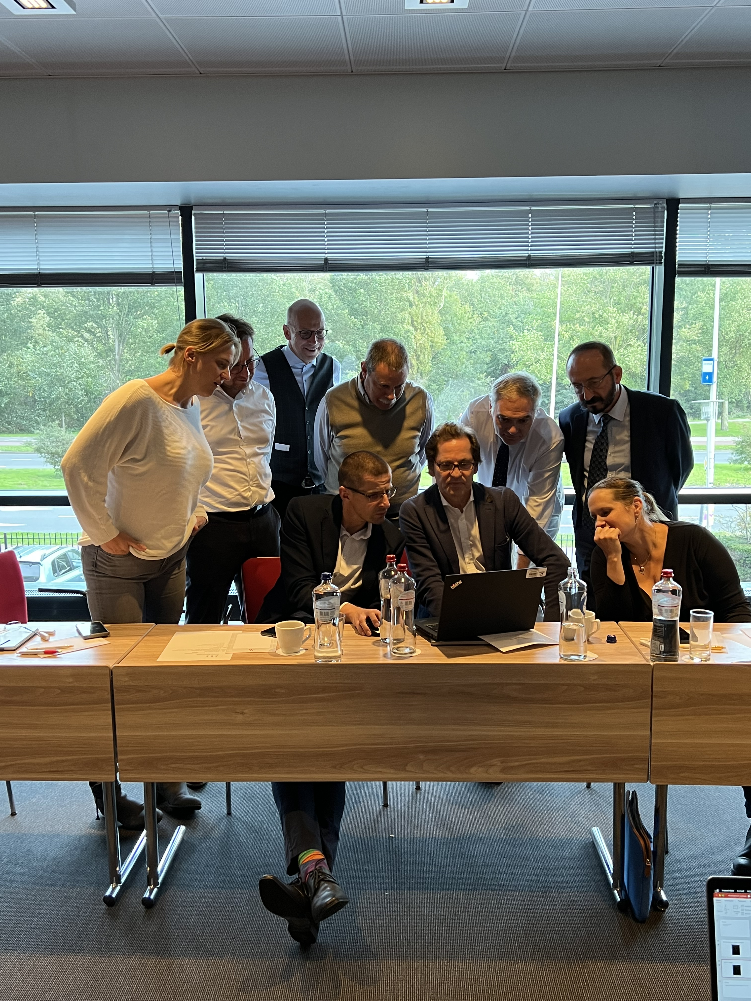
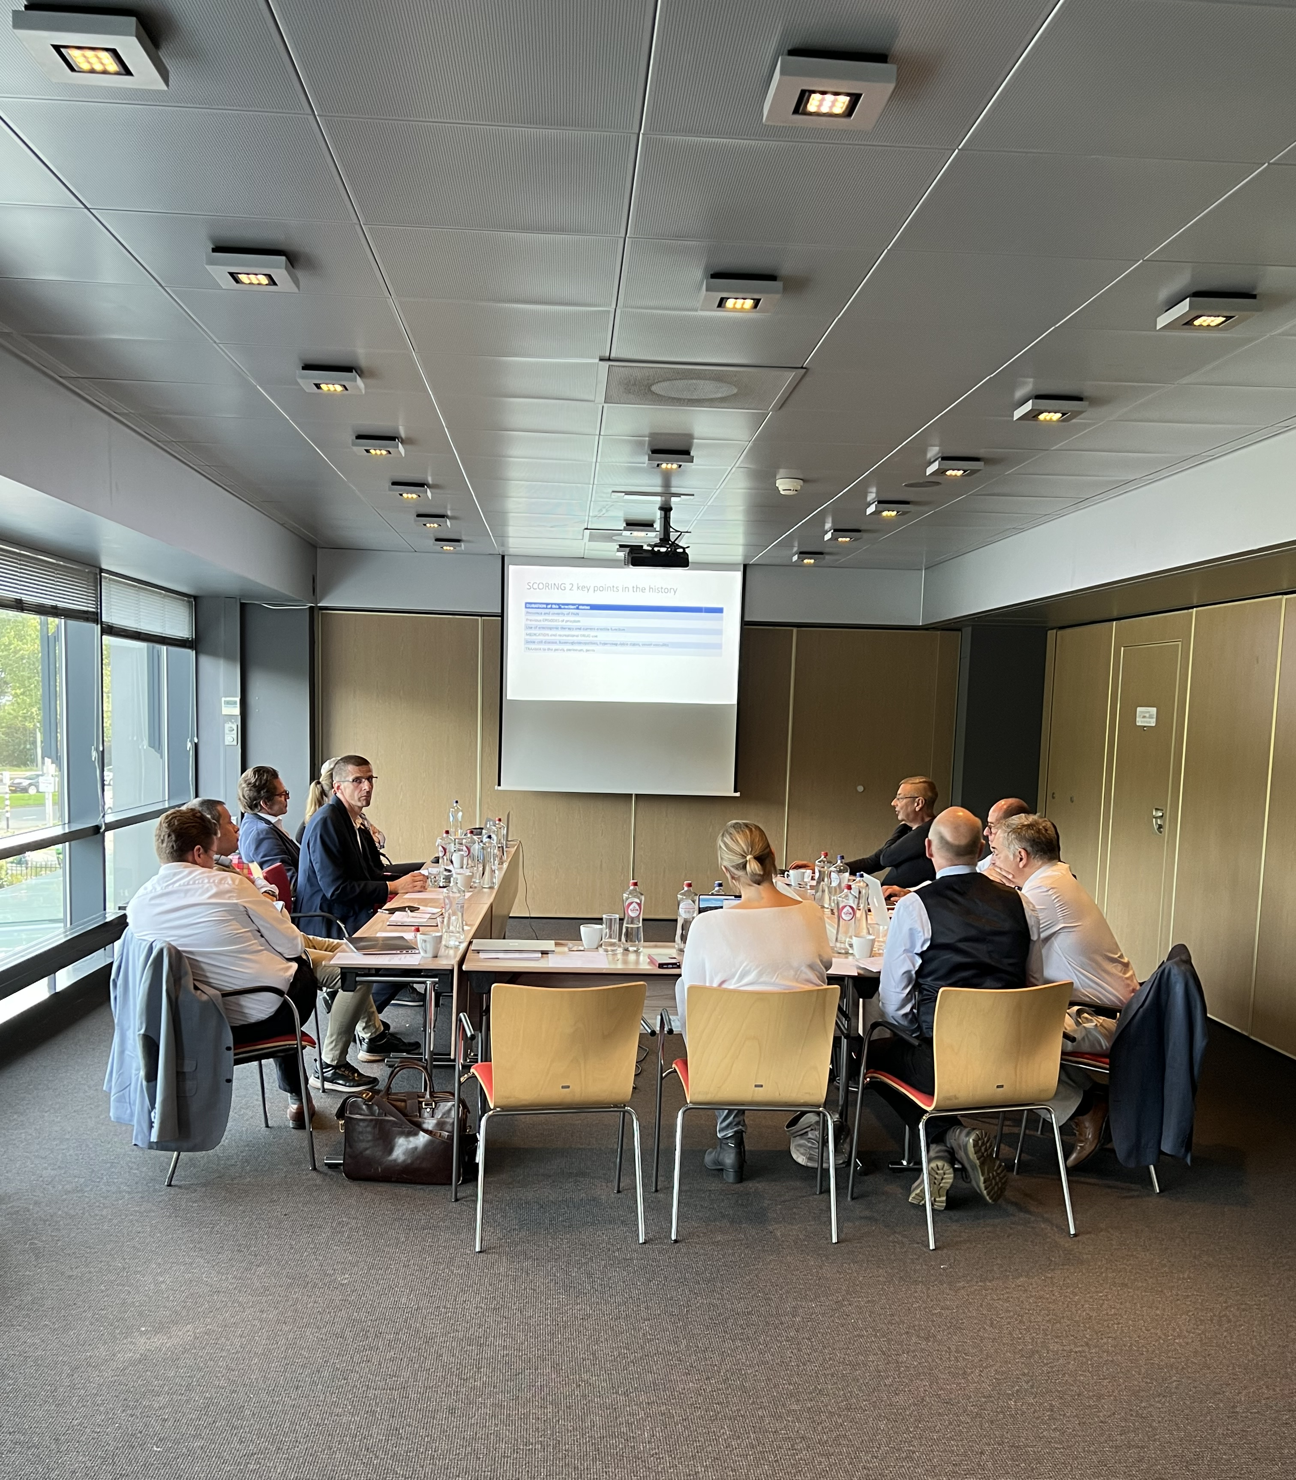

Slide 7
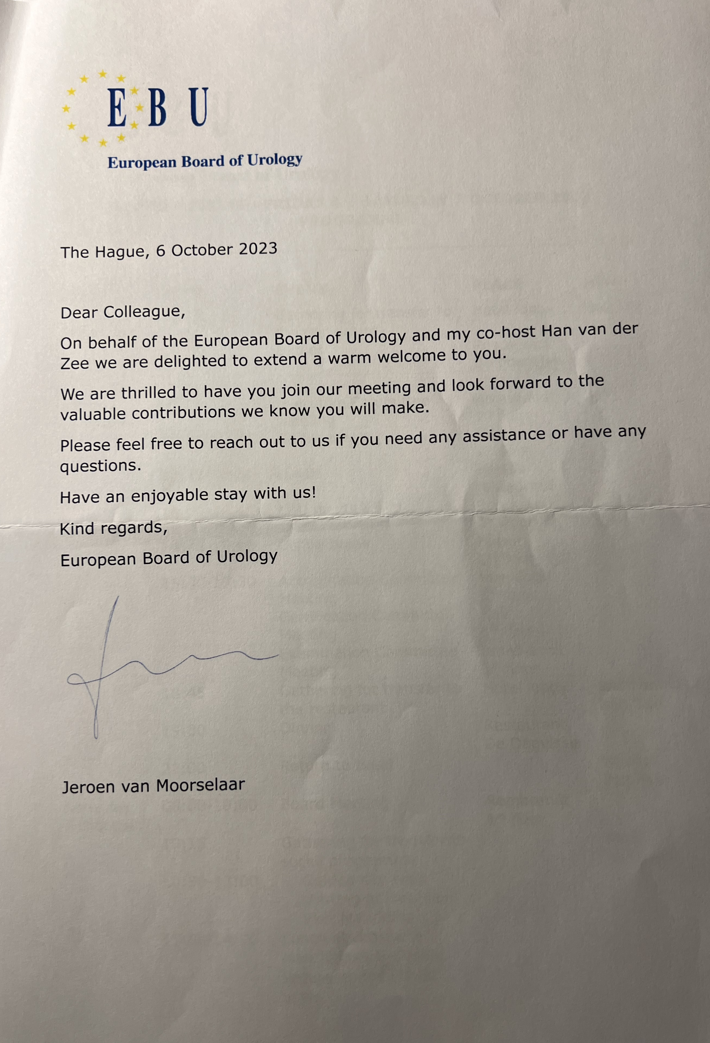

Slide 9
Statutes EBU April 12th, 2002

Slide 10
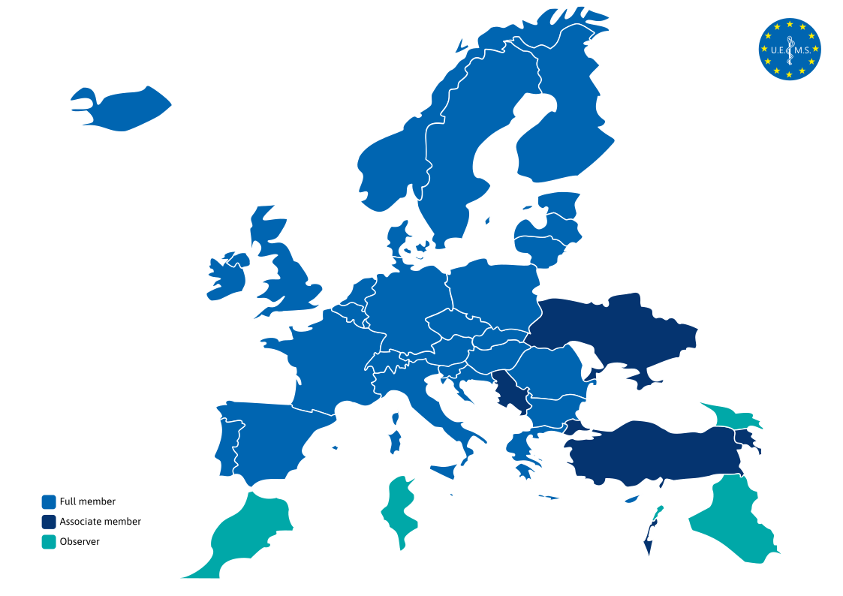

Slide 11
FEBU
FEBU is a mark of quality, we should keep the quality!
Revalidation of new FEBU every 5 year
At least 40 CME points per year (?)
We can use EU-ACME registration
Website with list of FEBUs

Slide 12
Wilma, Sigrid and Guy:
Thank you very much for organising our meeting!!

