Slide 1
Let’s make a mark: for today & tomorrow, together. By setting a standard for high-quality urologic patient care in Europe.

Slide 2
History
Founded in 1985, the EBU is part of a larger network: the European Union of Medical Specialists (UEMS)
The UEMS is a European non-profit organisation whose mission is to achieve the delivery of high-quality patient care by promoting and harmonising standards for medical practice and postgraduate education in various medical specialties.
At present, UEMS represents more than 1.6 million specialist doctors, from all EU countries and beyond.

Slide 3
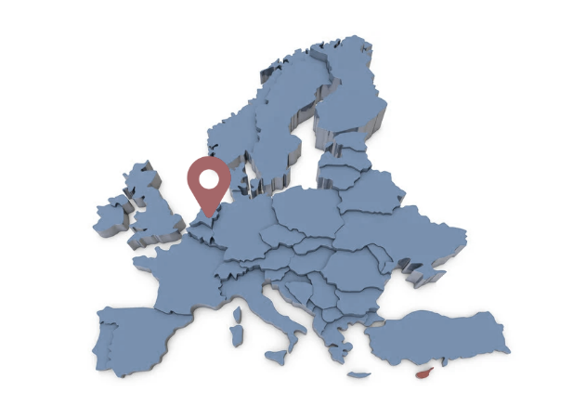
European Board of Urology
As a regulatory body the EBU plays a crucial role in standardising, evaluating, and promoting the quality of urological education and practice across Europe.
Based in Arnhem, Netherlands, the EBU works as an independent organisation, implementing the UEMS primary goals and vision in urology.
We closely collaborate with the European Association of Urology (EAU) and National Urological Societies, uniting urology specialists across Europe.

Slide 4
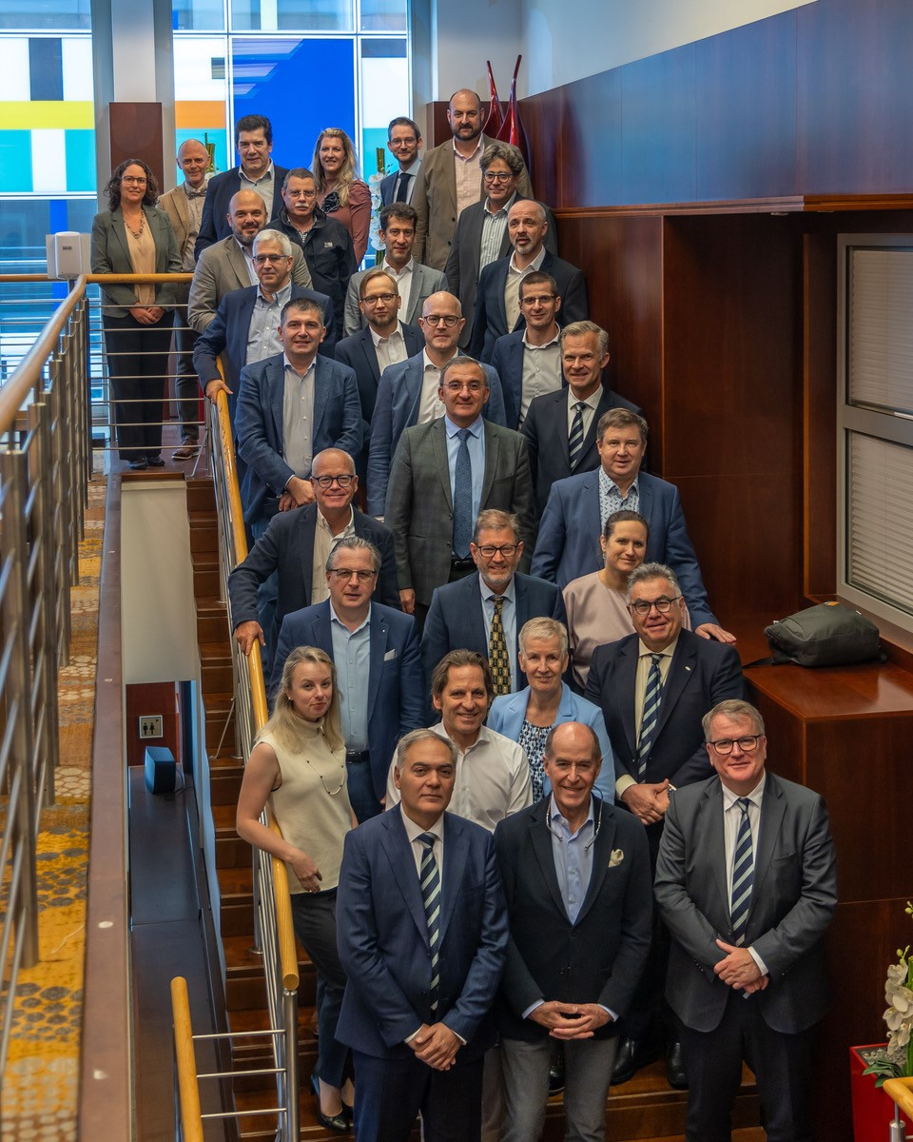
Who we are
Our mission is to stimulate
continuous improvement of standards in urological
education, training and
professional development in
Europe.
Our board consists of 60
members from 30 EBU-member
countries whose efforts are
distributed across
three specialised Committees.

Slide 5
Core business
Accreditation
Committee
Evaluate of CME/CPD activities
Certification
Committee
Review Residency Training Programmes RTPU
Examination
Committee
Organise Formative & Summative exams
Define European Training Requirements
Award the title Fellow of the EBU, FEBU
Evaluate Post-graduate training programmes

Slide 6
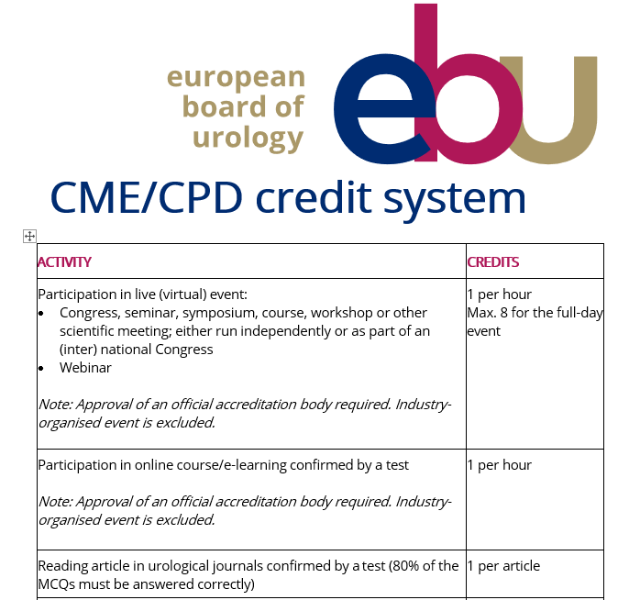
Accreditation Committee
Active engagement in Continuous Medical Education (CME) is required to provide the highest possible level of patient care, advance one’s career, and maintain one’s medical license.
For a CME program to be viable in meeting licensing and credentialing requirements, the programme must be accredited.

Slide 7
European Training Requirements
The ETR set out the knowledge, skills, and competencies that a urologist must acquire during their training to practice independently and safely.
The ETR plays a crucial role in promoting excellence in urological education and practice.
Download your copy from our website www.ebu.com

Slide 8
Certification Committee
Our certification programmes aim to ensure and improve the quality of graduate and post-graduate urological education in Europe.
Residents trained at an EBU-certified centre can benefit from a reduced fee in the In-Service Assessment and FEBU Written Exam
RTPU
EUSP
Joint EAU-EBU programme for training centres hosting European Urological Scholarship Programmes
Objective evaluation that provides recommendations for further improvement and development of urological training

Slide 9
Examination Committee
The committee’s core purpose is to set high standards, ensure consistency in urological knowledge, and promote excellence in patient care across Europe
“Training is not complete until an assessment has been conducted.”

Slide 10
Examinations
Formative assessments provide ongoing support and guidance during the learning journey, while summative assessments offer a snapshot of student achievement and overall progress
FORMATIVE
In-Service Assessment
SUMMATIVE
FEBU (Int) exams

Slide 11
In-Service Assessment
Comprehensive knowledge
A powerful learning tool
After the assessment candidates get access to their test result & feedback
Flexibility & accessibility
Open to trainees & residents worldwide
Available 24 hrs during 5 days
Affordable excellence
Gain expert insights at a minimal cost
Awarded 10 CME credits

Slide 12
FEBU (International) Exams
FEBU
Open to urologists trained & certified in Europe
FEBU International
Open to urologists trained & certified outside of Europe
Participation is subject to eligibility

Slide 13
FEBU (Int) exams
Part 1: Written Exam
A closed-book, multiple-choice, online proctored exam
Part 2: Oral Exam
Case-based, onsite exam using pre-recorded materials
Each candidate is independently evaluated by at least two examiners
We use cohort-based standard setting; the cut-off score is determined based on the average score and standard deviation
Awarded 20 CME credits
Eligible for 30 CME credits

Slide 14
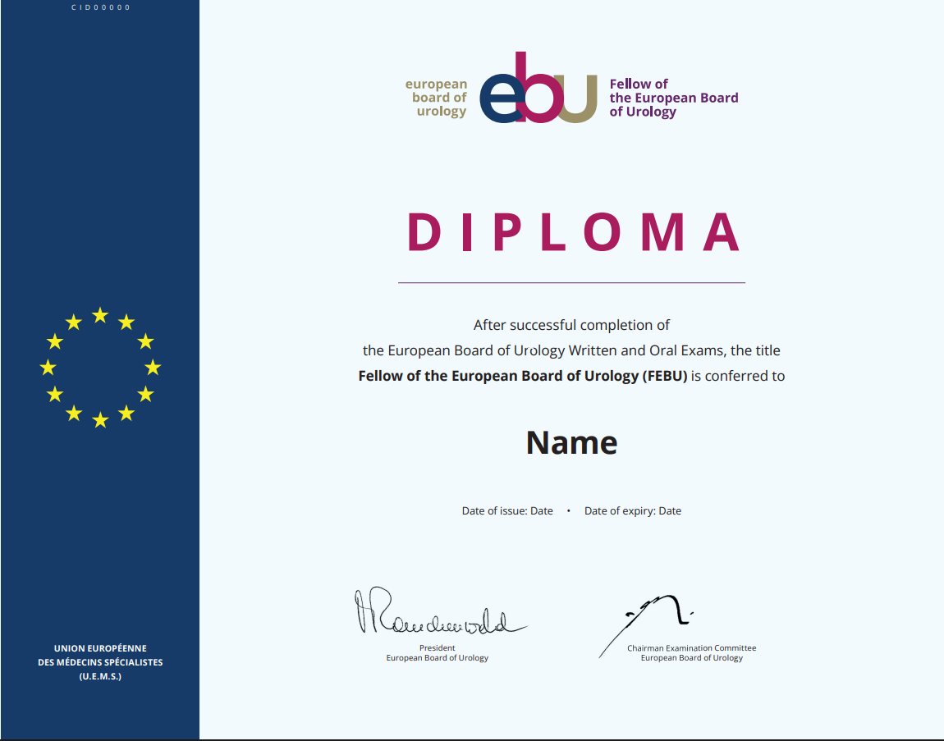
FEBU Diploma & Revalidation
Successful candidates are granted the prestigious title and diploma Fellow of the EBU, FEBU (Int)
Starting in 2025, the FEBU title will be valid for five years and is subject to revalidation
The revalidation process is
based on Lifelong Learning and
the accumulation of CME
credits (200 in 5 years).

Slide 15
Lifelong Learning
It is all about quality and intends to:
Serve the mission of EBU
Ensure that our knowledge remains current & relevant
Provide a self-learning and assessment tool
Keep the recording of CME system functional & practical for everyone
Provide more CME activity
Keep a strong support for the European urologists if they are involved in malpractice.

Slide 16
Connect with us
Website: www.ebu.com
Email: ebu@ebu.com
Follow us on social media

