Slide 1



Accreditation Committee
Prof. Archil Chkhotua - Chairman
Board Meeting 9-10 May 2025
Cork, Ireland

Slide 2
Agenda
EBU ETR Urology
CME/CPD Credit system
Subspecialty certification

Slide 3

European Training Requirements
The ETR set out the knowledge, skills, and competencies that a urologist must acquire during their training to practice independently and safely.
The ETR plays a crucial role in promoting excellence in urological education and practice.
Download your copy from our website www.ebu.com

Slide 4
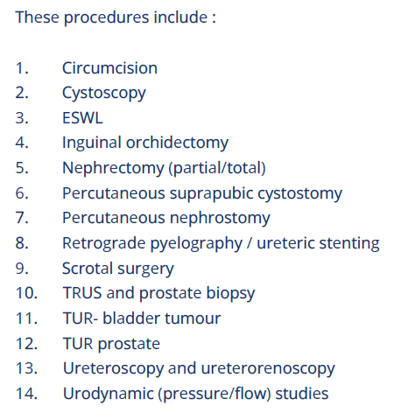
Comprehensive document
64-page document:
  Training requirements for trainees
  Training requirements for trainers
  Training requirements for institutions
Graded knowledge-based sections
Reviewed and approved
by the Examination Committee
Approved by the UEMS and
published on their website

Slide 5
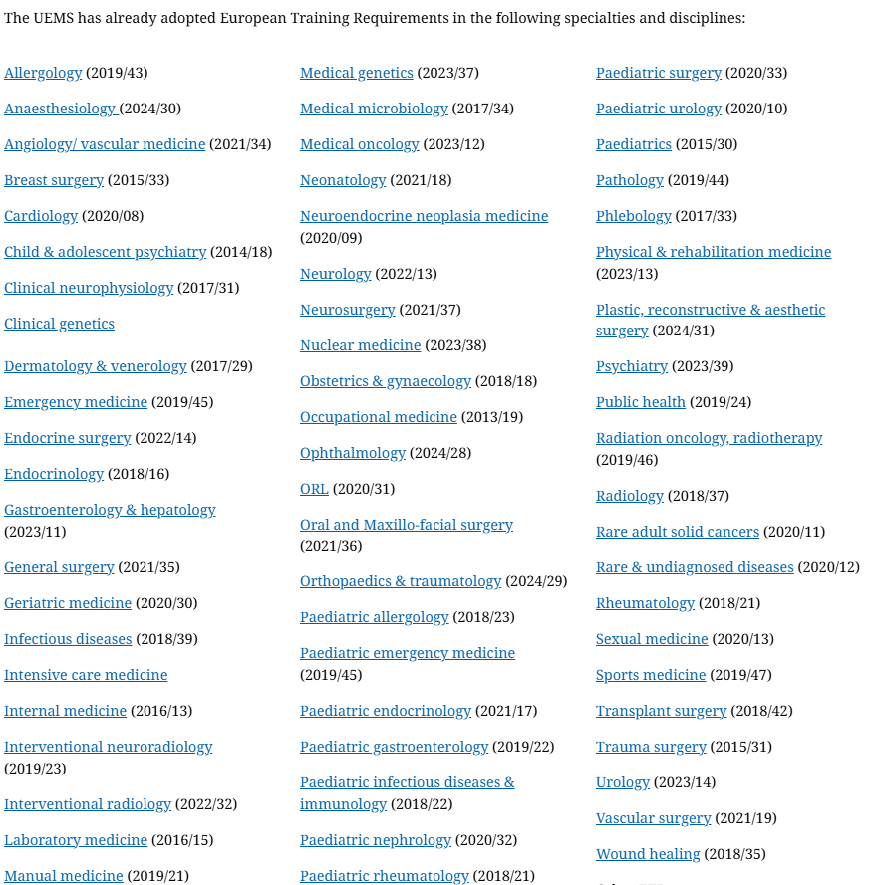
UEMS adopted ETRs

Slide 6
Endorsement
Endorsement by the national associations
Recognized as an important source of clinician guidance for training of urology residents in the member states
Endorsement will imply support or general approval of its content, acknowledging its value and quality
If the national guidelines exist, this document will not, and shouldn’t replace, but support and supplement it

Slide 7
Endorsement
EBU ETR Urology is considered for:
  UEMS member states (full + associate) only
Who should do it:
  EBU: 29 member countries, full and associated UEMS members only
  UEMS: 37 member states (full + associate), 43 Specialist Sections (including urology)
How to do it
  Role of national associations

Slide 8
Endorsement
Ask EBU member national associations to endorse it
Ask UEMS to promote it through the medical societies of member states
National associations should decide:
  Translation
  Adaptation
  implementation
EBU will not contact the national authorities to incorporate it in the national programme

Slide 9
CME/CPD Credit System
?
?
Notes:
9

Slide 10
Accreditation of scientific events

Slide 11
Subspecialty certification
Oncourology
Urolithiasis
Female urology
Andrology
Reconstructive urology
Transplantation urology
Neurourology
Office urology
Male functional urology

Slide 12
What to check
Knowledge
Practical skills
Scientific and educational activity
The practice is at least 75% (majority) devoted to particular subspecialty
Not only FEBU title holders
In 1-2 subspecialties
Minimum time from certification 5 years
Valid for 5 years
Subject to re-certification

Slide 13
Application process
Necessary documents
Defining criteria for:
  Knowledge
  Practical skills
  Scientific/educational activity
Processing fees
Online submission – Screening of the submitted documents - Review - Approval or refusal of application - Review of the approved applications - Issue of the Certificate
The certificate
FEBU – Re-FEBU - SC

Slide 14
FEBU
Re-FEBU
SC

