Slide 1
Board Meeting 10 May 2025
Certification Committee
Magne Dimmen
Chair

Slide 2
Certification Committee
Mia Madsen Denmark
Mihhail Žarkovski Estonia
Timo Nykopp Finland
Julien Branchereau France New member
Ioannis Varkarakis Greece
Francesco Esperto Italy
Juris Jansons Latvia
Arunas Želvys Lithuania
Michał Piotr Soczawa Poland
Pedro Coelho Nunes Portugal
Christian Mirvald Romania
Jure Bizjak Slovenia
Uroš Kacjan Slovenia
Philipp Baumeister Switzerland
Alexander Müller Switzerland
Han van der Zee The Netherlands Vice Chair
Magne Dimmen Norway Chair

Slide 3
RTPU application form
Decision to simplify the application taken at the board meeting in October 2024
Task force
E-mail exchange
Online meeting 15 April 2025
Draft new application form approved
Implementation autumn 2025
Online review

Slide 4
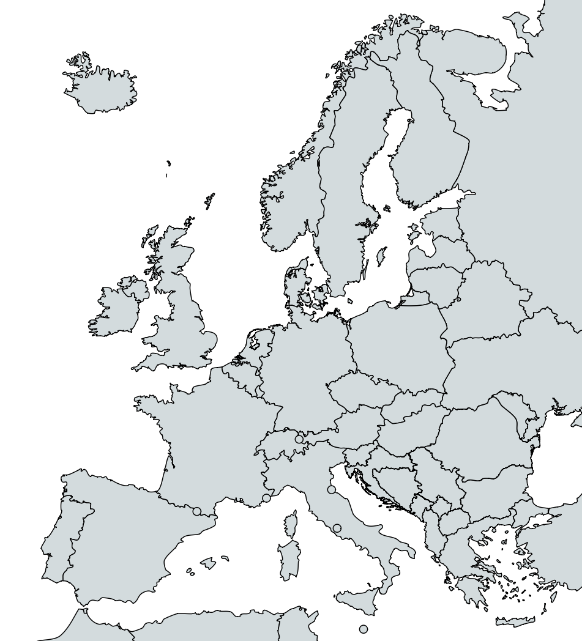
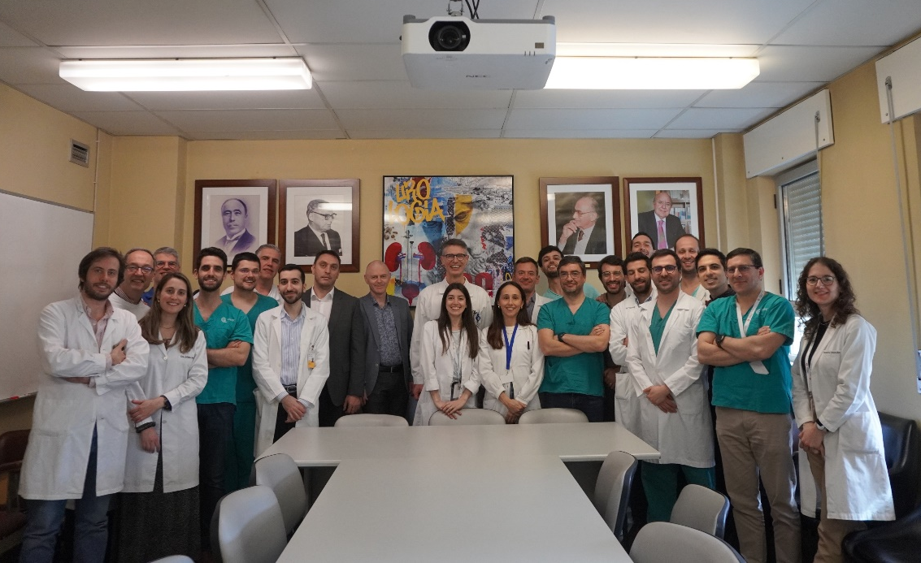
RTPU Certifications
11 site visits performed
3 first certifications

Slide 5
RTPU Applications
7 applications
all re-certifications

Slide 6
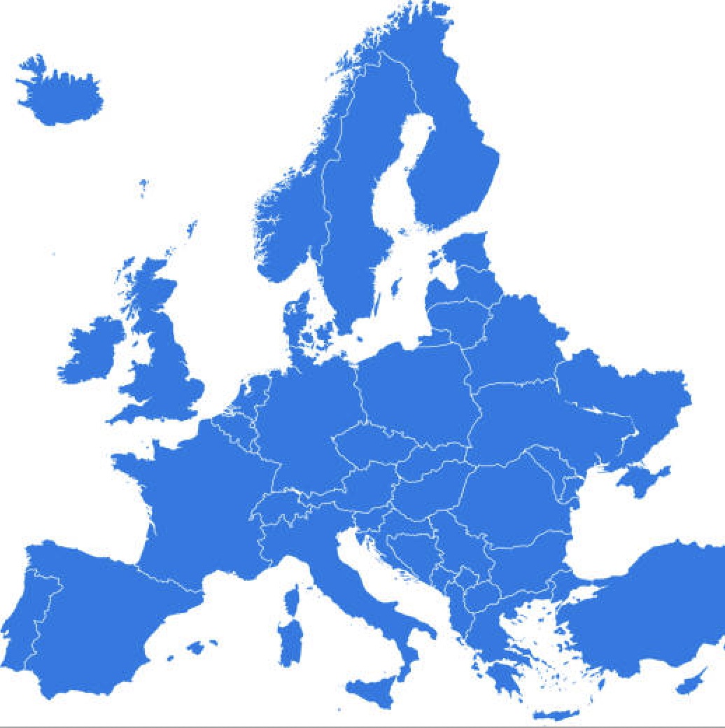
RTPUs
1
68 certified centers
21 countries
2
1
0
1
1
2
7
4
13
1
3
8
1
1
1
1
1
7
10
1
1

Slide 7
EUSP Host Center certification
7 new applications evaluated since the last meeting
All applications reviewed by
- M. Babjuk (EAU)
- M. Dimmen (EBU)
All applications approved for 5 years

Slide 8
EUSP Host centre 65 programmes 32 centres 13 countries
1
1
4
2
4
2
1
1
https://certifications.ebu.com/certified-host-centres
6
5
1
3
1
1

Slide 9
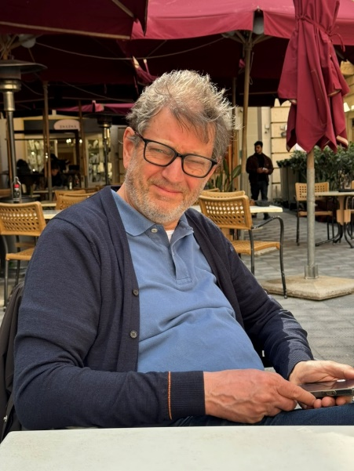
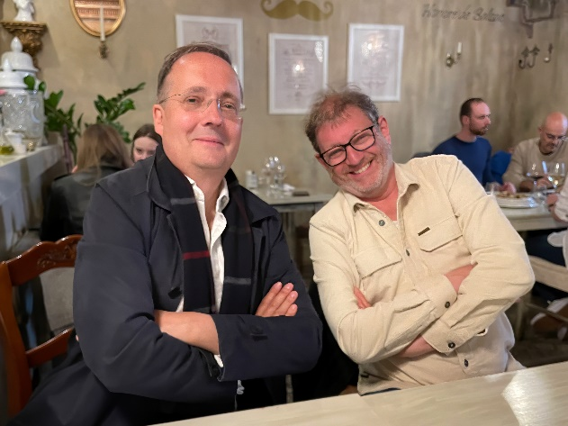
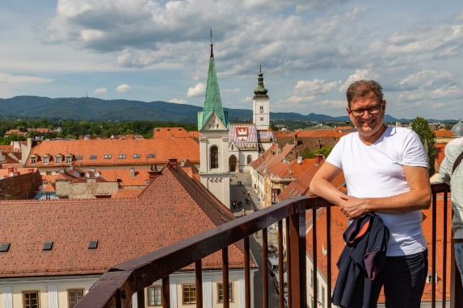
Departing member
Han van der Zee
Member since 2011
Vice chair since 2019
33 site visits performed
Expert member 2025-2027

Slide 10
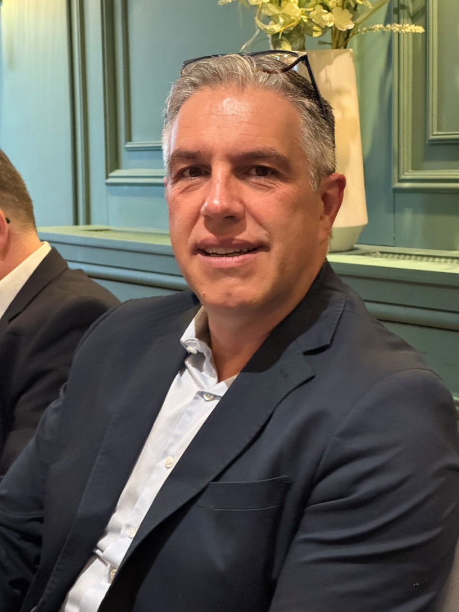
New vice chair
Pedro Coelho Nunes

