Slide 1
Examination Committee
Prof. Dr. Serdar Tekgül - Chairman
Board Meeting 9-10 May 2025 Cork, Ireland

Slide 2
Examination Committee
The committee’s core purpose is to set high standards, ensure consistency in urological knowledge, and promote excellence in patient care across Europe
“Training is not complete until an assessment has been conducted.”

Slide 3
Training Environment in Urology
Training hospitals/institutions
Clinics/Wards/OR
Faculty / consultants
Residency training program
(curriculum/surgical training)
accreditation
certification
In-Service Assessment
Trainees
Written Exam
Oral Exam

Slide 4
Examinations
Formative assessments provide ongoing support and guidance during the learning journey, while summative assessments offer a snapshot of student achievement and overall progress
FORMATIVE
In-Service Assessment
SUMMATIVE
FEBU (Int) exams

Slide 5
In-Service Assessment
Comprehensive knowledge
A powerful learning tool
After the assessment candidates get access to their test result & feedback
Flexibility & accessibility
Open to trainees & residents worldwide
Available 24 hrs during 5 days
Affordable excellence
Gain expert insights at a minimal cost
Awarded 10 CME credits

Slide 6
In-Service Assessment
100 single correct answer MCQ on the entire range of urological topics
Not a necessarily preparation exam; an interim assessment during training which helps
Candidate to compare and learn
Programme Director to monitor progress
Since 2021 offered as a Learning Tool
Candidate is given access to the MCQs with detailed validation comments for educational purposes
Available for 5 days (Monday to Friday)
Ongoing Project : Improve the content and make it available as a Lifelong Learning tool

Slide 7
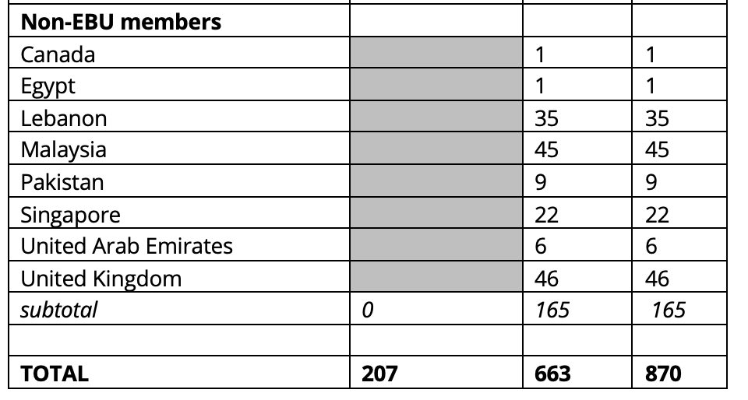
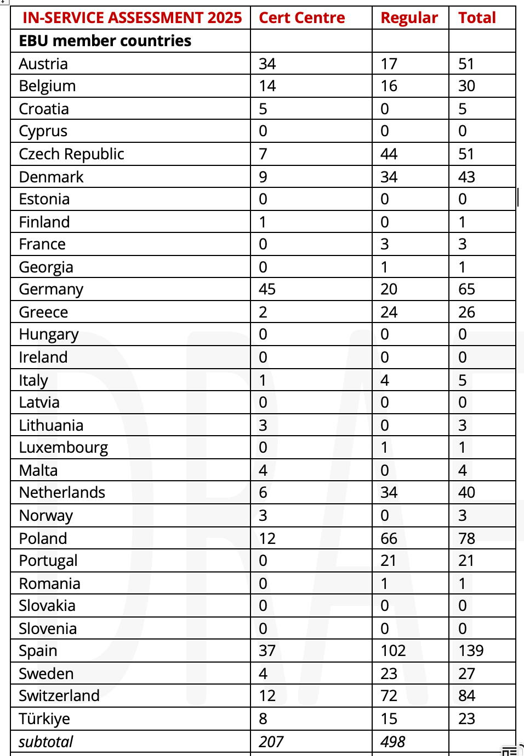
In-Service Assessment 2025-Statistics

Slide 8
FEBU examinations
Part 1 Written Exam
Part 2 Oral Exam
U N I O N E U R O P É E N N E D E S M É D E C I N S S P É C I A L I S T E S ( U . E . M . S . )

Slide 9
FEBU (Int) exams
Part 1: Written Exam
A closed-book, multiple-choice, online proctored exam
Part 2: Oral Exam
Case-based, onsite exam using pre-recorded materials
Each candidate is independently evaluated by at least two examiners
We use cohort-based standard setting; the cut-off score is determined based on the average score and standard deviation
Awarded 20 CME credits
Eligible for 30 CME credits
Organised exclusively with a national society

Slide 10
FEBU exams
Introduced for European urologists in 1992
7.576 FEBUs worldwide in 2025
The title Fellow of the EBU, FEBU, is well-established and recognised as a mark of quality

Slide 12
Our role
There are many ways of Urology Certification in Europe.
Standardisation across Europe is almost impossible while there is so much heterogenicity.
The EBU aims to develop standards that are both acceptable and applicable to all parties involved

Slide 13
Part 1 Written Exam
Web-based exam administered through online invigilation
110 single correct answer MCQs covering all aspects of urology
5 languages: English, German, Hungarian, Turkish and Polish
Based on the EU-ACME programme participation qualifies for 20 credits
Next exam is held Thursday 13 November 2025

Slide 14
Scoring Written Exam
Cohort-based standard setting
Cesura based on the average score of the group and standard deviation
No negative marking
U N I O N E U R O P É E N N E D E S M É D E C I N S S P É C I A L I S T E S ( U . E . M . S . )

Slide 15
Written Exam-Statistics
571
514

Slide 16
Part 2 Oral Exam
Pre-recorded exam taken on a laptop
Candidates are presented 4 clinical cases presented in a timeframe of about 60 minutes
Candidates are being evaluated independently by a minimum of 2 reviewers
Reviewers have no conflict of interest with the assigned candidates
Based on the EU-ACME programme the FEBU title qualifies for 30 credits
U N I O N E U R O P É E N N E D E S M É D E C I N S S P É C I A L I S T E S ( U . E . M . S . )

Slide 17
 | FW-24 | Regular | Cert Centre |  | FO-25
Austria | 30 | 19 | 11 |  | 15
Belgium | 21 | 6 | 15 |  | 16
Croatia | 5 | 5 | 0 |  | 5
Cyprus | 0 | 0 | 0 |  | 0
Czech Republic | 12 | 10 | 2 |  | 8
Denmark | 2 | 2 | 0 |  | 2
Estonia | 0 | 0 | 0 |  | 0
Finland | 1 | 0 | 1 |  | 1
France | 5 | 5 | 0 |  | 4
Georgia | 0 | 0 | 0 |  | 0
Germany | 115 | 105 | 10 |  | 85
Greece | 17 | 16 | 1 |  | 15
Hungary | 16 | 7 | 9 |  | 10
Ireland | 0 | 0 | 0 |  | 0
Italy | 43 | 43 | 0 |  | 29
Latvia | 1 | 1 | 0 |  | 0
Lithuania | 0 | 0 | 0 |  | 0
Luxembourg | 0 | 0 | 0 |  | 0
Malta | 2 | 0 | 2 |  | 3
Netherlands | 8 | 7 | 1 |  | 6
Norway | 0 | 0 | 0 |  | 0
Poland | 59 | 49 | 10 |  | 54
Portugal | 11 | 11 | 0 |  | 12
Romania | 1 | 1 | 0 |  | 1
Slovakia | 1 | 1 | 0 |  | 1
Slovenia | 1 | 0 | 1 |  | 1
Spain | 54 | 43 | 11 |  | 53
Sweden | 6 | 5 | 1 |  | 6
Switzerland | 26 | 25 | 1 |  | 33
Türkiye | 77 | 61 | 16 |  | 80
TOTAL | 514 | 422 | 92 |  | 440

Slide 18
FEBU International
Since 2007 international participants are not allowed to take FEBU exam in Europe.
Since 2021 the exams are open to urologists certified outside Europe
Participation is subject to eligibility:
Final-year residents, and
Certified urologists
U N I O N E U R O P É E N N E D E S M É D E C I N S S P É C I A L I S T E S ( U . E . M . S . )

Slide 19
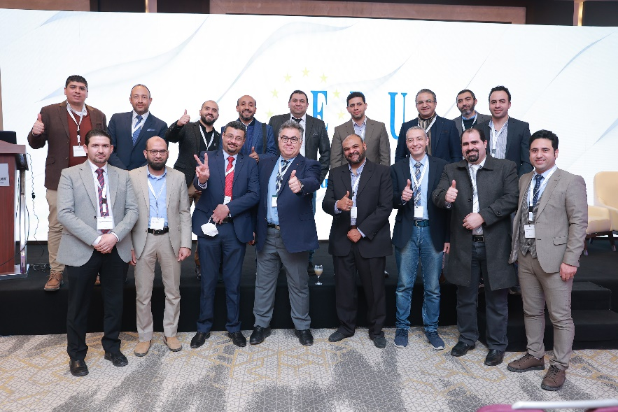
INTERNATIONAL CERTIFICATION ORAL EXAM
Open to urologists certified outside Europe
1st exam was held online in 2021
2nd exam 23 May 2023 in Cairo
3rd exam 3 May 2025 in Cairo

Slide 20
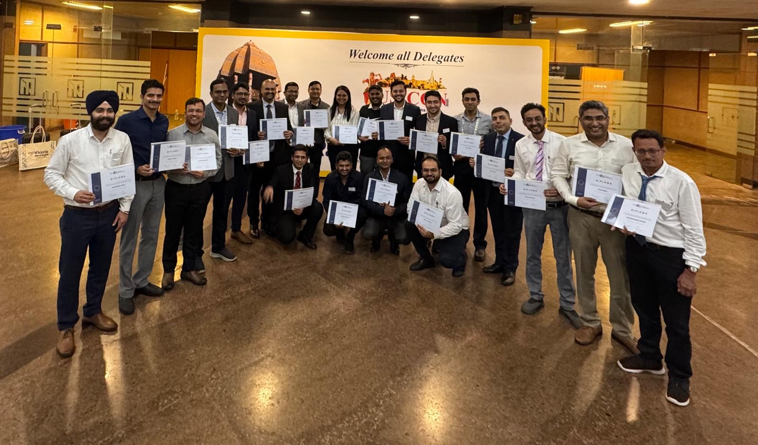
First FEBU Int Oral xam in India
USICON Chennai 12 January 2025

Slide 21
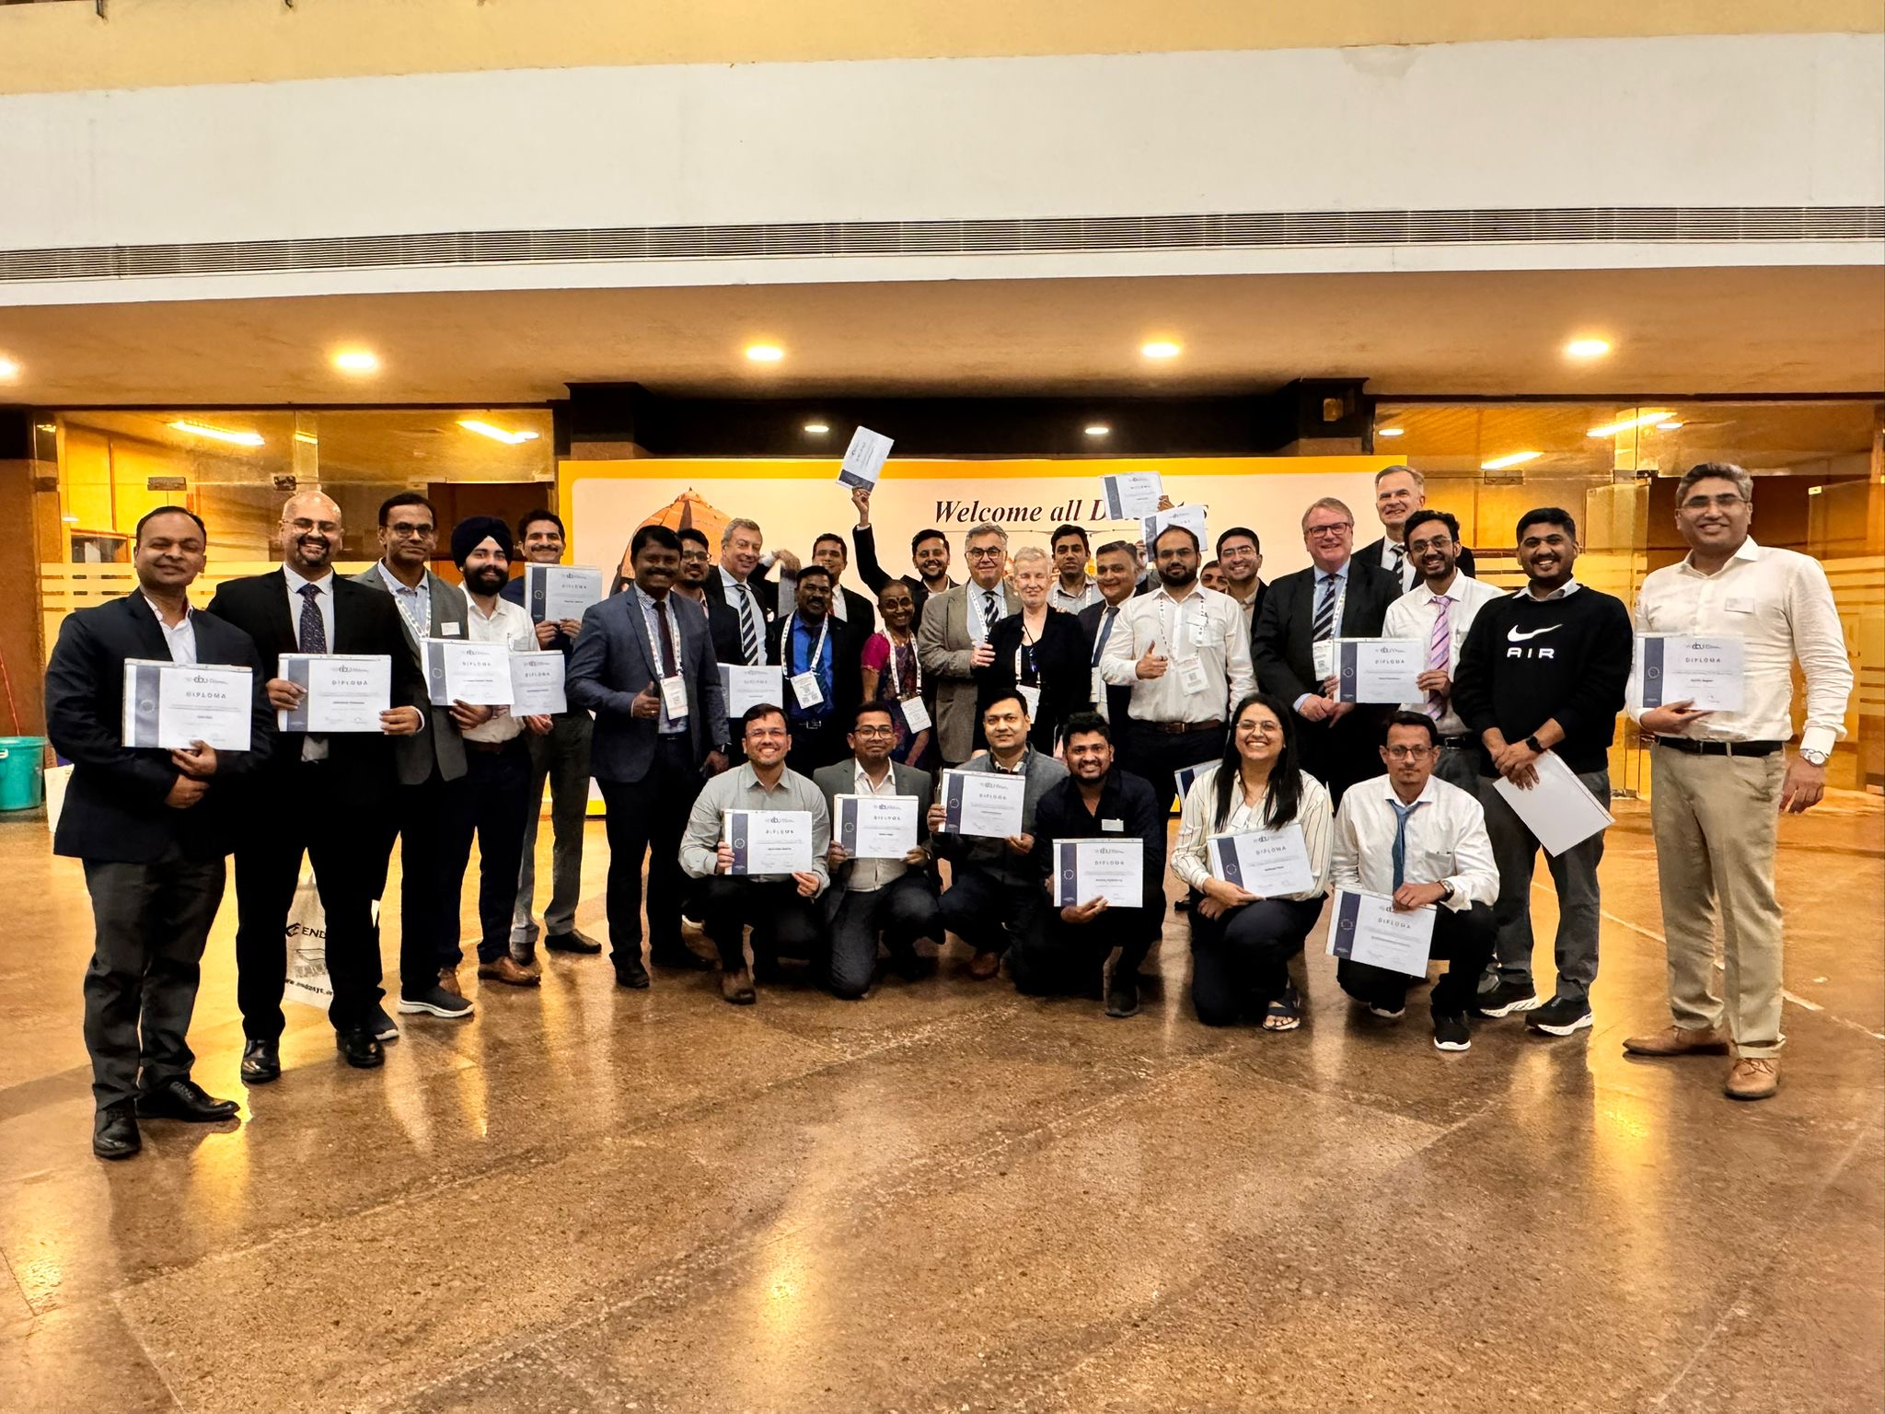

Slide 24
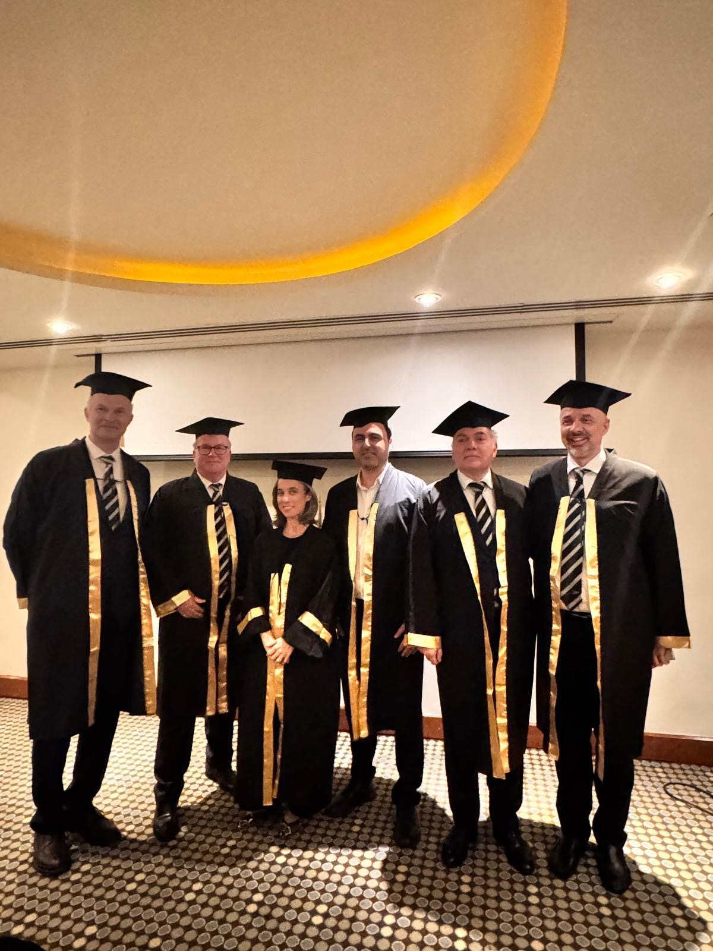
Cairo 3 May 2025
EBU examiners

Slide 25
Collaboration in running International Exams
EBU EXAM COMMITTEE
ESU
EAU GUIDELINES COMMITTEE
EAU GUIDELINES
Online education
ESU Courses
Preparing and conducting the exam

Slide 26
Lifelong Learning Programme: It is all about quality..
To serve the mission of EBU
To ensure that our knowledge remains current and relevant,
To provide a self learning and assessment tool
To keep the recording of CME system functional/ practical for everyone
To provide more CME activity
To keep a strong support for the European urologists if they are involved in malpractice

Slide 27
Lifelong Learning Program (LLL)
All diplomas issued by the European Board of Urology are time-limited from 2025 on and subject to the Lifelong Learning Program (LLL).
The FEBU diploma is valid for 5 years only and will expire on the anniversary of the date of issue.
Recipients of the FEBU diploma in 2025 will be subjected to apply for the LLL program within 3 years and recertification will be done 5 years later.

Slide 28
The Lifelong Learning Program is based on the competencies that should be defined by EBU and EU ACME .
Proposal criteria …
1) Good standing in Patient Care that is compassionate, appropriate, and effective for the treatment of health problems and the promotion of health; (needs to be documented by local authority/ society / institute)
2) Medical Knowledge about established and evolving biomedical, clinical, and cognate sciences and the application of this knowledge to patient care;
. Participation in Continuing Education activities (evidenced by CME points). 200 Points !
. Periodic self-assessment. (main source EAU guidelines) – In service assessment taken online. ( at least once in the last 2 years of recertification )
The details of crediting and points required needs to be worked out.

Slide 29
Explain ISA and LLL role and efficiency more
Sponsorship
Promotion
Feedback ( language - an issue?)

