Slide 1
Board Meeting 10 May 2025
Michael Rauchenwald
President

Slide 2
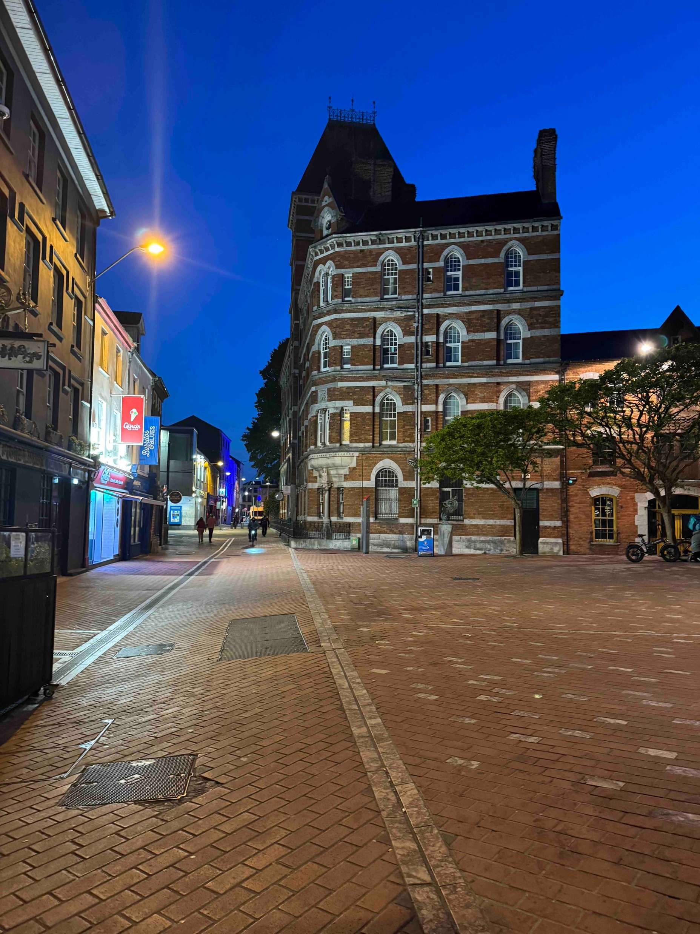

Slide 3
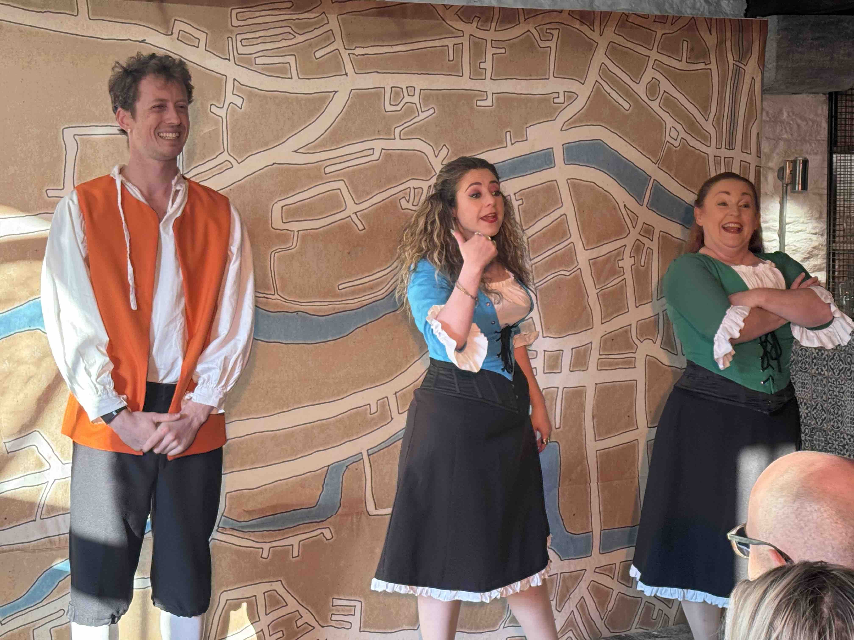
Histerical History of Cork

Slide 4
National Delegates
are the Communicators between the EBU and the National Societies

Slide 5
EBU is independent from EAU
Reminder
≠

Slide 6
Your role in promoting
In-Service-Assessment (ISA) Self-Assessment
FEBU Exams (as a national licensing examination)

Slide 7
Endorsement of ETR

Slide 8
Re: Statutes
Work In progress !
Have to be simplified
Adapted to changing legal requirements
Change of functional periods Executive Board

Slide 9
Board Meetings
Change of format
1 live meeting (2 nights instead of 1)
1 online meeting
No final decision taken yet for 2026

