Slide 1



Accreditation Committee
Prof. Archil Chkhotua - Chairman
Board Meeting 10-11 October, 2025 Athens, Greece

Slide 2
Agenda
ETR endorsement
CME/CPD Credit system
Accreditation of scientific events
FEBU revalidation
Subspecialty certification

Slide 3

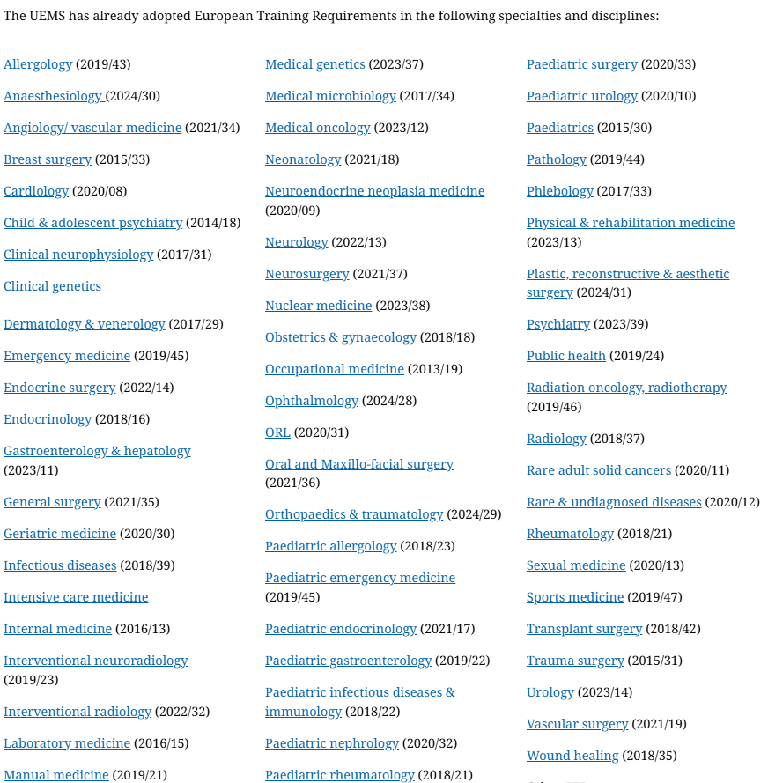
European Training Requirements
Download your copy from our website www.ebu.com

Slide 4
ETR – approval by UEMS
Online meeting with the UEMS top level officials on November 4
ETR will be submitted for the approval to the Council Meeting in spring 2026.

Slide 5
Endorsement
Endorsement by the national associations members of the EBU
Official letter will be sent to the EBU members
Endorsement may involve:
A formal statement of support from your society, and/or
Listing your society among the endorsing organisations on the EBU website and future publications.

Slide 6
CME/CPD Credit system

Slide 7
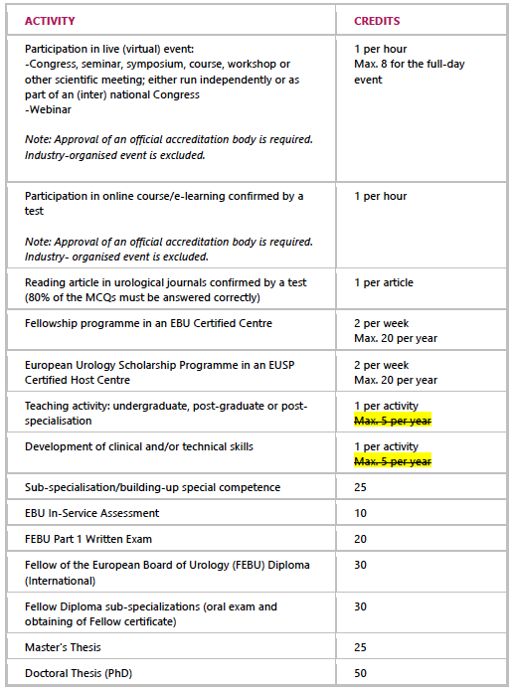
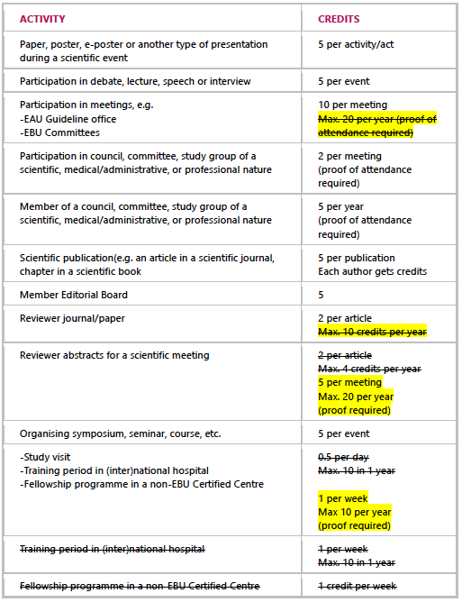
Online meeting of the accreditation committee and EU-ACME on July 10 together with:
Wilma Gietman
Beata Adamczyk

Slide 8
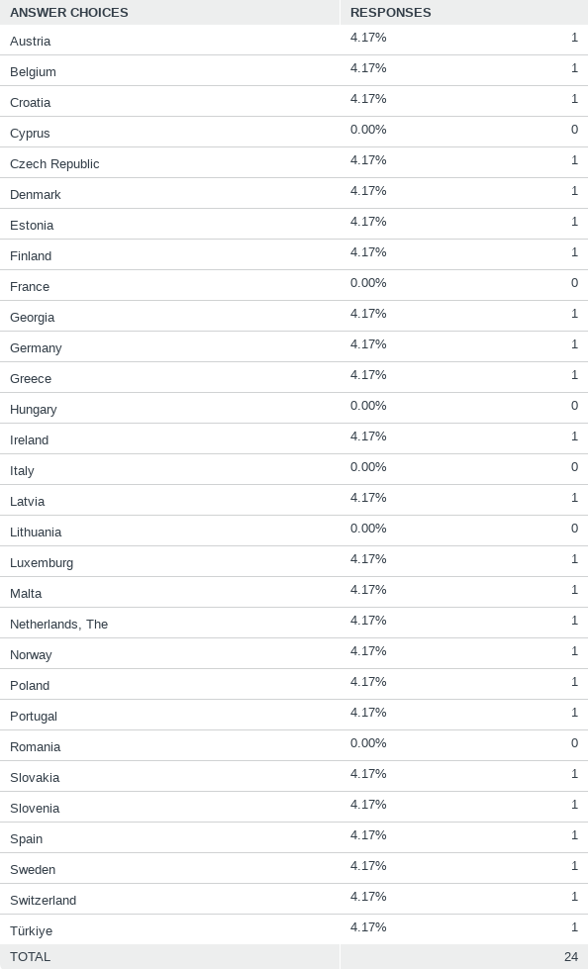
Q1: In which country do you currently practice medicine?
CME/CPD in Europe: Survey
Answered: 24 Skipped: 0

Slide 9
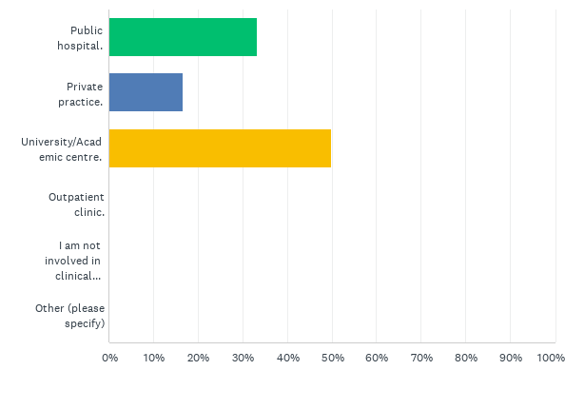
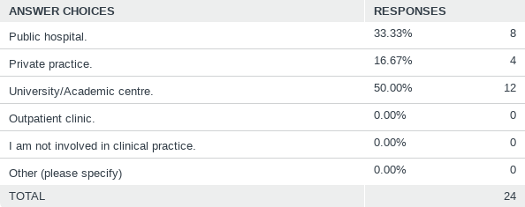
Q2: What is your primary place of work?
Answered: 24 Skipped: 0

Slide 10
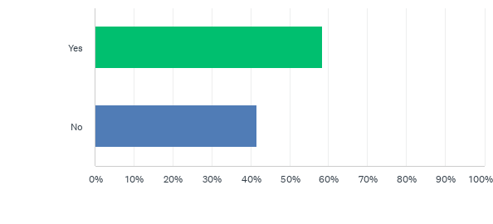
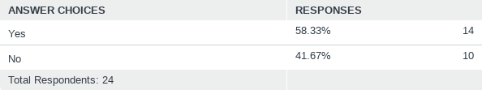
Q3: Does your country have an active CME/CPD system?
Answered: 24 Skipped: 0

Slide 11
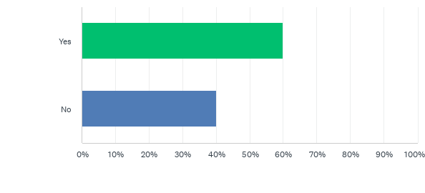
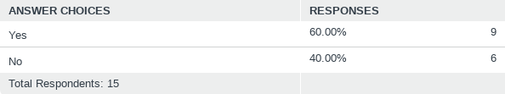
Q4: Is participation in your country's CME/CPD system mandatory?
Answered: 15 Skipped: 9

Slide 12
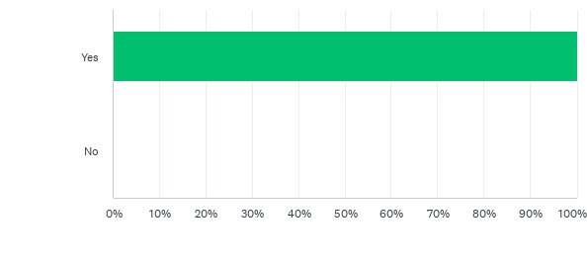
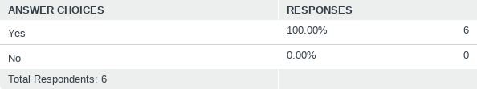
Q5: If not mandatory, do you believe it should be?
Answered: 6 Skipped: 18

Slide 13
Q6: If the system exists but is not mandatory, do you still participate?
Answered: 6 Skipped: 18

Slide 14
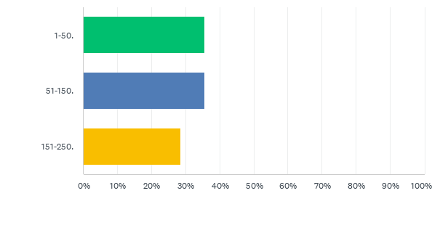
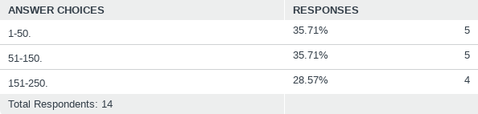
Q7: How many CME/CPD hours or credits are you required to collect within your national system?
Answered: 14 Skipped: 10

Slide 15
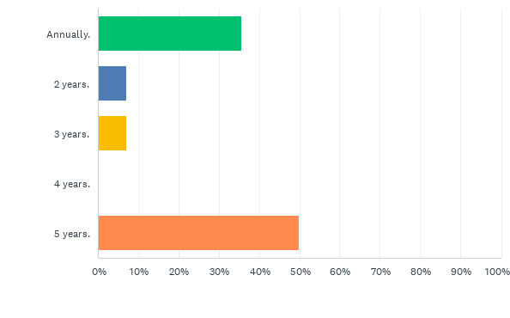
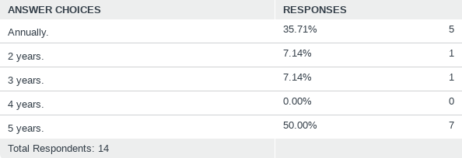
Q8: Over what time period should the total number of CME/CPD points be collected?
Answered: 14 Skipped: 10

Slide 16
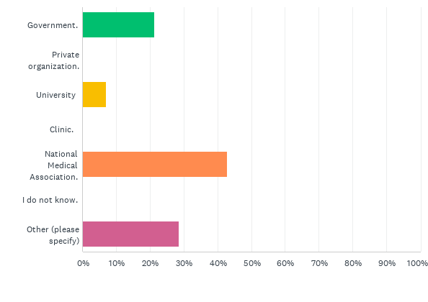
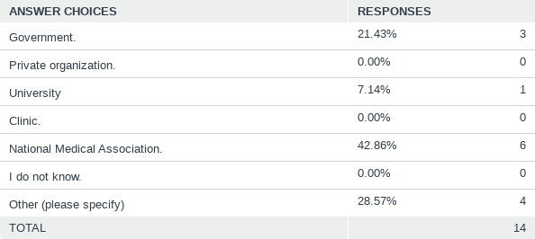
Q9: Who oversees the CME/CPD system in your country?
Answered: 14 Skipped: 10

Slide 17
Q10 How would you improve your CME/CPD experience? Feel free to write a comment.
#1: It is unrealistic or non-applicable if not mandatory. It must be mandatory
#2: Better reimbursement for doctors with points in Belgium – very original, example of direct financial incentive
#9: Several very important questions, like: what happens if the person lapses FEBU title? Will he be removed from the FEBU register? How and who will check it?
#12: to change the number of credits to 200 per 5years instead of 30 annually.

Slide 18
Accreditation of scientific events

Slide 19
Accreditation of scientific events

Slide 20

EVENTS EVALUATED BY EBU ACC
From the total of 433 CME events registered till October 2025, 43 were sent to the EBU ACC members for evaluation.

Slide 21
Subspecialty certification

Slide 22
Subspecialty certification
Oncourology
Urolithiasis
Female urology
Andrology
Reconstructive urology
Transplantation urology
Neurourology
Office urology
Male functional urology

Slide 23
FEBU
Re-FEBU
SC

