Slide 1

Board Meeting Oct 11th 2025
Certification Committee
Magne Dimmen
Chair

Slide 2
Certification Committee
Stepan Vesely Czech Republic
Mia Madsen Denmark
Mihhail Žarkovski Estonia
Timo Nykopp Finland
Julien Branchereau France
Ioannis Varkarakis Greece
Miklós Romics Hungary
Francesco Esperto Italy
Juris Jansons Latvia
Arunas Želvys Lithuania
Michał Piotr Soczawa Poland
Pedro Coelho Nunes Portugal (Vice Chair)
Christian Mirvald Romania
Jure Bizjak Slovenia
Uroš Kacjan Slovenia
Philipp Baumeister Switzerland
Alexander Müller Switzerland
Han van der Zee The Netherlands (Expert member)
Magne Dimmen Norway (Chair, to be replaced)

Slide 3
Revision application form
Task force
New application form is implemented
Less detailed
Remaining:
Minor revisions
Technical issues

Slide 4
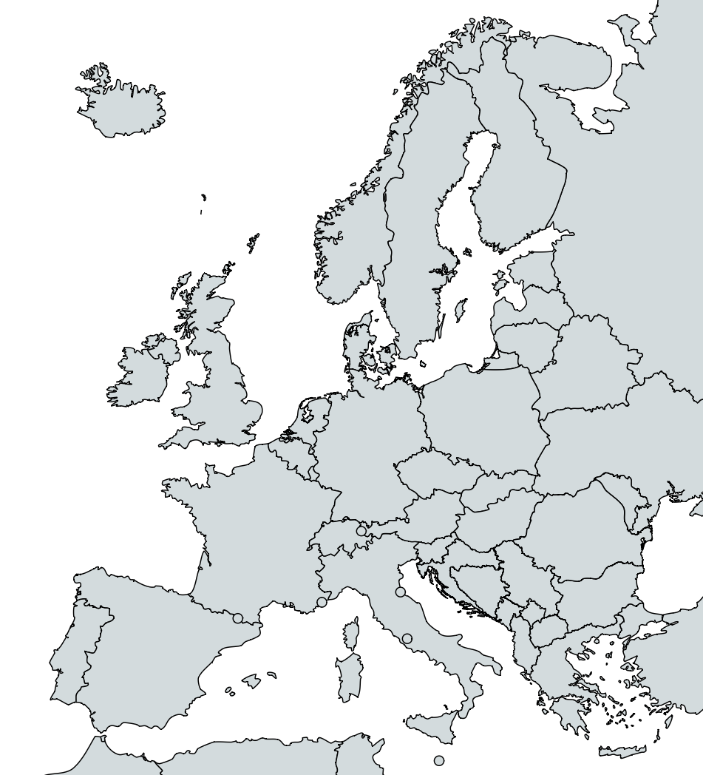


RTPU Certifications
6 site visits performed
All recertifications
1 site visit in November

Slide 5
RTPU Applications
3 applications
All new certifications
Site visitors assigned

Slide 6
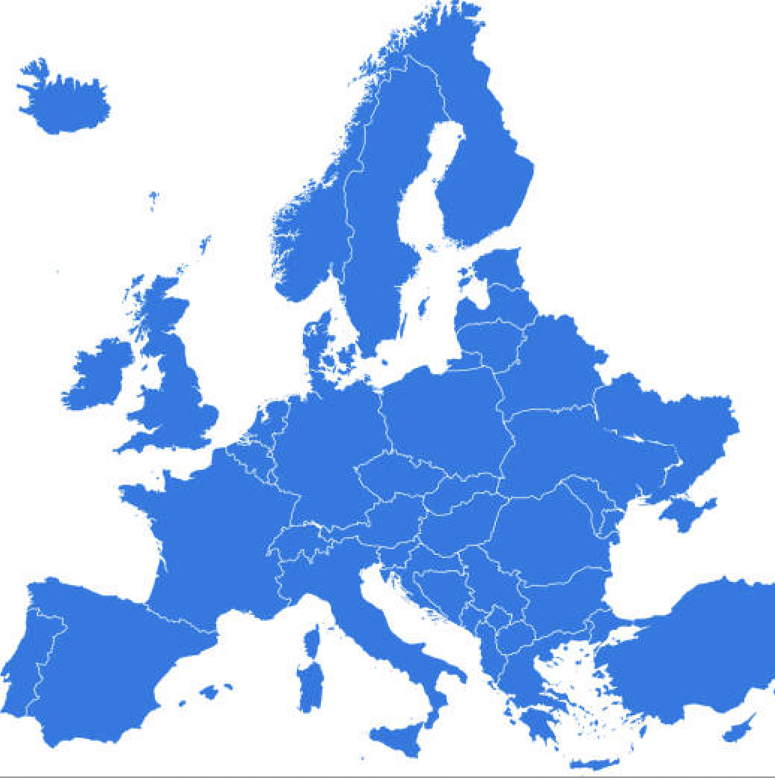
RTPU
1
68 certified centers
21 countries
2
1
0
1
1
2
7
4
13
1
3
8
1
1
1
1
1
7
11
1
1

Slide 7
EUSP Host Center
8 new applications evaluated since the last meeting
All applications reviewed by
M. Babjuk(EAU) and M. Dimmen (EBU)
Most applications approved for 5 years.
1 approved for 3 years
1 denied certification due to lack of research

Slide 8
EUSP Host centre 70 programmes 32 centres 14 countries
1
1
4
3
4
2
1
1
https://certifications.ebu.com/certified-host-centres
7
6
1
3
1
1
U N I O N E U R O P É E N N E D E S M É D E C I N S S P É C I A L I S T E S ( U . E . M . S . )

Slide 9


