Slide 1

EU-ACME EBU Board Meeting 10 October 2025
Prof. Dr. M. Babjuk

Slide 2

EU-ACME Committee
Chairman M. Babjuk
EAU members:
HJ. N’Dow - Secretary General – The Adjunct Secretary General responsible for Education
E. Liatsikos - Chairman of the ESU Office
M. Albersen - Chairman of the Scientific Office
EBU members
M. Rauchenwald - President A. Chkhotua - Chair Accreditation Committee
M. Dimmen - Chair Examination Committee

Slide 3
EU-ACME – key functions:
Tracking Educational Activities: Medical practitioners in urology can keep track of their educational activities, regardless of where they practice or participate in accredited activities.
Validation: EU-ACME validates the activities registered by its members, ensuring they meet certain standards.
Interprofessional Accreditation: They provide accreditation for CME/CNE events and Distance Learning materials, ensuring they are of high quality.
Quality Improvement: EU-ACME helps improve the quality of CME/CNE in urology.

Slide 4
MEMBERSHIP
As of 2025, the total number of active EU-ACME members is 16.869, and EU-ACNE members is 2.714. Our members come from 149 countries
Agreements:
National Urological Societies from: Estonia, the Netherlands, Poland
International Urological Societies: EAU, EAUN, ESPU and ICS

Slide 5
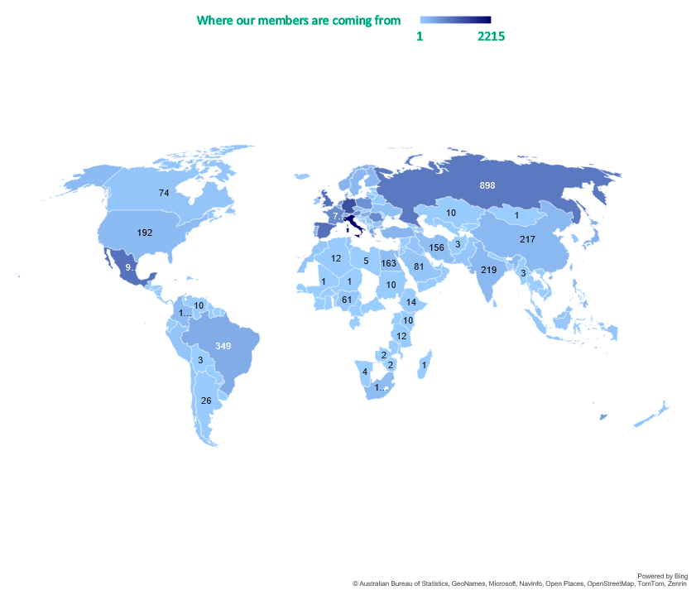
MEMBERSHIP
As of 2025, the total number of active EU-ACME members is 16.869, and EU-ACNE members is 2.714. Our members come from 149 countries
Agreements:
National Urological Societies from: Estonia, the Netherlands, Poland
International Urological Societies: EAU, EAUN, ESPU and ICS
Total of 19.653 EU-ACME/CNE members in 2025 from 149 countries

Slide 6
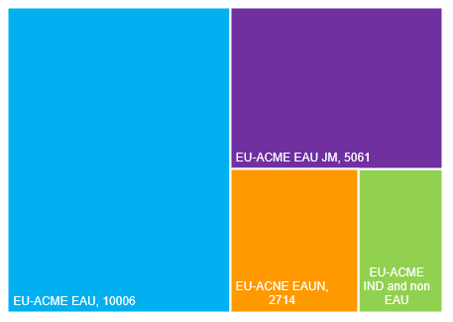
MEMBERSHIP
Within the total of 19.653 EU-ACME/CNE members there:
10.006 EU-ACME EAU members,
5.061 EU-ACME EAU JM,
2.784 EU-ACNE EAUN members.
1.802 EU-ACME members signed individually and directly via societies.

Slide 7
CME/CNE/CPD ACTIVITES
The total number of registered CME/CNE/CPD activities in the EU-ACME database as of September 2025 is 1.279 including 433 CME, 9 CNE and 837 CPD activities.
Out of a total of 433 CME activities, 61 were accredited within the EU-ACME programme — including 47 that were sent to the EBU ACC members for evaluation.

Slide 8
CME/CNE/CPD ACTIVITES
Continuing Medical Education (CME)/Continuing Nursing Education (CNE)
CME/CNE activities aim to keep medical professionals updated with essential and relevant information to enhance their practice. Successful CME/CNE programs are designed based on educational principles that promote:
Knowledge Acquisition: Ensuring practitioners gain up-to-date knowledge.
Efficiency: Streamlining processes to make learning more effective.
Professional Integrity: Upholding high standards of practice.
Ethical Standards: Adhering to ethical guidelines in medical practice.
Example of CME/CNE activities: workshop, congress, course, e-learning, seminar, etc.
Continuing Professional Development (CPD)
CPD involves the ongoing process of maintaining, improving, and broadening knowledge and skills. It also encompasses the development of professional qualities necessary for the execution of duties throughout a practitioner's career.
Examples of CPD activities: presentation, article, lecture, teaching activities, committee member, etc.
These activities collectively ensure that medical professionals are well-equipped to provide the highest quality of care and continue to advance in their fields.

Slide 9
CREDIT REGISTRATION
In 2024, 7.757 EU-ACME members, making up 43% of the total, registered their CME/CPD credits in their online portfolios

Slide 10
MCQs ONLINE
The total number of answered MCQs published in the European Urology Journal in as of September 2025 is 2.196.
The total number of answered correctly MCQs is 1.829, including 1.586 answered by EU-ACME Junior Members.

Slide 11
ESU Courses Pre-&Post test
During the EAU 2025 Congress 47 ESU courses and the EAUN 2025 Congress 2 courses were selected to provide pre- & post- knowledge tests.
The EU-ACME MCQs Task Force is involved in checking the quality of the MCQs.
Prof. Dr. M. Babjuk
Prof. Dr. J.M. Nijman
Prof. Dr. R.J.A. Van Moorselaar
Notes:
Courses 2, 20, 23, 25 and 46 have non or not sufficient number of MCQs to provide test

Slide 12
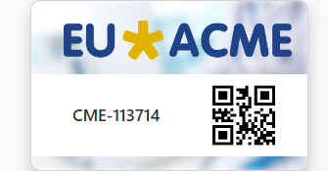
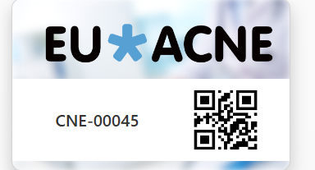
EU-ACME digital card
The EU-ACME/CNE members may now use the digital membership card, which is available via MyCME.

Slide 13

Promotion / Awareness
Regular contributions to platforms such as EAU Newsletter
Meeting with chairs of YOU and YAU – podcast on CME/CPD
Participation in YOU meeting during EMUC 2025
Regular post on EU-ACME website
EU-ACME Knowledge Base

Slide 14
JOINT ACTIVITIES
EUSP Host Centra Certification
47 active certified specialties within the Certified EUSP Host Centres programme
Between 2023 and 2025 (up to the present), a total of 160 different visits have been recorded within the EUSP programme. Of these, 111 were accepted, and among the accepted visits, 75 were conducted at EUSP Certified Centres.
FEBU Revalidation
Starts 2025 - The EU-ACME office will assist with the FEBU Revalidation process by registering CME/CPD credits for FEBU holders and submitting the relevant reports to the EBU office.

Slide 15

FEBU 2025
Out of 484 candidates who passed the FEBU exam in 2025, 60% are already members of EU-ACME.

Slide 16
How EU-ACME Will Facilitate Rrevalidation of FEBU
FEBU EU-ACME members:
Have access to the online CME/CPD portfolio (MyCME)
Register CME/CPD activities in MyCME – online portfolio,
Receive a yearly Credit Registry Report listing all collected CME/CPD credit points.
The EU-ACME office provides:
Registration of accredited on national and/or European level CME events,
Validation of activities registered by the EU-ACME members,
Reporting to the EBU office with CME/CPD credits collected by FEBU EU-ACME members.

Slide 17
How FEBU may become an EU-ACME Member
There are two ways to become a member of the EU-ACME programme:
Medical professional can become a member of the EU-ACME/ACNE programme once they are either a member of a national urological society or an international scientific society that is affiliated with the EU-ACME/EU-ACME programme The following international urological societies have joined the programme: EAU, EAUN, ESPU, ICS and the following national urological societies from the following countries : Estonia, Poland, The Netherlands,
The medical professional who is a member of a national or international urological association that is not (yet) affiliated with the EU-ACME programme may become an individual member.
More details and membership application on https://eu-acme.org/medical-professional/becoming-the-eu-acme-member/

Slide 18
Ways FEBU Can Collect CME/CPD Credits
Attend Accredited Workshops and Courses: Participate in workshops and courses accredited by EU-ACME.
Online Learning Modules: Complete online learning modules and e-learning courses available through EU-ACME.
Presentations and Lectures: Deliver presentations and lectures at accredited events.
Publish Articles: Write and publish articles in recognized journals.
Committee Memberships: Engage in committee memberships and other professional activities.
Teaching Activities: Conduct teaching activities and mentorship programs.
More details - https://eu-acme.org/medical-professional/number-of-credits-per-activity-type/

Slide 19
EU-ACME MyCME/CNE
EU-ACME/EU-ACNE member
Activities (examples):
Participation in an accredited event
Paper, poster, e-poster or another type of presentation during a scientific event
Participation in a guideline, examination committee meeting
Sub-specialisation/building-up special competence
Teaching activity: undergraduate, post-graduate or post-specialisation
Scientific publication (e.g. an article in a scientific journal, chapter in a scientific book)
Organising symposium, seminar, course, etc.
Fellowship programme in an EBU Certified Centre
Reviewer journal/paper
European Board of Urology – ACC (EBU ACC)
European Board of Paediatric Urology (EBPU)
European Urology Accreditation Board for Continuing Nursing Education (EUABCNE)
Registration of an activity via MyCME/CNE
EU-ACME/CNE
Accreditation board
EU-ACME/CNE office
Member account

Slide 20
How National Society Can Help
Registering Nationally Accredited Events: National societies can register their accredited events in the EU-ACME database to ensure wider recognition and participation.
Promoting EU-ACME Membership: Encourage members to join EU-ACME to benefit from its educational resources and accreditation.
Feedback and Improvement: Provide feedback on EU-ACME activities to help improve the quality and relevance of offerings.
Support for Revalidation: Assist members in meeting revalidation requirements by providing necessary resources and guidance.
Advocacy: Advocate for the importance of continuous professional development and accreditation within the urological community.

Slide 21

EU-ACME/CNE: Supporting Urological Professionals
Empowering every urology professional—across borders and beyond—with smarter tools, stronger collaborations, and a transformative CME/CNE experience.
Empowering lifelong learning in urology

Slide 22

THANK YOU!
info@eu-acme.org
www.eu-acme.org

