Slide 1

Board Meeting
October 11, 2025
Athens/Greece
Michael Rauchenwald
President

Slide 2
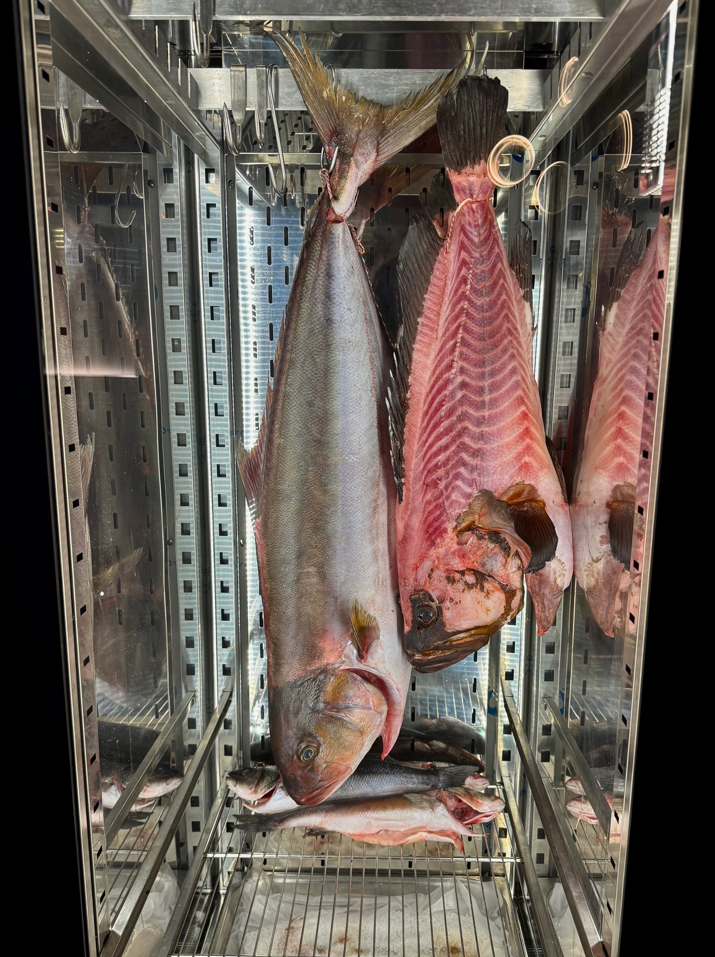

Slide 3


Slide 4
New EBU Member
Armenien Association
of Urology

Slide 5
Executive Committee
Change in function:
Serdar Tekgül – President elect
Magne Dimmen – Secretary elect
New member:
Stig Müller – Chairman Examination Comm

Slide 6
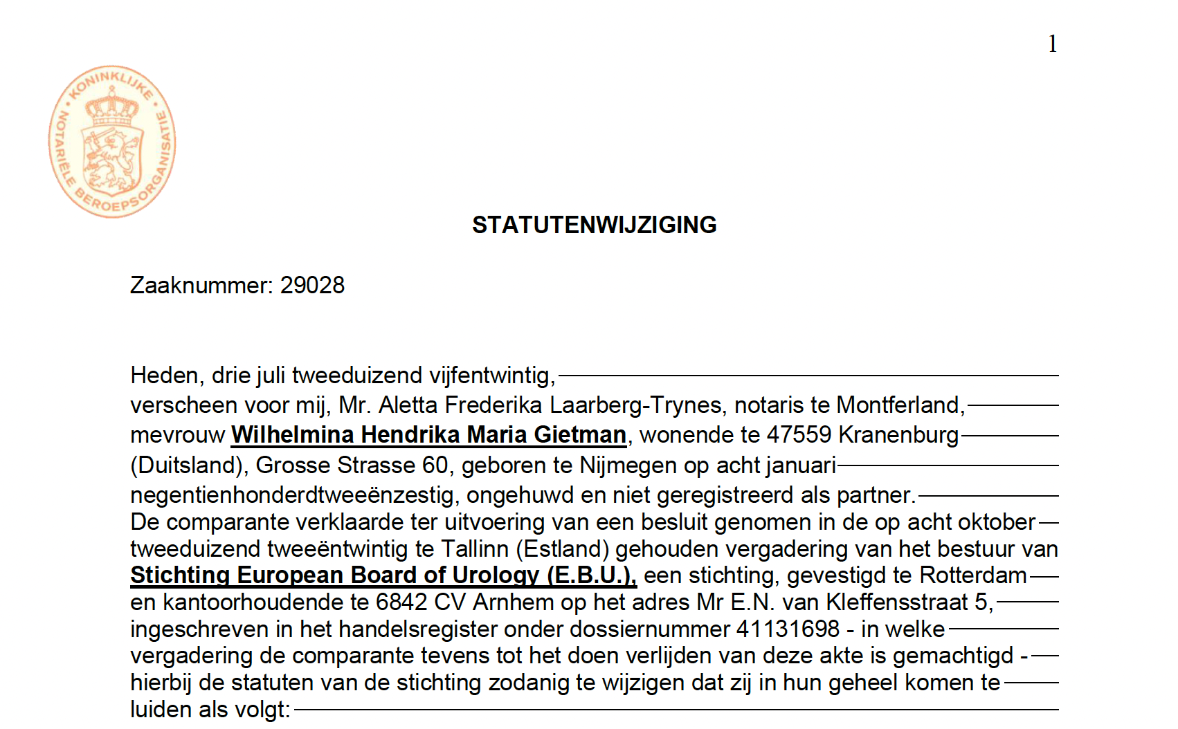
Notes:
English Trasnslation about to finished and published on the Website

Slide 7
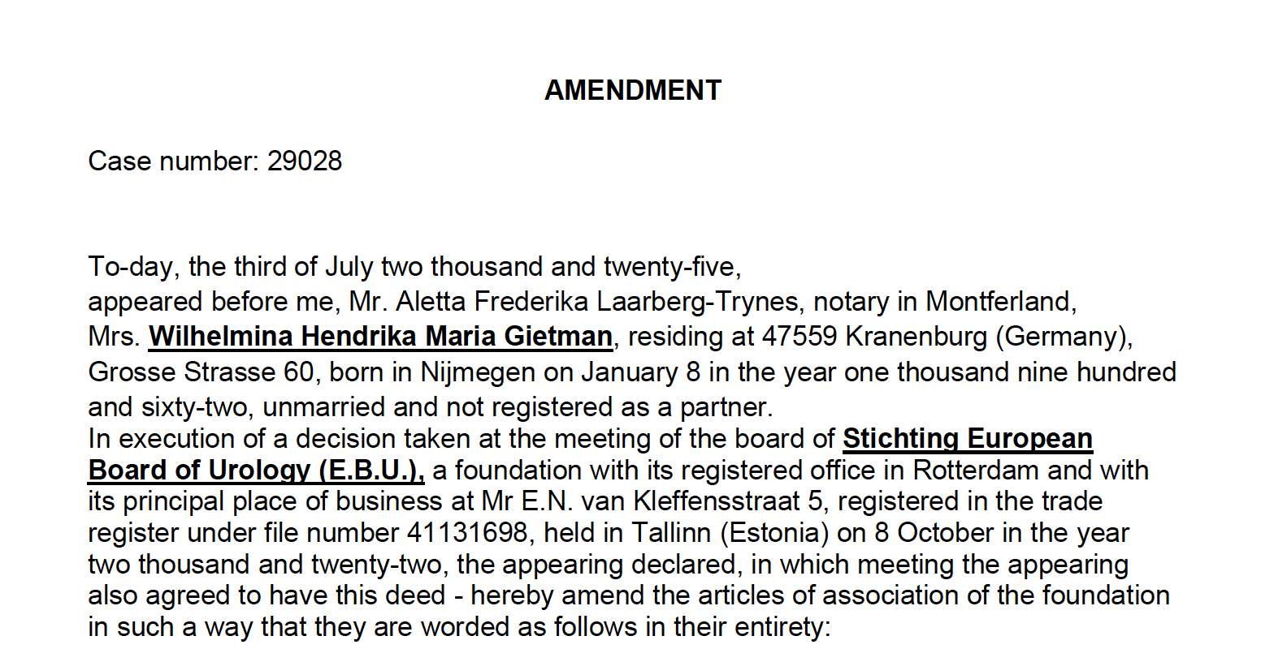

Slide 8
National Delegates
are the Communicators between the EBU
and the National Societies
In both directions !
Notes:
Let your societies know what we are doing and vice versa let us know the needs and compülaints of your society

Slide 9


to remember & send the message
≠

Slide 10
Promotion of
ISA – In-Service-Assessment
Self-Assessment
FEBU-Examination
(as national license examination)

Slide 11

Endorsement of ETR

Slide 12
Board Meetings
Change of format:
1 attendance meeting (2 nights instead of 1 ?)
1 online meeting
Board Meetings 2026:
May 8th – Online
October 9th-10th – Oslo/Norway

Slide 13
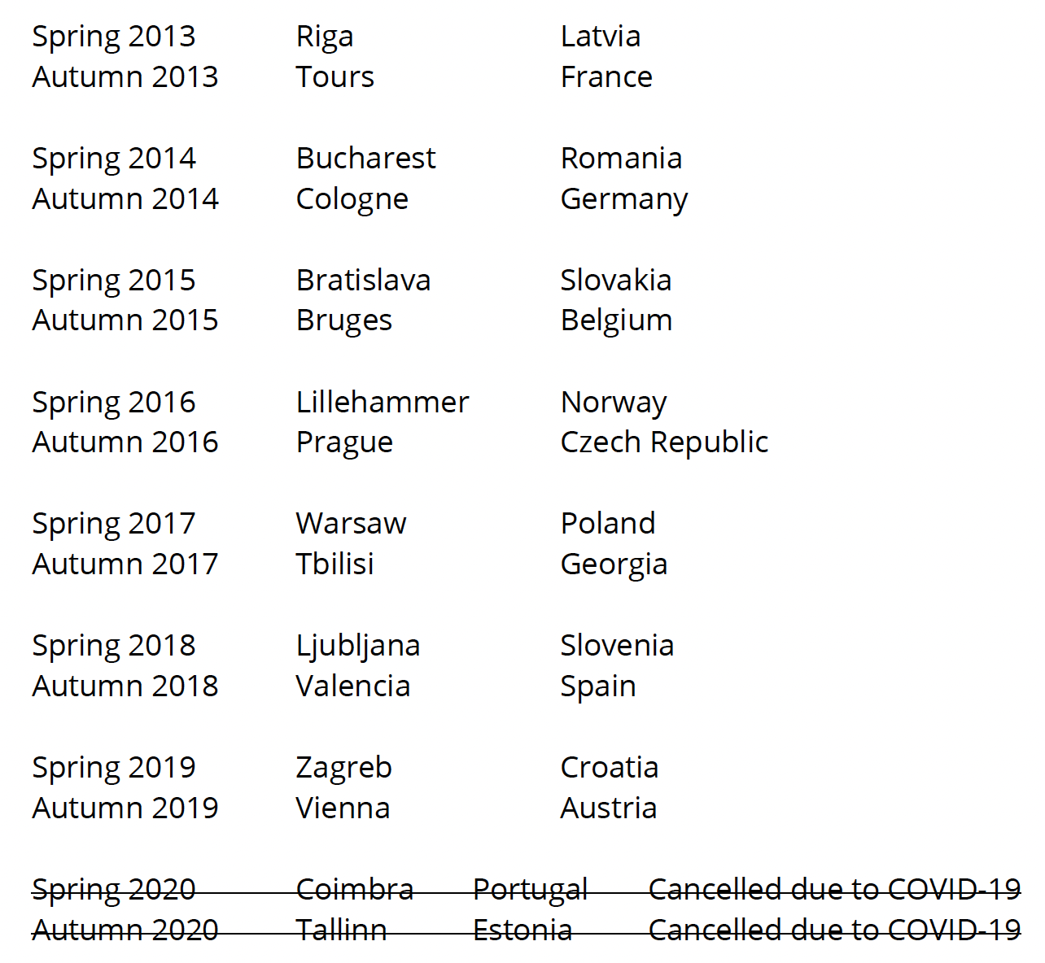
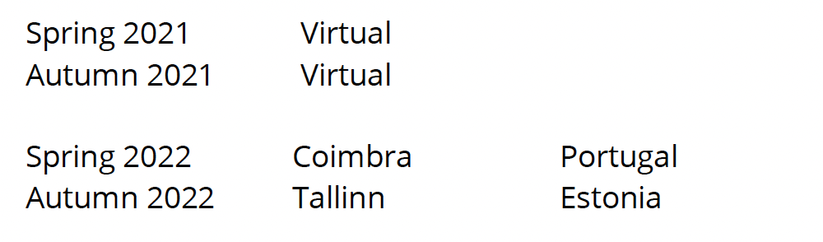
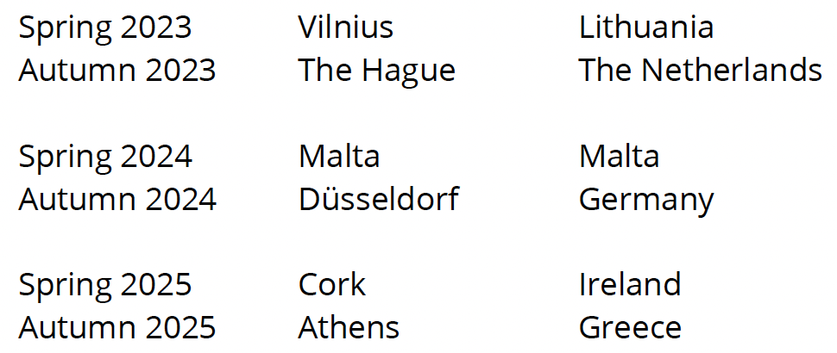
EBU Board Meetings 2013 - 2025

