Slide 1



Accreditation Committee report
Prof. Archil Chkhotua
Chairman, Accreditation Committee
Board Meeting May 8, 2026

Slide 2
EBU ETR Urology
Subspecialty certification

Slide 3
EBU ETR Urology

Slide 4
CONTEXT & RATIONALE
How This ETR Was Created
First Update Since Original
Collaborative Development
Original ETR approved May 2023 at UEMS General Assembly. Multiple specialty sections provided constructive feedback for improvement, necessitating the first comprehensive revision.
EBU Accreditation and UEMS ETR Committees worked in close collaboration, incorporating substantial changes of different UEMS sections.
Sections involved:
Timeline: EBU General Assembly approval October 2024 → UEMS ETR Committee review January 2025 → Final revisions completed in January-April 2026
• Radiology
• Surgery
• PRM
• Medical Genetics
• Paediatric Surgery
• Occupational Medicine
Alignment with CBME
All essential feedbacks have been addressed and majority incorporated
This update fully integrates Competency-Based Medical Education (CBME) principles, shifting from time-based to competency-based training.
Key CBME Elements Integrated:
Primary Objectives
• CanMEDS framework for physician roles
01
Raise training standards across Europe
• Entrustable Professional Activities (EPAs)
02
Ensure harmonized core competencies
• 5-level competency progression system
• Workplace-based assessments
03
Facilitate international recognition of specialists’ competencies
04
Reflect contemporary medical advances

Slide 5
DEVELOPMENT PROCESS
How This ETR Was Created
Working Groups
Development Timeline
Accreditation Committee
MAY 2023
Original ETR Approved
Dr Karl German (Chair) → Prof Archil Chkhotua + Committee members
UEMS General Assembly
Primary document authors
Subsequent Revisions
2023-24
Feedback Collection
Multiple specialty reviews
Examination Committee
OCT 2024
EBU Approval
Prof Serdar Tekgul (Chair) + Committee members
General Assembly endorsement
Reviewed all knowledge sections & grading
Jan 2025
01-04. 2026
UEMS ETR Committee Review
Comments & recommendations
Executive Board, EBU
APR 2026
Final Revisions Complete
Reviewed and approved
Ready for UEMS Council Approval
Approval Chain
Review & Consultations
1
EBU Executive Committee
Comprehensive review process engaged multiple UEMS medical sections to ensure broad specialty input.
2
EBU General Assembly
3
UEMS ETR Committee review
8+
100%
4
UEMS Council (April 2026)
Specialty Sections
Feedback Addressed

Slide 6
UPDATES 2025-2026
Key Updates & Enhancements
CanMEDS Framework
Safeguarding Enhanced
Prostate Cancer
Full integration of all 7 CanMEDS roles with alignment to urology competencies
New section on policies for safeguarding children and vulnerable adults, including:
Enhanced emphasis on biomarker knowledge (PSA, blood, urine, tissue markers) and nomograms for staging
Frailty-aware assessment approach
Shared decision-making integration
EPAs Introduced
Multidisciplinary collaboration (geriatrics, anaesthesia, rehabilitation)
Bladder Cancer
6 Essential Entrustable Professional Activities for holistic assessment at Level 5
New inclusion of histology variants for urothelial cancer and improved MDT tumor board definition
Genetic Aetiology
Knowledge Grading
Expanded emphasis on genetic basis of urological diseases:
Additional Updates
New 3-level grading system for all knowledge domains:
Genetic testing and counselling
Endovascular prostate treatment
Hereditary cancer syndromes
Sexual health and STI prevention
1
Basic knowledge
Genetic variants classification
Transgender surgery knowledge
2
Intermediate mastery
Hospital-acquired infections emphasis
3
Advanced mastery
Neurogenic bladder & self-catheterization
Research exposure for trainees

Slide 8
Page 11: Maybe add a section on (adult) transgender care
Page 18 and 53: Consider using the term “congenital differences” instead of “congenital anomalies”
Page 54 (section on hypospadias): We suggest adding in the second paragraph the sentence: “To consider referring hypospadias cases to plastic and reconstructive surgery specialist with demonstrated expertise / special interest in hypospadias reconstructive procedures.”
• Currently, none of the major European urological guidelines contain a separate section or specific recommendations on transgender surgery and care (EAU, DGU, etc.). However, your point is very important and should be given high priority in the next revision of the ETR.
• We have used the term “congenital anomalies”, as this is the terminology used in the Guidelines of the European Association of Urology. It is a well-recognized and accepted term within the urological community in Europe.
• Regarding your suggestion on hypospadias (page 54): hypospadias repair is an integral part of urological surgery in all European and non-European countries. Paediatric Urology is a subspecialty of Urology. The ETR describes the required core knowledge and it is understood that referral to a specialized Paediatric Urology centre should be made when appropriate.

Slide 12
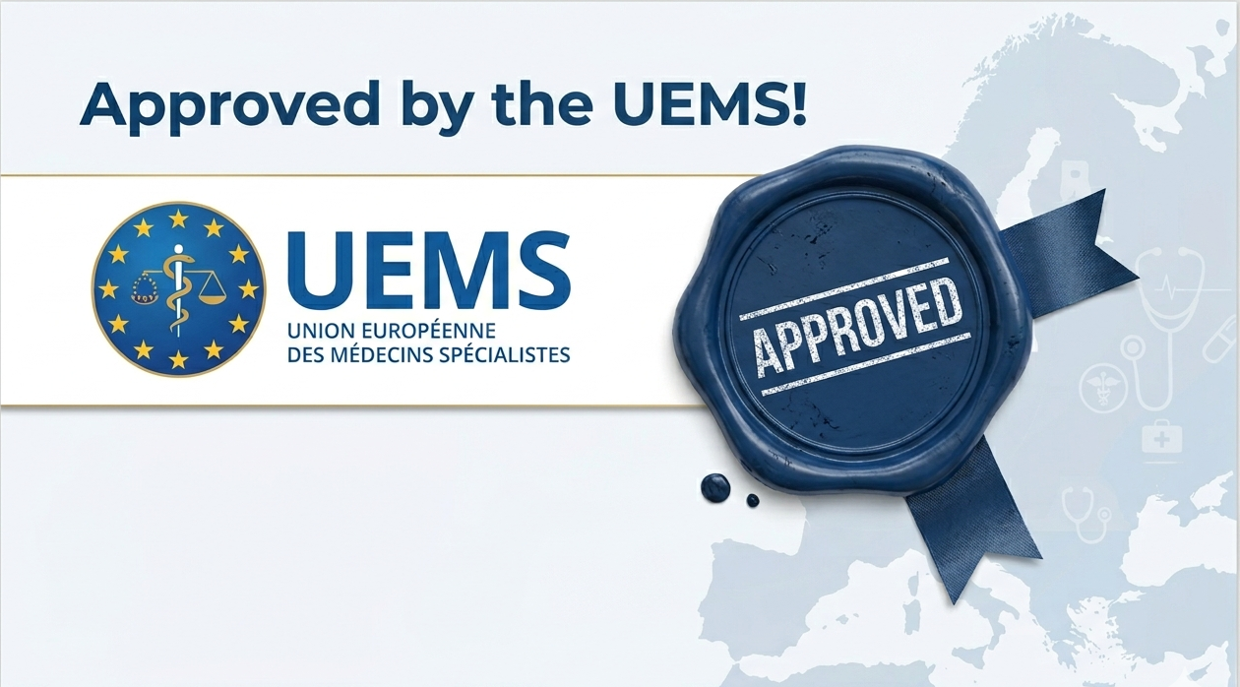
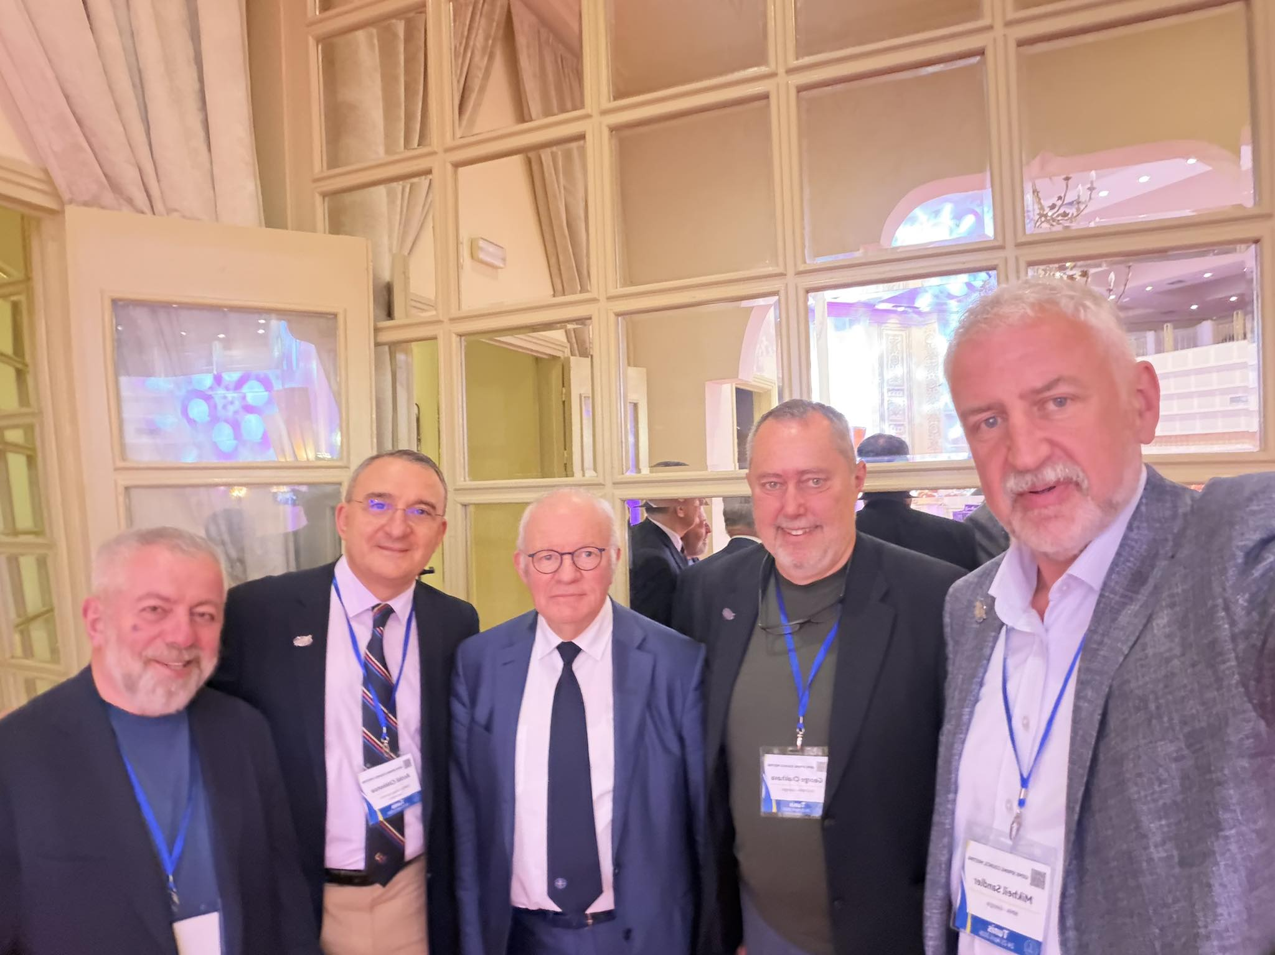
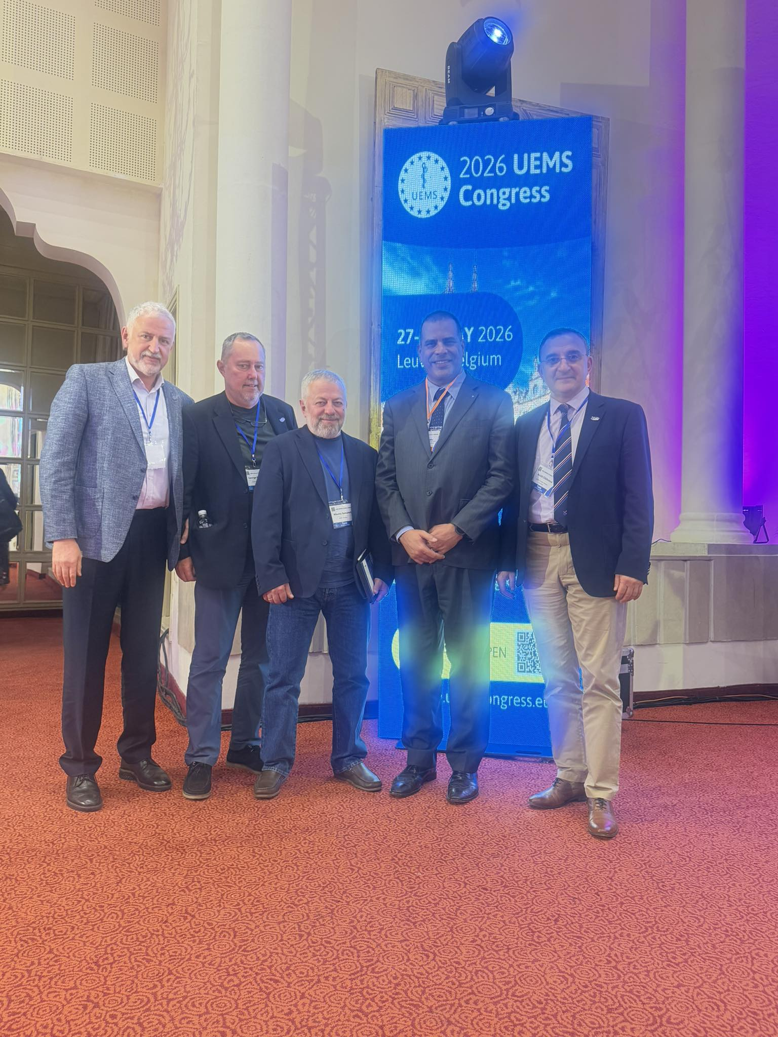
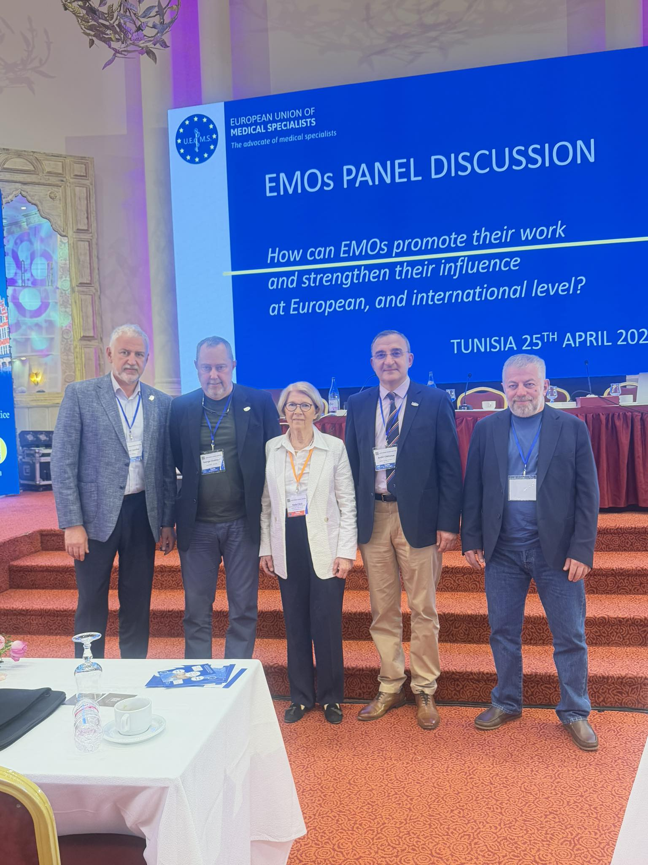

Slide 13
IMPLEMENTATION
Implementation & Next Steps
Alignment with National Programs
EBU's Harmonization Role
The ETR is designed to complement, not supersede, national training programs:
EBU acts as coordinating and monitoring body for urology training in the EU:
Standard Setting
Defines training standards for institutions, trainers, and trainees
Respect for National Authority
Certification
NMCAs retain primary responsibility for training standards in their countries
Actively involved in assessment and certification of residency programs
Adaptation to Local Context
Quality Assurance
Certification Committee determines standards and quality metrics
Training environment may be achieved in adapted ways depending on local traditions
Examination
Harmonization Goal
High-quality FEBU exams reflecting current European standards
Ensure same core competencies across Europe while respecting local needs

Slide 14
Endorsement & Next Steps
Endorsement by the national associations
Recognized as an important source of clinician guidance for training of urology residents in the member states
Endorsement will imply support or general approval of its content, acknowledging its value and quality
If the national guidelines exist, this document will not, and shouldn’t replace, but support and supplement it
EBU ETR Urology is considered for:
  UEMS member states (full + associate) only
Who should do it:
  EBU: 29 member countries, full and associated UEMS members only
  UEMS: 37 member states (full + associate), 43 Specialist Sections (including urology)
How to do it
  Role of national associations
  EAU and its sections
  UEMS

Slide 15
Endorsement & Next Steps
Ask the EBU member national associations to endorse it
EAU support for promotion within member associations
Ask UEMS to promote it through the medical societies of member states
National associations should decide:
  Translation
  Adaptation
  Implementation
EBU will not try to contact the national authorities to incorporate it in the national program

Slide 16
Subspecialty certification
Andrology

Slide 17
Subspecialties
  Oncourology
  Urolithiasis
  Female urology
  Andrology
  Reconstructive urology
  Transplantation urology
  Neurourology
  Office urology
  Male functional urology
EBU
+
Andrology Section EAU

Slide 18
Criteria
Voluntary
Urologist only? Endocrinologist, Sexual Medicine, Reproductive medicine, etc.???
Not only FEBU title holders
50-75% of practice devoted to andrological urology
Must have a valid national medical license
Other possible subspecialties: office urology, reconstructive urology ???
Minimum time from certification 5 years
Valid for 5 years

Slide 19
What to check
Knowledge
Practical skills
Scientific and educational activity

Slide 20
Application Process
Online submission
Necessary documents to apply
Defining criteria for:
  Knowledge
  Practical skills
  Scientific/educational activity
Processing fees
Certificate issue
FEBU – Re-FEBU - SC

Slide 21
Necessary documents
CV
Valid national medical license
Written recommendation from:
  Chief of the division
  Chief of department
  Head of the hospital
Minimum number of annual cases???
  varicocelectomy (50), Sperm retrieval (30), vas recanalization (20)
  penile prosthesis (50 cases), corporoplasty (50), open urethroplasty (30)
  M to F (50), F to M (30)
CME points (150-200 points/5 year)

Slide 22
Theoretical Knowledge
FEBU exam in the last 5 years
Attending national/international congresses, conferences, scientific meetings
Moderating/Chairing Scientific session on specific subspecialties
ESU courses
Andrology fellowship or training courses
Online courses, webinars, teleconferences, etc.
Master courses in andrology and/or infertility
Panel member, round table discussion
Abstract reviewer in EAU, SIU, DGU, etc. scientific meetings
…

Slide 23
Practical skills
Practice logs: Med book, log book, etc. records
Number of annual surgeries, cases, patient consultations on Andrology
Live surgery during national, international scientific meetings
Surgeries, patient consultations performed abroad on invitation
Fellowships
Hand-on training sessions
…

Slide 24
Scientific & Educational Activity
PhD
Publishing
  Papers in national, international, peer review scientific journals
  >20 indexed publications, at least 5 as first author ???
  H-index >10 ???
  Textbook, book or chapter in the book
  Guideline (EAU, national), Protocol, etc.
Clinical trials, fundamental scientific projects, multicenter studies, etc. (PI, investigator, etc.)
Invited lecturer at the national and international congresses, conferences, scientific meetings
Examiner in the FEBU oral exam
Reviewer of the national, international, peer review scientific journals
Editorial Board membership in the national, international, peer review scientific journals
Lectures, seminars, workshops
Chairman of residency program
Awards, prizes, certificates, etc.

Slide 25
The certificate
Dr. Name Surname
Has been certified by the European Board of Urology
In the following subspecialty:
Andrology
Valid till 01. 01. 2031

Slide 26
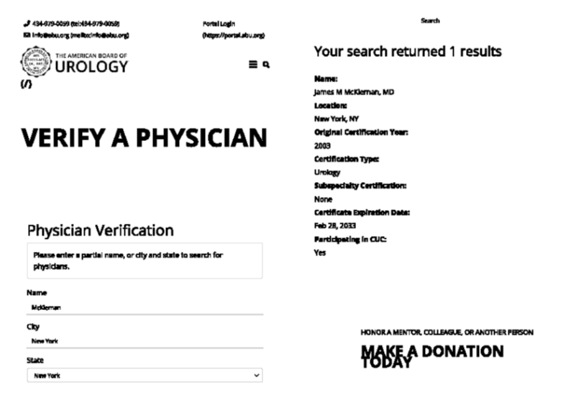
List of the certified Urologists will be annually published on the EBU web page:
  Name, surname
  City, country
  Date FEBU title
  Date subspecialty certification
  Subspecialty/ies certified
  Validity date

Slide 27
Life Long Learning (LLL) Concept
FEBU
Re-FEBU
SC

