Slide 1



Examination Committee Report
Stig Müller
Chair
Board Meeting May 8, 2026

Slide 2
Agenda
New members
Exams 2026
Core activities
Assignments 2026
Lifelong learning

Slide 3
New members
Marianne Leitsmann (Austria)
Haluk Erol (Türkiye)

Slide 4
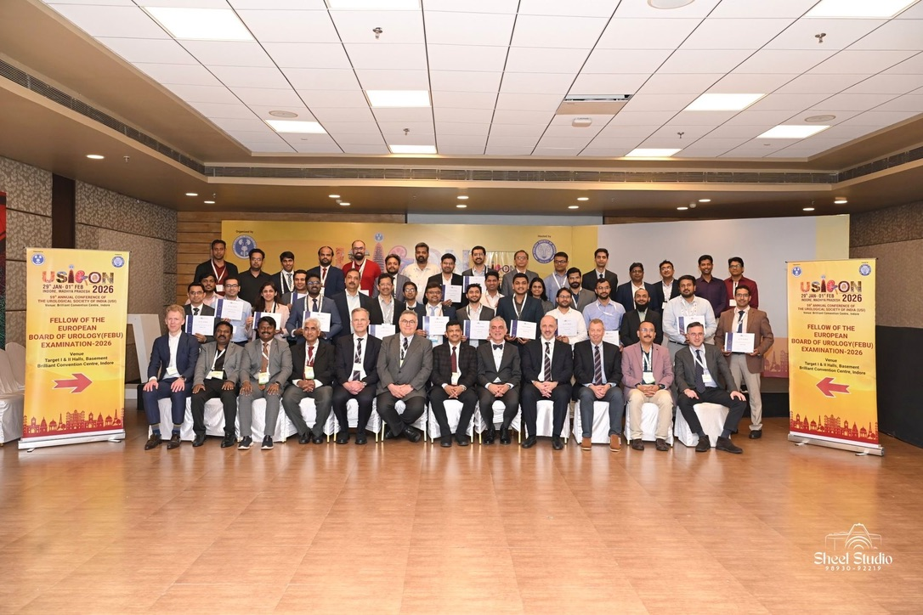
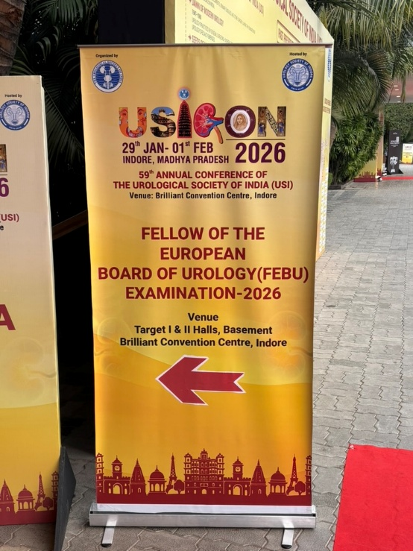
FEBU Int Oral Exam India
39 candidates; 100% pass rate

Slide 5
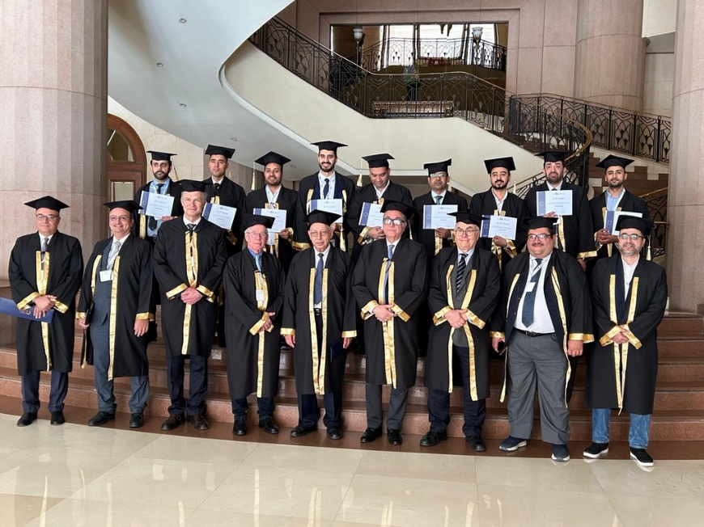
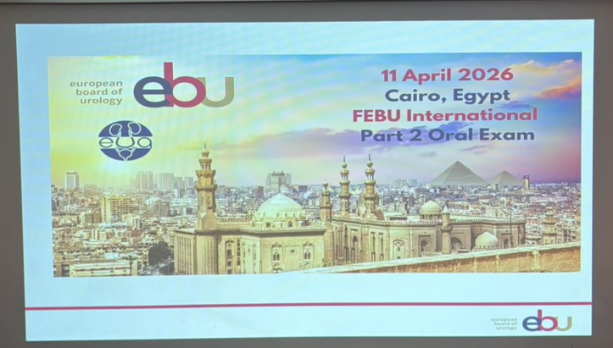
FEBU Int Oral Exam Cairo
11 candidates: 73% pass rate
Note: 15 candidates had to cancel due to travel restrictions

Slide 6
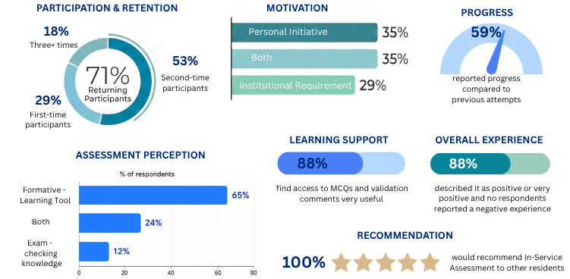
In-Service Assessment
775 candidates (36 countries)

Slide 7
Upcoming exams
FEBU Part 2 Oral Exam 20 June (Leuven)
    DeepL PRO: generates the translations
    ReadSpeaker: generates text to speech
FEBU Part 1 Written Exam 12 November
    DeepL PRO: generates the translations

Slide 8
Core activities
FORMATIVE | Type | Frequency | Content
In-Service Assessment | MCQ exam | 1 x year in March | 100 MCQs
SUMMATIVE
Written Exam | MCQ exam | 1 x year in November | 110 MCQs
Oral Exam | Pre-recorded case-based exam | 1 x year in June | 8 Case reports

Slide 9
Core activities
FEBU | Venue(s) | Date | Cooperation
European exam | Leuven | June
National exams | Warsaw Budapest Ankara or Istanbul Athens | June | National societies
FEBU International
India | Alternates yearly | January/February | USI
Egypt | Cairo | April | EUA

Slide 10
Members contribution
Member type | Assignment
Associate Members | Submit new MCQs
Committee Members
Written Taskforce | Submit new MCQs Screen/Approve MCQs Proof-read/Approve content
Oral Taskforce | Submit case reports Proof-read/Approve content Act as online or onsite reviewer
TF Lifelong Learning | ?

Slide 11
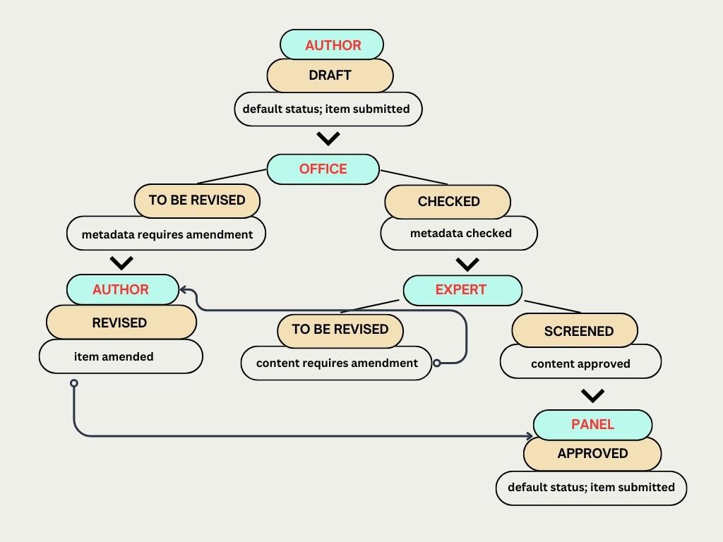
Item flow chart (new items)
Associate members
November meeting

Slide 12
Item checklist
Positive stem
Correct category
Validation comment
Reference / Source
Content:
  Knowledge recall (ISA)
  Interpretative skill (ISA / written exam)
  Problem solving (written exam)

Slide 13
Item flow chart (old items)
Old items:
retired authors
Examfolio ...
November meeting
DELETE ITEM

Slide 14
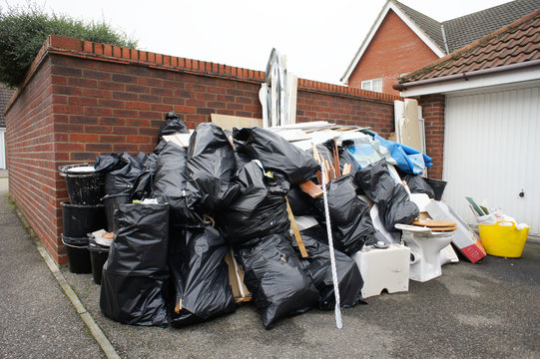
What do we need to do?
 | Category | Amount | Screener(s)
1 | Andrology/Infertility | 26
2 | Functional/BPH/Incontinence | 8
3 | Lithiasis/Infections | 15
4 | Miscellaneous | 14
5 | Oncology | 47
6 | Paediatrics/Congenital | 15
7 | Surgery | 12
8 | Transplantation/Nephrology | 1
9 | Trauma/Emergency | 28
 | Total | 166
New items:
Old items:

Slide 15
Assignments
To be determined
Wait for e-mail
AssessmentQ help: contact Wilma/Stig

Slide 16
Lifelong learning
Revalidation of FEBU
Based on CME/CPD points
EBU will offer a «revalidation exam»
Mix of general and sub-specialty questions

