Slide 1
Board Meeting 8 May 2026
Prof. Michael Rauchenwald
President

Slide 2


Our mission is to stimulate continuous improvement of standards in urological education, training and professional development in Europe

Slide 3
Agenda
1. Board Meeting 11 October 2025-Approval minutes
2. Executive Board Nominations
  Guy Bogaert: Nomination 2nd term Treasurer
  John Varkarakis: Nomination Chair Certification Committee
3. Reports by the Executive Board
  Accreditation Committee
  Certification Committee
  Examination Committee
  Treasurer
3. Next meetings: We will present a survey before the end of the meeting
4. Any other business
Notes:
Before moving to slide 4, please inform the board of the nominations under point 2

Slide 4
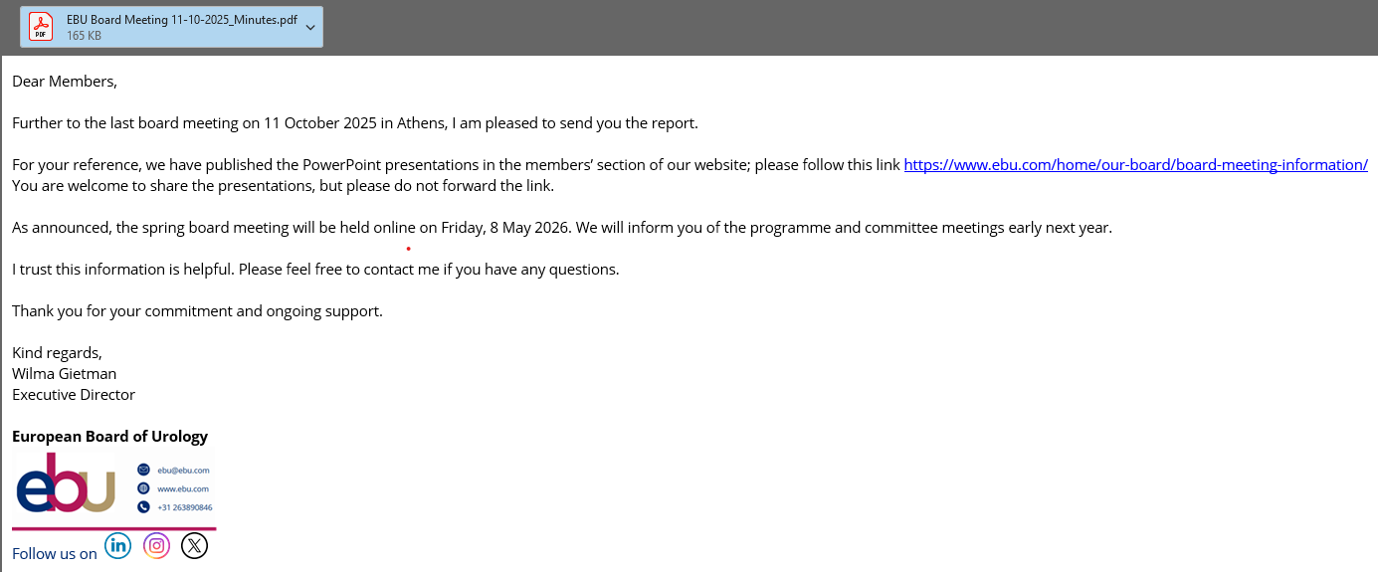
Board Meeting October 2025
Approval of the minutes
The meeting report, including the presentations, will be published on our website. You will receive an email with the link in May.
Notes:
Wilma to present the minutes on the screen. If there are no comments, these are approved as an accurate record.

Slide 5
Welcome new members
Armenia*: Armen Avoyan & Arman Tsaturyan
Austria: Marianne Leitsmann
Estonia: Mihhail Kovtun
Finland: Senja Jousmaki
Italy: Carlo Bettocchi
Portugal: Isaac Campos Braga
Romania: Costin Petcu
Slovakia: Lenka Barreto
Türkiye: Haluk Erol & Şaban Sarikaya
*Special welcome to the delegates from the Armenian Association of Urology, member since 2025

Slide 6
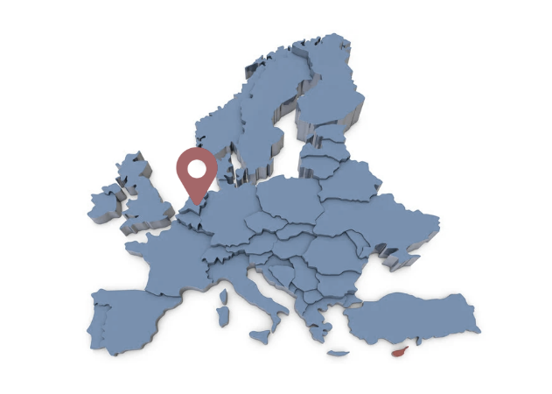
European Board of Urology
As a regulatory body the EBU plays a crucial role in standardising, evaluating, and promoting the quality of urological education and practice across Europe.
Based in Arnhem, Netherlands, the EBU works as an independent organisation, implementing the UEMS primary goals and vision in urology.
We closely collaborate with the European Association of Urology (EAU) and National Urological Societies, uniting urology specialists across Europe.
Notes:
For the new members, you give a short overview of our work

Slide 7
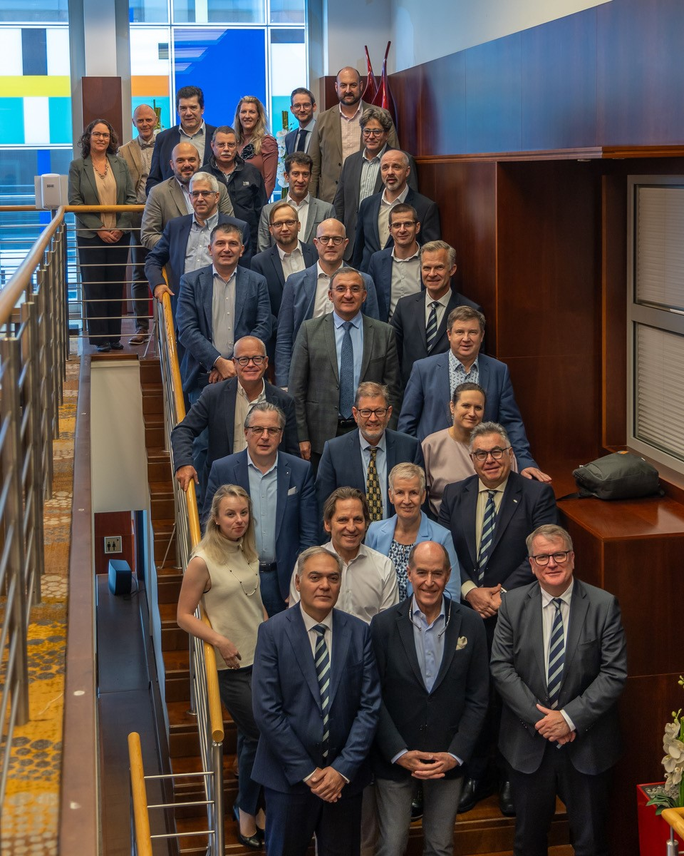
Who we are
Our mission is to stimulate
continuous improvement
of standards in urological
education, training and
professional development in
Europe.
Our board consists of 60
members from 31 EBU-member
countries whose efforts are
distributed across
three specialised Committees.

Slide 8
Core business
Accreditation
Committee
Evaluate of CME/CPD activities
Certification
Committee
Review Residency Training Programmes RTPU
Examination
Committee
Organise Formative & Summative exams
Define European Training Requirements
Award the title Fellow of the EBU, FEBU
Evaluate Post-graduate training programmes

Slide 9

Accreditation Committee
Active engagement in Continuous Medical Education (CME) is required to provide the highest possible level of patient care, advance one’s career, and maintain one’s medical license.
For a CME programme to be viable in meeting licensing and credentialing requirements, the programme must be accredited.

Slide 10

Certification Committee
Our certification programmes aim to ensure and improve the quality of graduate and post-graduate urological education in Europe.
Residents trained at an EBU-certified centre can benefit from a reduced fee in the In-Service Assessment and FEBU Written Exam
RTPU
EUSP
Joint EAU-EBU programme for training centres hosting European Urological Scholarship Programmes
Objective evaluation that provides recommendations for further improvement and development of urological training

Slide 11
Examination Committee
The committee’s core purpose is to set high standards, ensure consistency in urological knowledge, and promote excellence in patient care across Europe
“Training is not complete until an assessment has been conducted.”

Slide 12
National Delegates
You are the Communicators between the EBU and your National Society in both directions !
You support us by promoting:
  The In-Service-Assessment: Knowledge test
  FEBU Exams: as national license exam
Notes:
Let your societies know what we are doing and vice versa let us know the needs and compülaints of your society

Slide 13
Calendar 2026
FEBU Part 2 Oral Exam 20 June
FEBU Part 1 Written Exam 12 November
Board Meeting 9-10 October in Oslo

Slide 14

Board Meetings 2027
May: Onsite or Online?
October: Nantes, France

